Slide 1
ENGLISH FOR IT
Week 5 VOCABULARY
Output devices

Slide 2
Today you will:
Differentiate between input and output devices
Understand how computer displays work
Understand functionalities of touch screen
Name the types and describe technical functions of printers
Learn some more IT initialisms

Slide 3
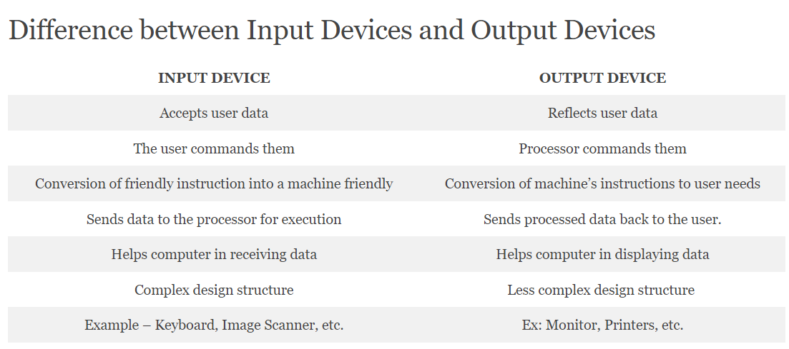

Slide 4
DISPLAYS

Slide 5
How screen displays work

Slide 6
Check your answers:
PIXEL
VIDEO ADAPTER
ASPECT RATIO
PLASMA SCREEN
RESOLUTION
COLOUR DEPTH

Slide 7
Read the text again and answer these questions:

Slide 8
Check your answers:
CRT = Cathode Ray Tube; LCD= Liquid Crystal Display
Diagonally (in inches)
TFT (thin film transistor)
Brightness or luminance is measured in cd/m2 (candela per square meter)
Phosphor
They consume less power, produce brighter colours and are flexible

Slide 9
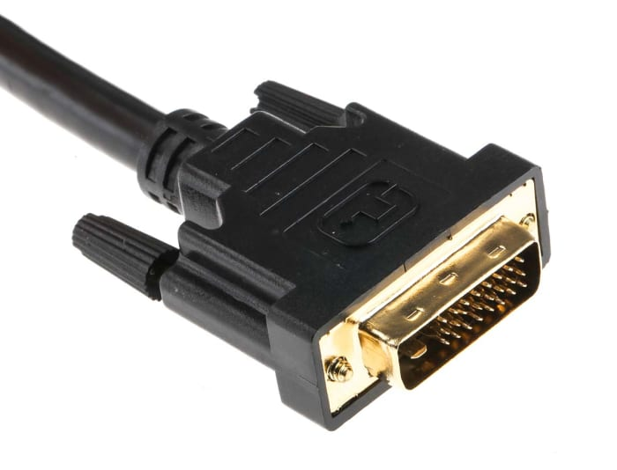
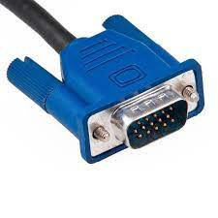
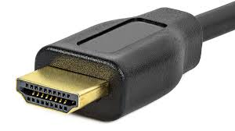
Cables
VGA | DVI | HDMI
Video graphics adapter | Digital video interface | High-Definition Multimedia Interface
Used in old CRT monitors; primarily to link a computer to a display device – OUTDATED TODAY | Used in LCD monitors; DVI only supports video signals (not audio) | Widely used today - HDMI supports features such as Ethernet connectivity, both video and audio

Slide 10
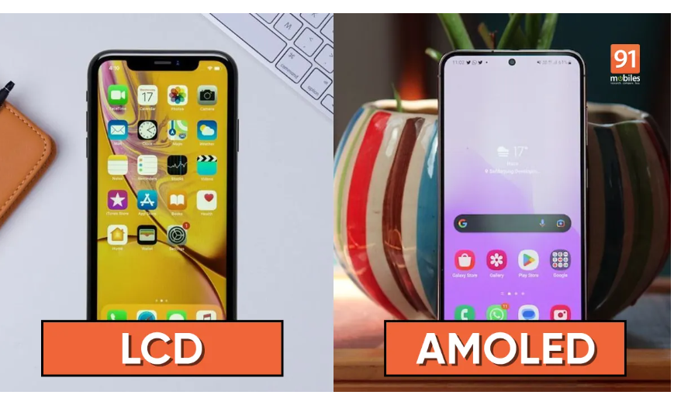
New displays
LCD and AMOLED are the two most common displays found on consumer electronics, including smartphones, tablets, wearables, TVs, and more.
LCD = liquid crystal display – uses TFT (thin film transistor) technology
AMOLED = active matrix organic light-emitting diode – uses OLED technology
Read the article to find out more: https://www.91mobiles.com/hub/lcd-vs-amoled/

Slide 11
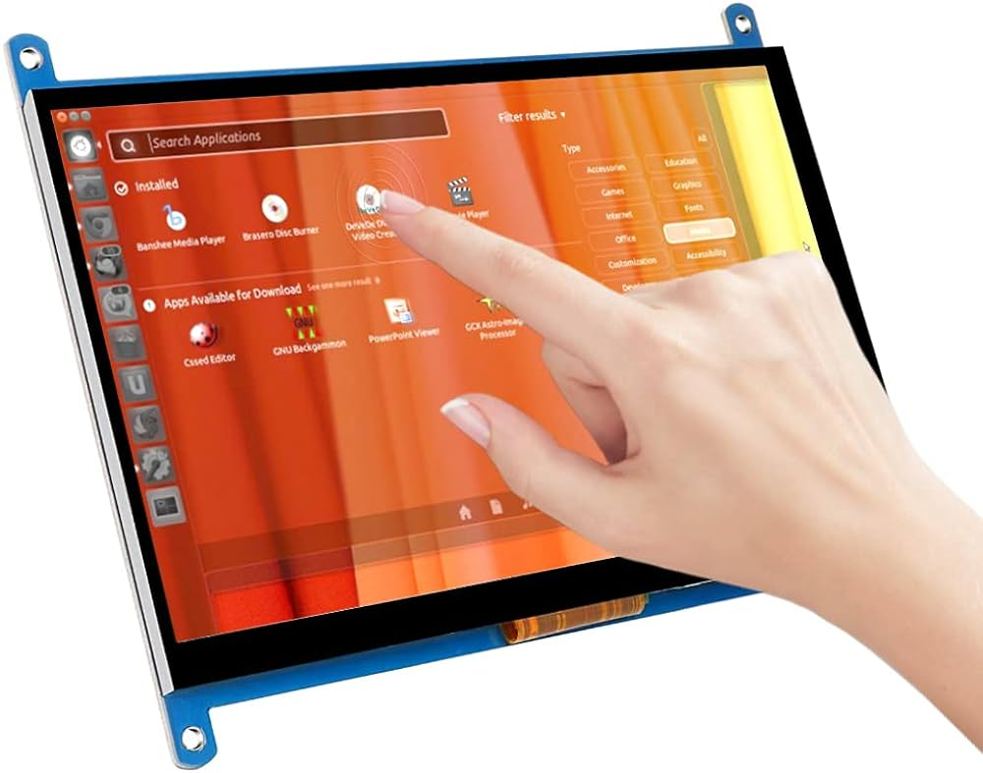
Touchscreen
Navigating Win10 with Touch Interface
Windows 10 was built with touch in mind.
Instead of using a mouse or keyboard to manipulate Windows 10, you use your fingers to touch the screen in specific ways.
These actions are called GESTURES:
tap and hold
tap
double-tap
spread
pinch
slide
turn
swipe
Open IE file named “Week 5 Touch screen gestures – exercise” and guess the names of gestures in pairs.
Both an Input & Output Device

Slide 12
PRINTERS

Slide 13
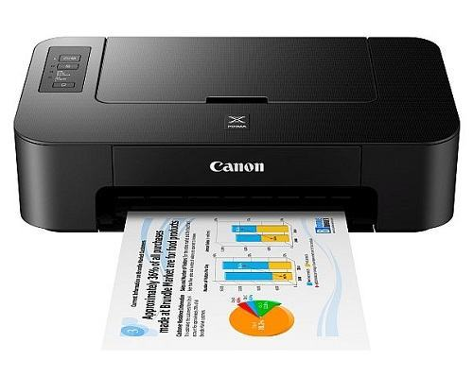
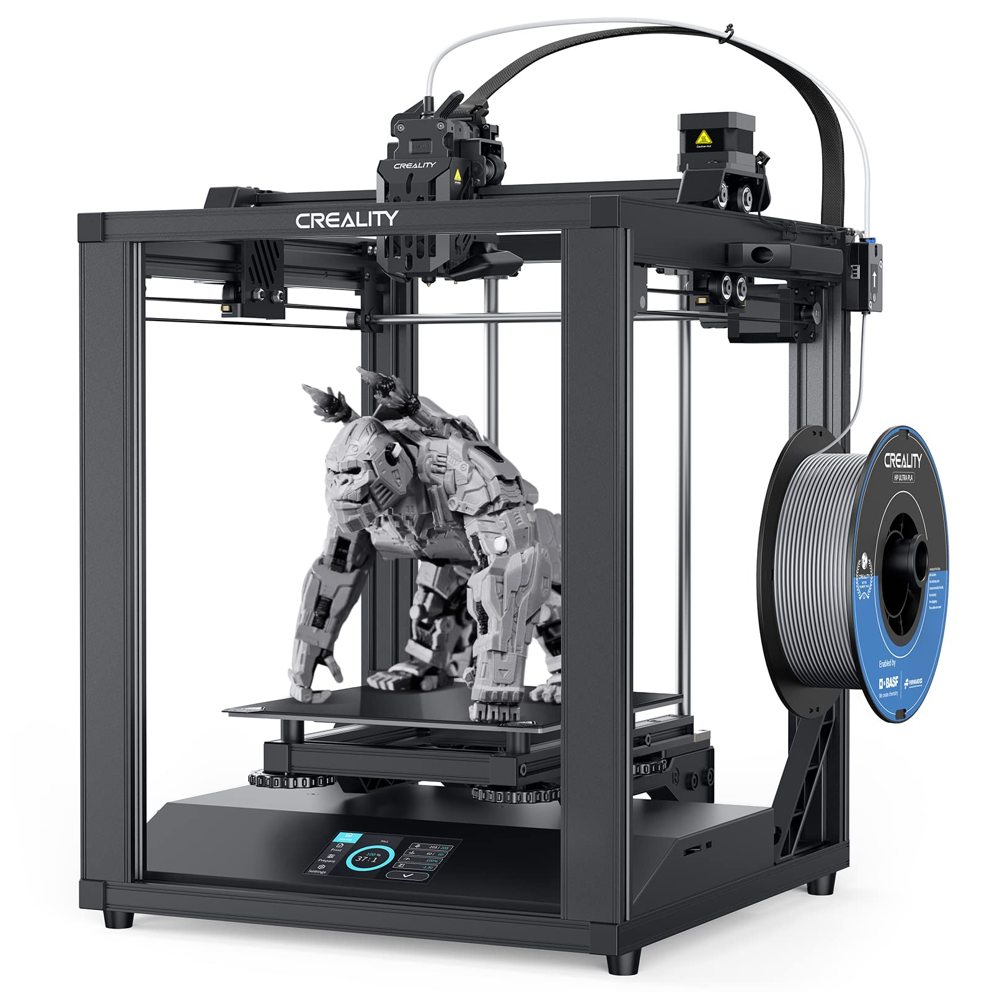
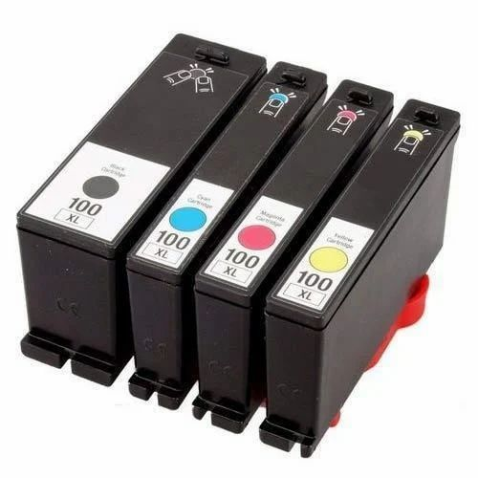
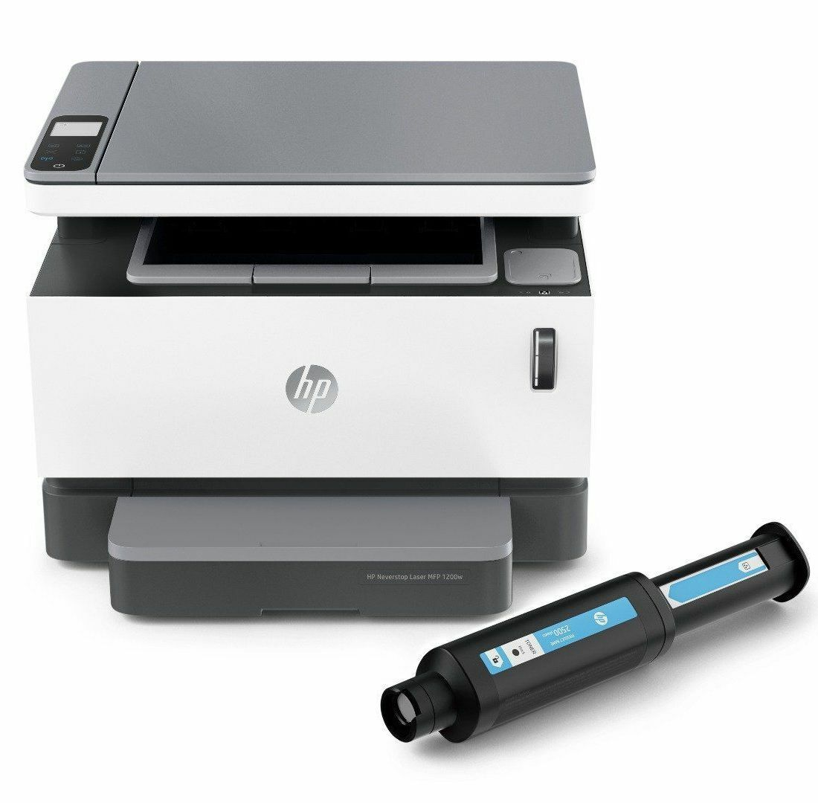
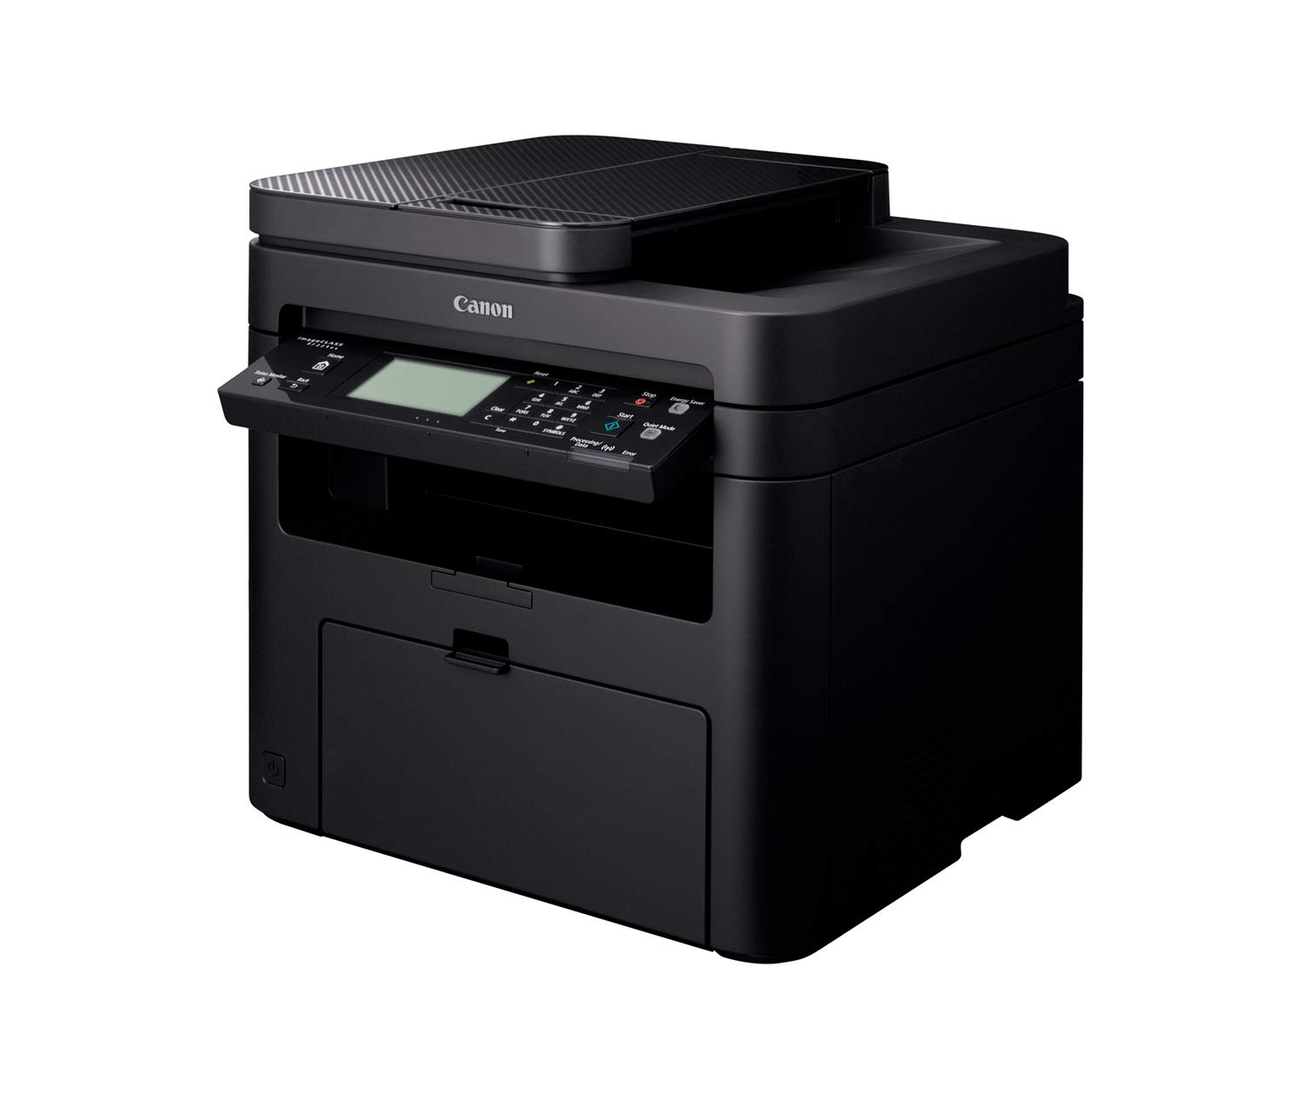
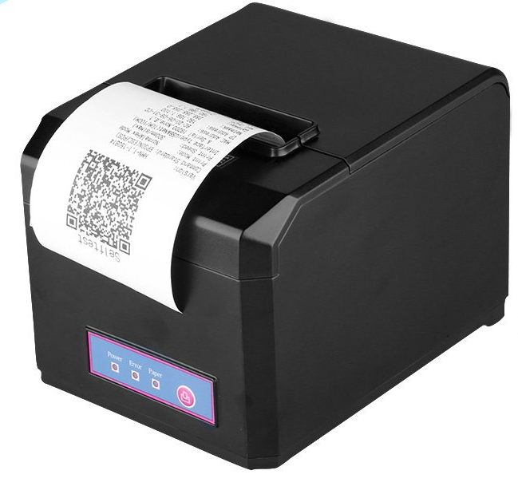
Can you name these types of printers?

Slide 14
Read the article on page 38 in your textbook to find out more.
INK-JET PRINTER
3D PRINTER
CARTRIDGE
LASER PRINTER
THERMAL PRINTER
MULTIFUNCTIONAL PRINTER
TONER

Slide 15
Common printer types
Inkjet printers recreate a digital image by spraying ink onto paper. These are the most common type of personal printer.
Laser printers are used to create high-quality prints by passing a laser beam at a high speed over a negatively charged drum to define an image. Color laser printers are more often found in professional settings.
3D printers are a relatively new printer technology. 3D printing creates a physical object from a digital file. It works by adding layer upon layer of material ((including plastics, metals, food, cement, wood) until the print job is complete and the object is whole.
Thermal printers produce an image on paper by passing paper with a thermochromic coating over a print head comprised of electrically heated elements and produces an image in the area where the heated coating turns black. Useful for printing codes, labels, receipts…
All-in-one printers are multifunction devices that combine printing with other technologies such as a copier, scanner and/or fax machine.

Slide 16

Listen to an extract about multi-function printers and answer:

Slide 17
Check your answers:

Slide 18
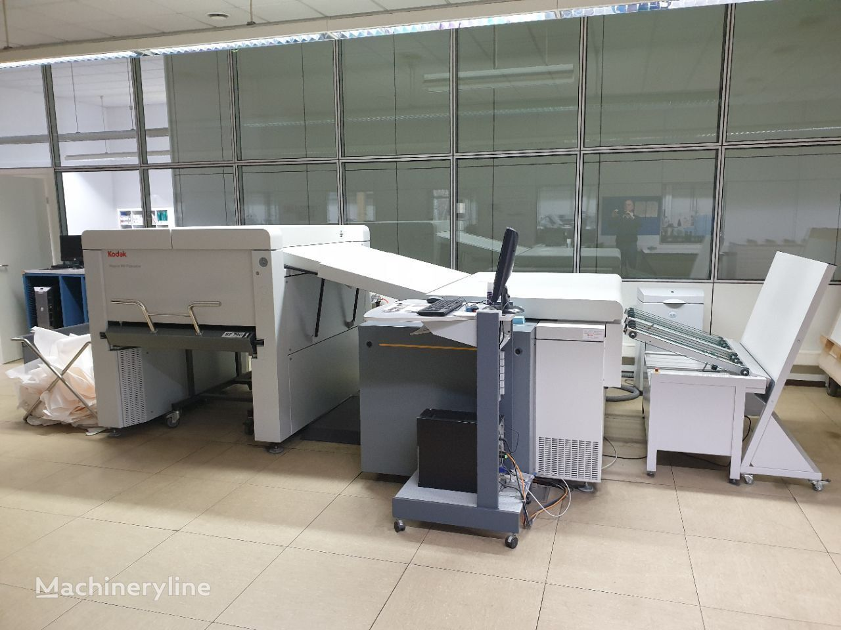
Imagesetters
An ultra-high-resolution large-format computer output device, able to produce quality surpassing that of a typical home or office printer. The resolution of a home printer is generally up to 300 dots per inch (dpi), with an office printer having 600 dpi, whereas the dpi of an imagesetter is 1270, 2540 or up to 4000 dpi
Used in graphic design industry and DTP (desktop publishing)

Slide 19
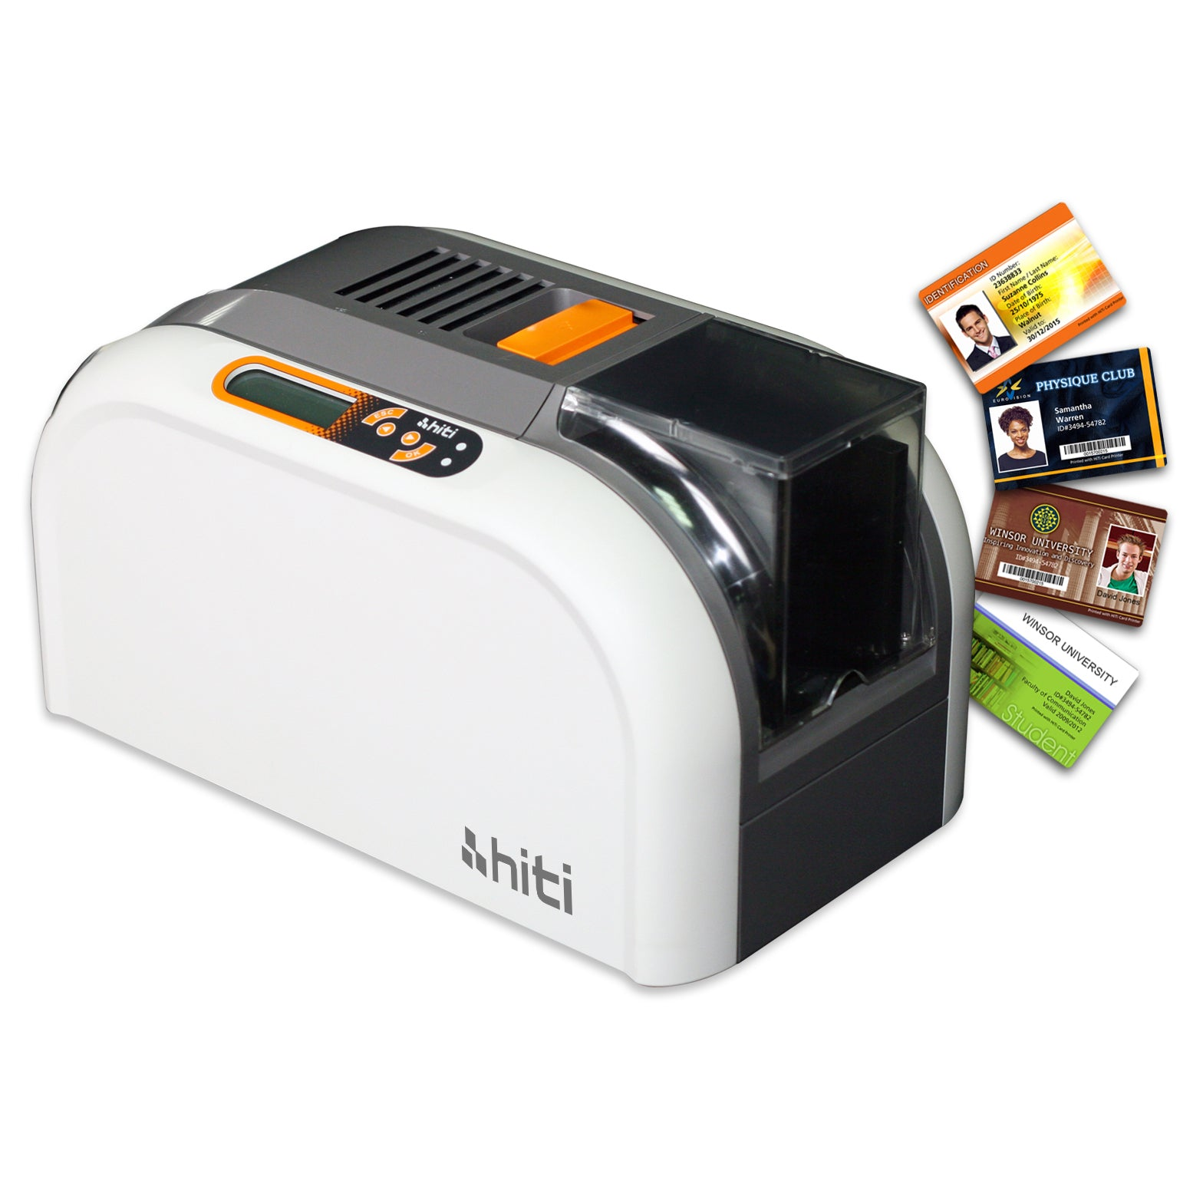
Card printers
electronic desktop printers with single card feeders which print and personalize plastic cards. This format is used in ID-cards, credit cards, driver's licenses, health insurance cards etc.
designed with laminating, striping, and punching functions, and use desktop or web-based software

Slide 20
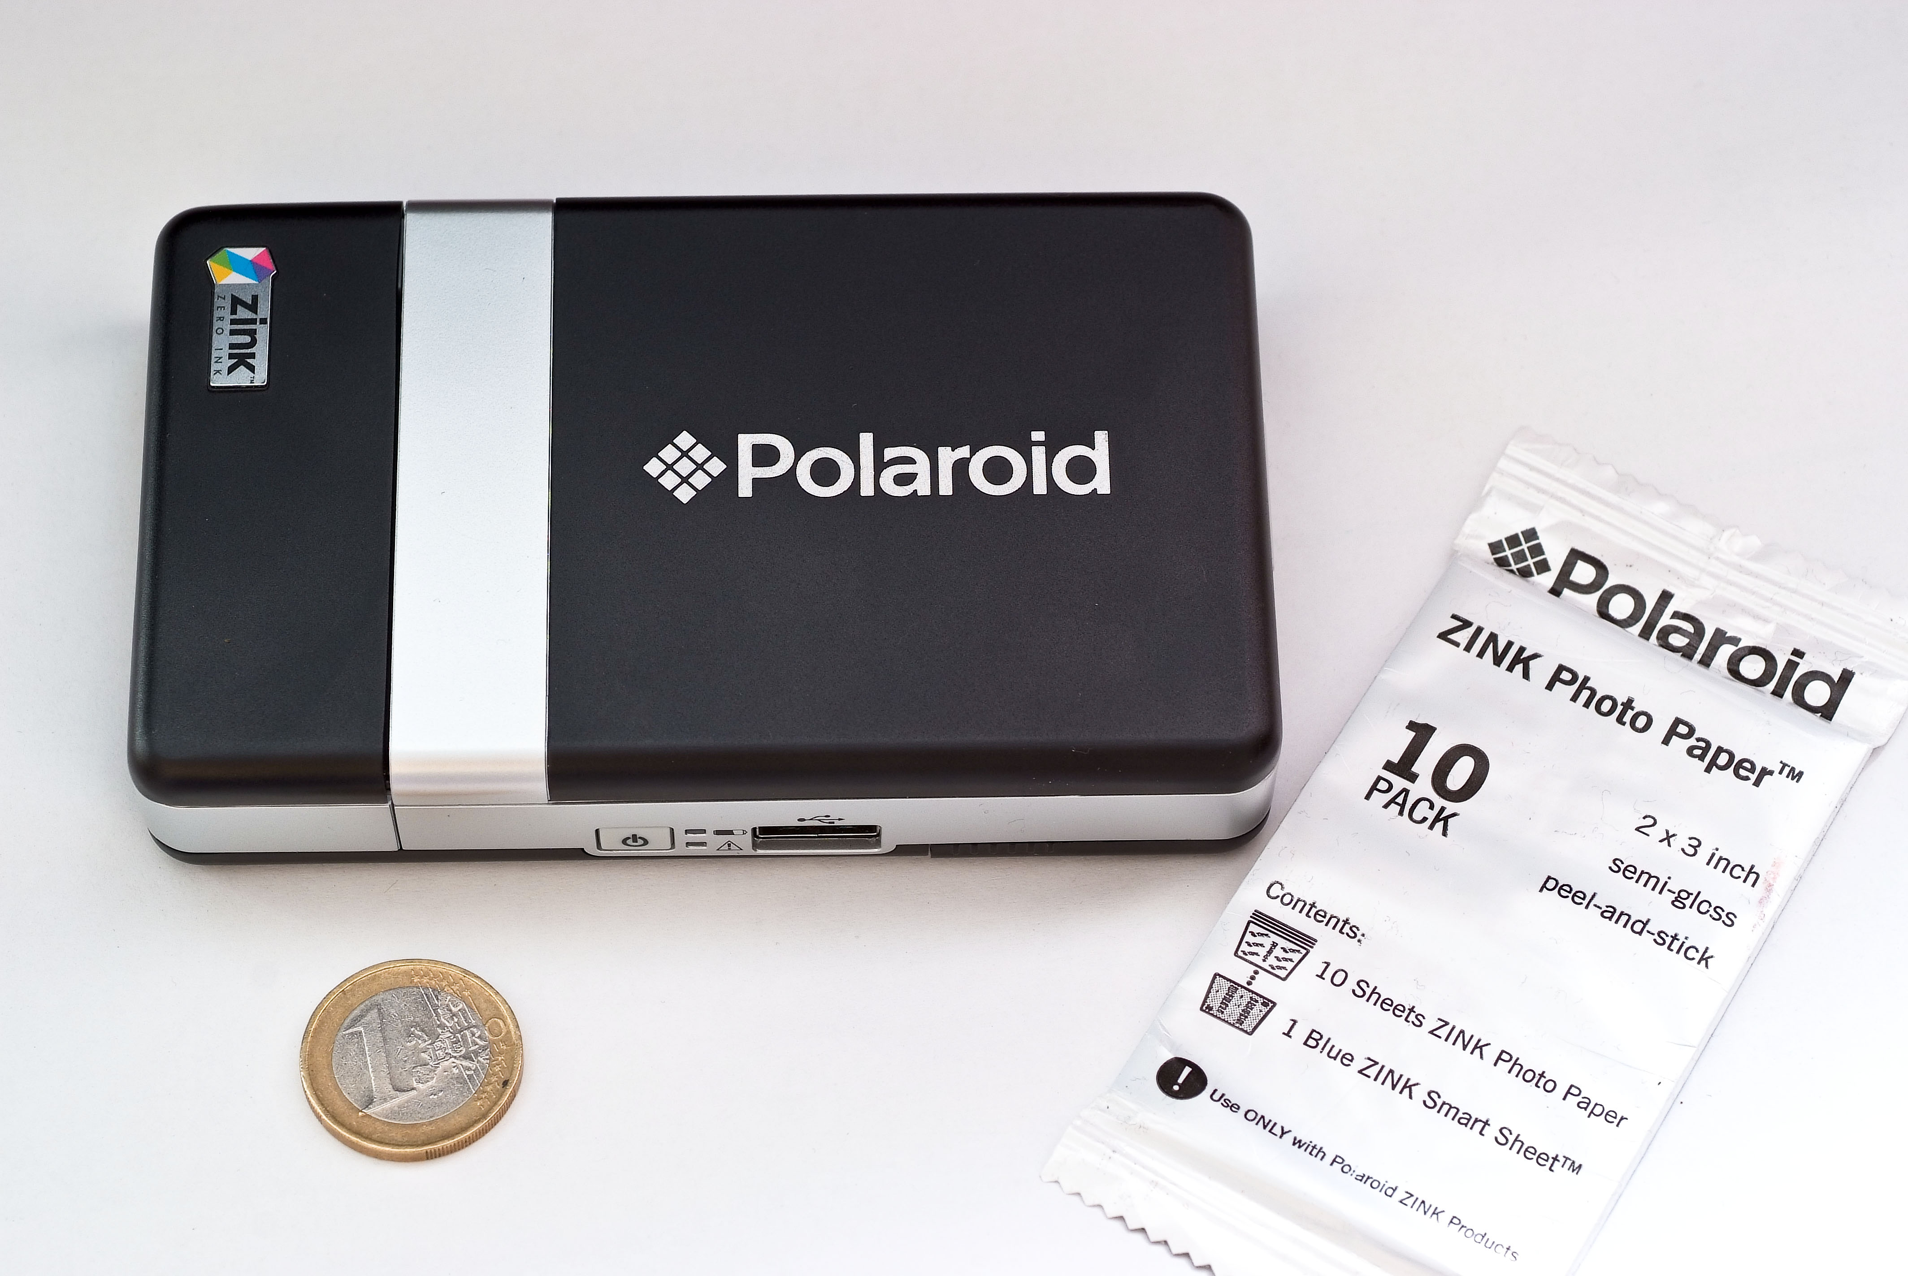
ZINK
a portmanteau of zero and ink
a full-color printing technology for digital devices that does not require ink cartridges and prints in a single pass
The printing technology and its thermal paper are developed by Zink Holdings LLC, which started as a project inside Polaroid Corporation
The paper has several layers: a backing layer with optional pressure sensitive adhesive, heat-sensitive layers with cyan, magenta and yellow dyes in colorless form, and an overcoat.

Slide 21
Older printer types
So called first-generation printer types (obsolete, outdated)
Dot matrix printers: use pins to print dots required to shape a character. Dot matrix printers offer very basic print quality. Today’s modern retailers that work with Point of Sale (POS) systems have two options when it comes to receipt printers- thermal receipt printers and dot matrix printers.
A plotter is a machine that produces vector graphics drawings. Plotters draw lines on paper using a pen, or in some applications, use a knife to cut a material like vinyl or leather. Used in CAD, but since the mid 1980s superseded by laser printers and digital technologies such as Solvent, Aqueous, and UV.

Slide 22
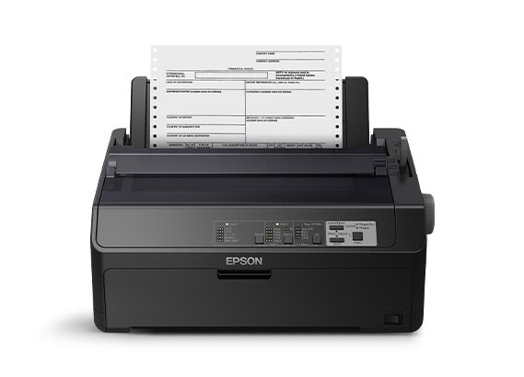
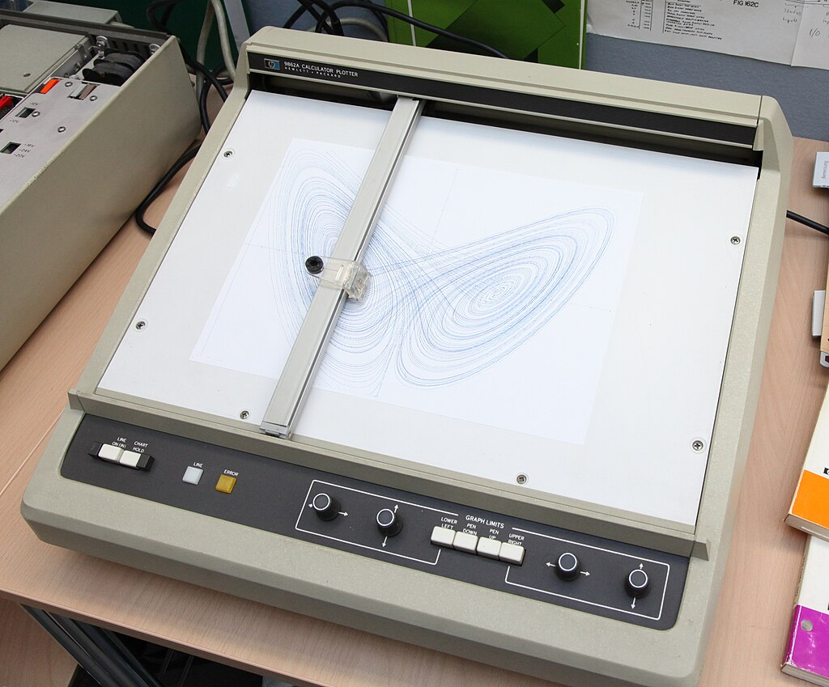
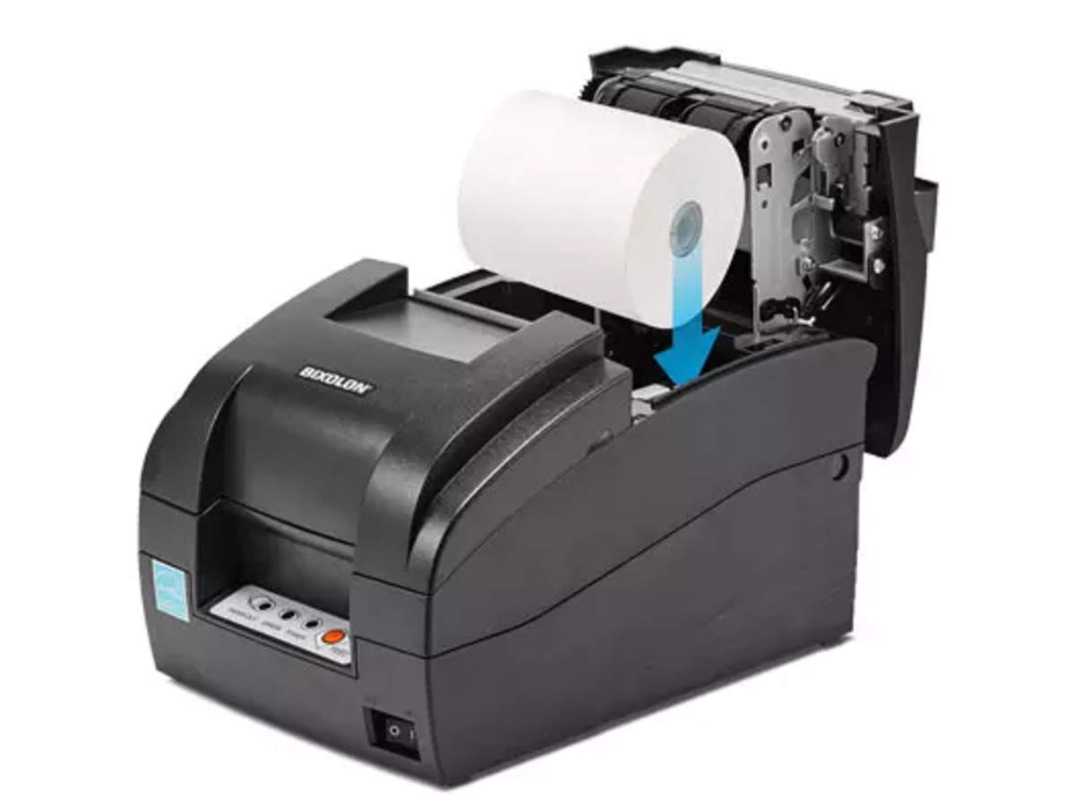
Epson dot matrix printer
Hewlett-Packard 9862A calculator plotter
POS receipt dot matrix printer

Slide 23
INITIALISMS

Slide 24
New initialisms
Can you remember what these initialisms stand for?
DTP
POS
ZINK
CRT
VGA
DVI
HDMI
cd/m2
TFT
LCD
OLED
AMOLED

Slide 25
Check your answers
DTP - desktop publishing
POS - Point of Sale
ZINK – zero ink
CRT - Cathode Ray Tube
VGA – video graphics adapter
DVI – digital video interface
HDMI - High-Definition Multimedia Interface
cd/m2 - candela per square meter
TFT - thin film transistor
LCD - liquid crystal display
OLED - organic light-emitting diode
AMOLED – active-matrix organic light-emitting diode

Slide 26

Further practice on PRINTING VOCABULARY
Marks, Vocabulary Book – 1.8 (pp 14 -15) https://www.scribd.com/document/266312924/Check-Your-English-Vocabulary-for-Computers-and-Information-Technology

Slide 27
Resources:
Remacha, Infotech – Units 7 and 8 (pp 32-40) https://www.academia.edu/28436822/Infotech_english_for_computer_users_Students_Book_4th_Edition
Marks, Vocabulary Book – 1.8 (pp 14 -15) https://www.scribd.com/document/266312924/Check-Your-English-Vocabulary-for-Computers-and-Information-Technology
https://data-flair.training/blogs/input-output-devices-of-computer/
https://www.techtarget.com/whatis/definition/printer
https://www.techopedia.com/definition/1268/imagesetter
https://www.91mobiles.com/hub/lcd-vs-amoled/

Slide 28
#neverstoplearning

