Slide 1
Companies

Slide 3
What is business?
He went into business with his brother.
It’s been a pleasure doing business with you.
He is in the music business.
Business is the activity of producing, buying and selling goods and services.

Slide 4
Key
Business is the activity of producing, buying and selling goods and services.

Slide 5
What is a company?
A company is a legally registered business.

Slide 6
Can you name any companies?

Slide 7
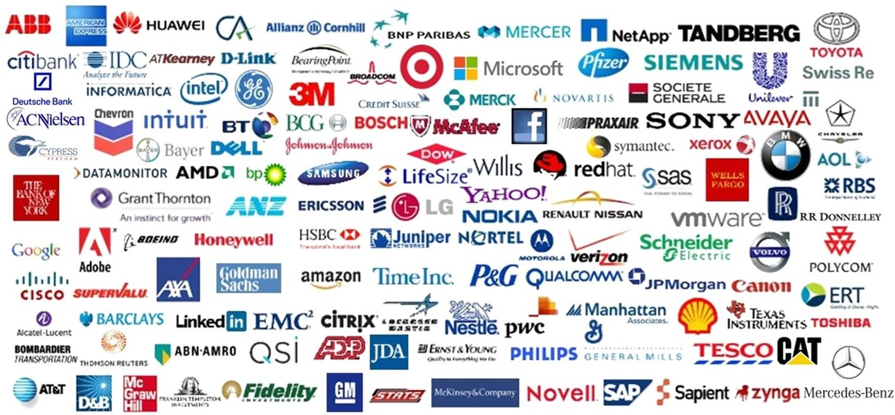
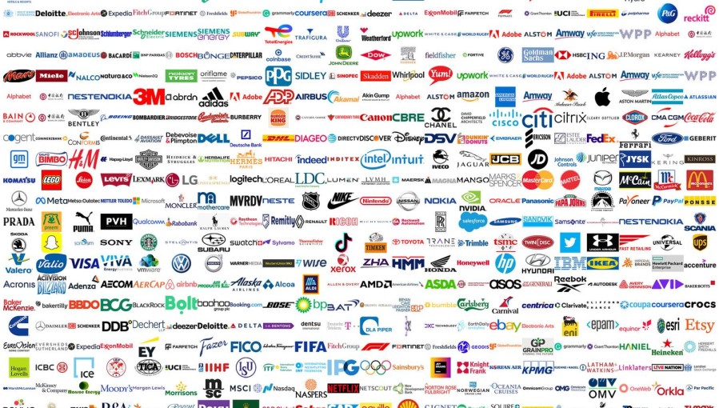

Slide 8
What types of companies can you name?

Slide 9
Do you recognise any of these?

Slide 10
Let’s not forget about these businesses:

Slide 11
Companies are classified based on various features, such as:
ownership
liability
members
control
…
Legal regulations differ from country to country, jurisdiction to jurisdiction.

Slide 12
Sole trader (a.k.a. sole proprietorship, individual entrepreneurship)
When someone has their own business with no additional shareholders.
(Croatian equivalent: obrt!)
hairdressers, mechanics, tailors, but also freelancers such
as graphic designers, digital marketing experts, etc.

Slide 13
Partnership
Where two or more people or businesses work together. Three main categories of partnership are: - general partnership - limited partnership, and - limited liability partnership Professionals like doctors, lawyers, accountants and architects often form a limited liability partnership.

Slide 14
Limited company, Ltd.
A private company where individual shareholders lose only the value of their shares if the company becomes insolvent.
(Croatian equivalent: d.o.o.)

Slide 15
Public limited company (Plc)
A limited company where the shares are bought and sold freely.
(Croatian equivalent: d.d.)
Inc. → the US equivalent of plc.

Slide 16
Corporation
A large company, especially in the US.
corporate | culture | the way a company’s employees think and act
 | ladder | the different levels of management in a company
 | headquarters | a company’s main office
 | logo | a symbol used by a company on its products, advertising, etc.
 | image | all the ideas, opinions, etc. that people have about a company
 | profits | the money made by companies

Slide 17
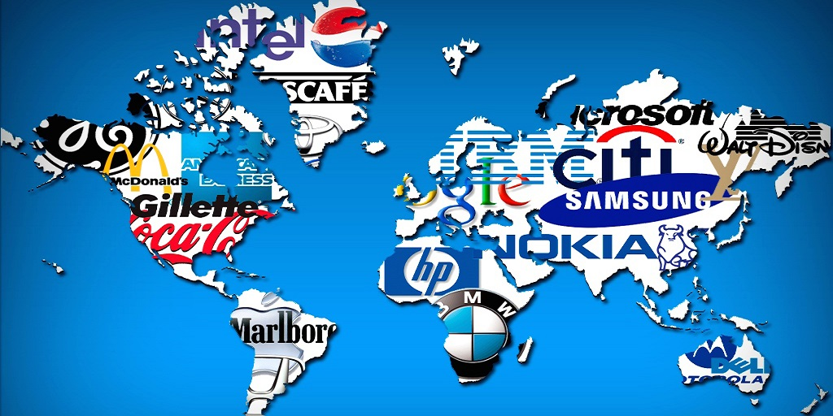
A multinational corporation (MNC)
A company that operates in different countries, usually with a complex structure, e.g. a parent company owns subsidiaries.

Slide 18
Merger, Acquisition, Takeover
MERGER – two or more companies join together to create a
single larger company
(e.g. H.J. Heinz Co. and Kraft Foods Group created
a new organization - The Kraft Heinz Company)
ACQUISITION / TAKEOVER – similar to a merger with one company taking control by buying more than half the shares; may or may not involve the consent of the target company
(e.g. FRIENDLY TAKEOVER/ACQUISITION: Meta acquiring WhatsApp, Google acquiring Android;
HOSTILE TAKEOVER: Kraft Foods taking over Cadbury PLC)

Slide 19
Joint venture
JOINT VENTURE – two or more companies make a joint
investment in a project without actually
merging (e.g. Bugatti Rimac)

Slide 20
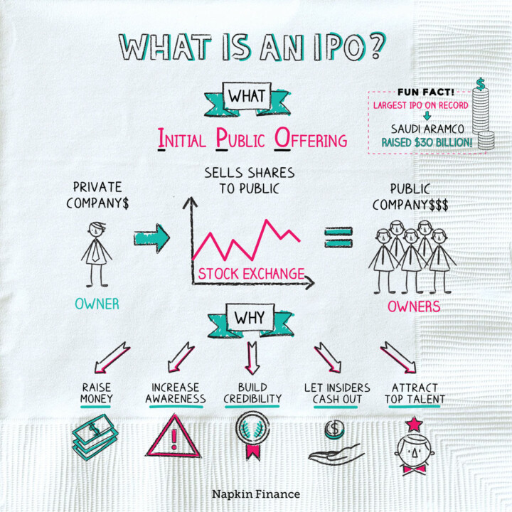
Initial Public Offering (IPO)
The process of offering shares of a private company to the public in a new stock issuance.

Slide 21
Sources
https://corporatefinanceinstitute.com
https://www.ukliquidators.org.uk
https://consumeradvisory.co.uk

Slide 22
#neverstoplearning

