Slide 1
Past Simple and Past Continuous

Slide 2
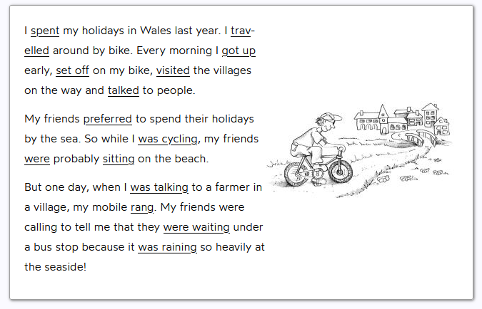
The simple past and the past progressive (continuous) are used to express actions in the past, however each has a different function.
The simple past expresses completed, sequential actions in the past and is therefore the main narrative form.
The past continuous expresses actions that were in progress at a specific point in the past; this tense establishes background and sets the scene.

Slide 3
THE PAST SIMPLE
We use the past simple for something in the past which is
FINISHED!
I bought a new car last week.

Slide 4
THE PAST SIMPLE - FORM
Regular verbs + d, ed → divide - divided, open – opened, cry – cried, play - played
Irregular verbs → 2nd column → learn them by heart!
(There’s a list on Infoeduka☺)
Questions → DID + infinitive
Did you see Peter last night? – Yes, I did./No, I didn’t.
Where were you yesterday?
Negatives → DID + NOT + infinitive
I did not/didn’t see Peter at your party last night.

Slide 5
THE PAST CONTINUOUS
The past continuous means that at a time in the past we were in the middle of an action:
at a specific time
→Yesterday at 4 pm I was travelling home from work.
two actions happening at the same time
→ While I was studying, my partner was making dinner.
longer action is interrupted by a shorter one
→ The boss walked into my office while I was having an online meeting.

Slide 6
THE PAST CONTINUOUS - FORM
past tense of BE (was/were)+ verb+ing
→ We were watching TV last night when you called.
Questions → Were you watching TV last night when I called?
Yes, we were. / No, we weren’t.
Negatives → We were not/ weren’t watching TV last night when you called. We were studying.

Slide 7
Past Simple vs Past Continuous
PAST SIMPLE
PAST CONTINUOUS
to talk about states or completed actions at a specific time in the past
Bill Gates founded Microsoft in 1975.
to talk about a longer action in
progress at a specific time in
the past
At 8 o’clock this morning, I
was waiting for the bus to
work.

Slide 8
Past Simple vs Past Continuous
PAST SIMPLE
PAST CONTINUOUS
to talk about repeated or
habitual actions in the past
Whenever I went to London
on business, I stayed at the
Hilton.
to talk about a temporary
action or situation in progress
in the past.
I was working overtime a lot before the end-of-year audit.

Slide 9
Past Simple vs Past Continuous
PAST SIMPLE
PAST CONTINUOUS
to talk about past events that follow one after another
She stood up angrily, grabbed her bag and left the
meeting.
to talk about a background event or longer action that is interrupted by a shorter event or action in the past simple.
*We often use when, while or as.
While the speaker was presenting his report, I noticed several mistakes on his slides.

Slide 10
Verbs that are not used in the continuous form
stative verbs
be*, cost, fit, mean, remain, suit
Example:
  The weather was awful.
verbs that indicate possession/belonging
belong, have*
Example:
  I didn’t have a lot of luggage.
verbs of sensory perception
feel*, hear, see*, smell*, taste*, touch
Example:
  I saw many villages.

Slide 11
Verbs that are not used in the continuous form
verbs that express feelings
hate, hope, like, love, prefer, regret, want, wish
Example:
  My friends preferred to spend their holidays by the sea.
verbs of thought and recognition
believe, know, realise, recognise, seem, think*, understand
Example:
  I thought they would be sitting at the beach all day.
clauses accompanying direct speech
answer, ask, reply, say
Example:
  “We are spending all day inside,” my friends said.

Slide 12
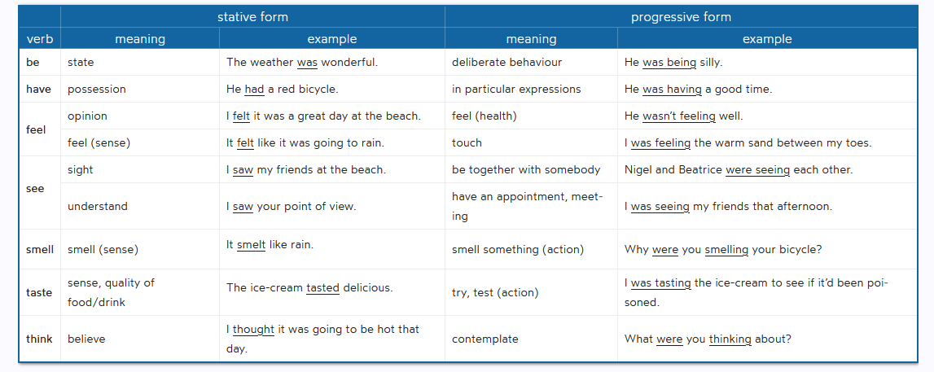
Stative verbs that have a continuous form, but the meaning is different:

Slide 13
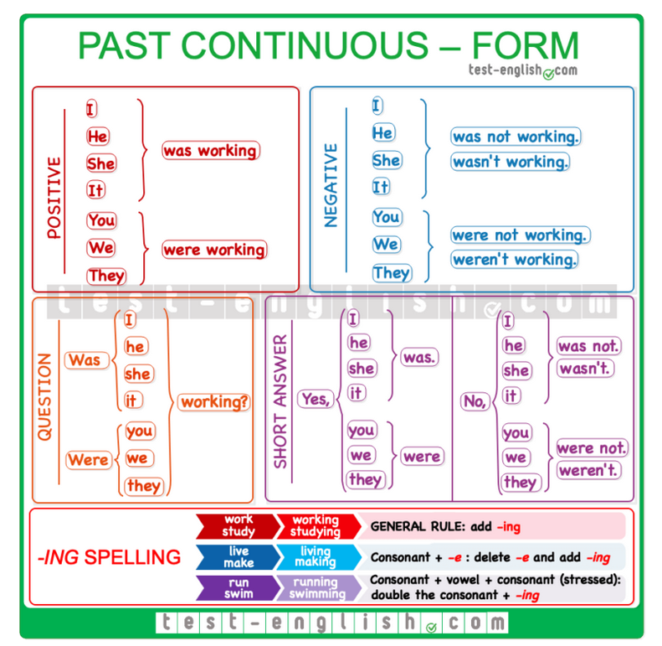
Summary chart

Slide 14
Let’s revise!
https://test-english.com/grammar-points/a2/past-continuous-past-simple/
https://elt.oup.com/student/grammarfriends/level04/tests/test9?cc=hr&selLanguage=hr
https://www.perfect-english-grammar.com/past-simple-past-continuous-exercise-1.html

Slide 15
#neverstoplearning

