Slide 1
General presentation
LO3

Slide 2
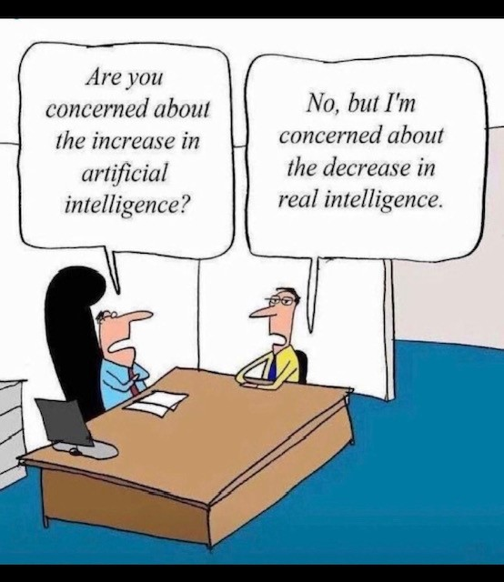
ChatGPT?

Slide 3
General guidelines
Learning outcome 3: 6 points!
Your presentation has to be no less than 8 and no more than 10 minutes long.
That said, you need to speak for at least 8 minutes. Speaking for e.g. 6 minutes and then showing a 2 minute video – does not count!

Slide 4
General guidelines
Make sure that the topic you are covering is not inappropriate – if you are not sure – contact me 😊
Do your research – put some time and effort into your presentation.

Slide 5
General guidelines: can I use notes?
Yes, but:
Have cards/small pieces of paper instead of an A4 paper
Do not just write down the whole presentation and read it out loud.

Slide 6
General guidelines contd.
Remember: this presentation is a learning outcome.
To pass the class, you have to hold it in class, in front of your classmates, by the end of the semester. There is no way around it.

Slide 7

Stage fright?
If you think you might have a difficult time speaking in front of your group, let me know. Sharing your concerns with your teacher – could make a difference.
Also remember that both your teacher and your classmates are on your side – no need to be scared or worried ☺.

Slide 8
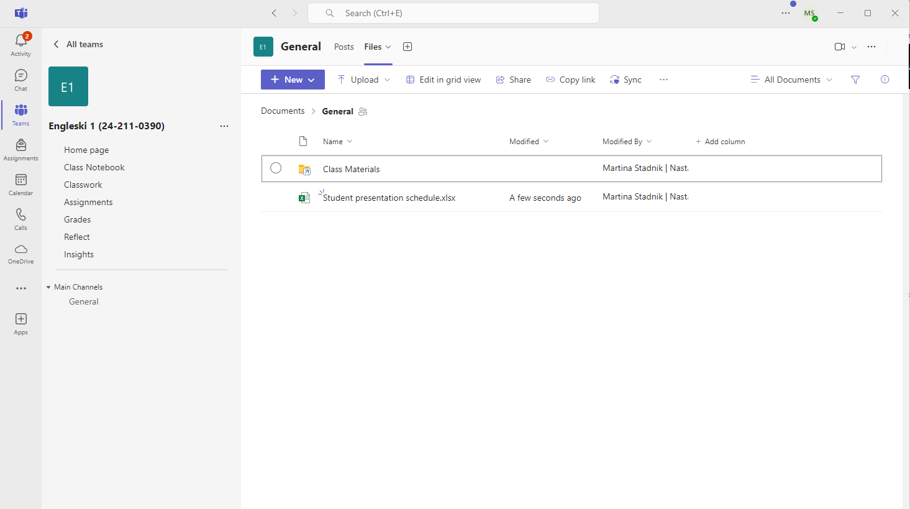
Student presentation schedule
Students hold presentations according to the Student presentation schedule on our MS Teams channel Engleski 1
Depending on the group size, 1 or 2 students hold a presentation each class
Path: Engleski 1 > Files > Student presentation schedule.xlsx

Slide 9
Missing your time slot
If you know you will miss your presentation time slot – switch with a colleague and e-mail me ASAP.
That way I can offer your time slot to someone else, or I can prepare another activity for the group.
Simply not showing up is not very nice – I’m sure you would agree. Of course, last-minute situations do happen and I am fully aware of that.

Slide 10
Missing your time slot contd.
You may reschedule your presentation once in advance with no effect on your points. Rescheduling a second time will result in MINUS 1 point.
You cannot keep postponing your presentation!
If you simply do not show up or send me an e-mail after the fact, you can still hold your presentation at a later date. BUT this will result in MINUS 1 point.

Slide 11
Preparation
Practice, practice, practice (in front of a mirror or videotape yourself).
Think of what questions listeners might ask and prepare sample responses.
Ensure the presentation is the correct length.
Review visuals to ensure they are accurate.

Slide 12
Structure
Have a strong introduction that grabs your listeners’ attention. What’s in it for them and why should they listen?
In the introduction, state what the presentation will cover.
Have an introduction, middle, and conclusion.
Stay on topic and talk about one thing at a time.
In the conclusion, summarize the main points of the presentation.
Invite questions at the end.
-> Q&A at the end is mandatory part of the presentation!

Slide 13
3 main slides to have
INTRODUCTORY SLIDE which states your name and the topic of your presentation
A SLIDE WITH SOURCES you have used
A FINAL SLIDE that says “Thank you for your attention”, “The end” or a similar closing statement
* Note: you can combine the sources and the final slide into one slide

Slide 14
Visuals
Limit the number of slides.
Limit the amount of text on each slide.
Don’t read your slides.
Use a large font size.

Slide 15
Visuals contd.
Feel free to include videos of up to 2 minutes – if they contribute to the overall presentation (but remember, they do not count towards the speaking minimum of 8 minutes).
You may want to show some websites – but have it ready right away or leave it for the end
You may want to use the whiteboard to explain a point
BASICALLY, you need to decide which visual aids are appropriate for your presentation

Slide 16
How to get the audience’s attention?
Choose one of the following:
Humor
A story
A quote
A rhetorical question
A startling statement
A personal experience

Slide 17
Language
Vary your tone of voice and sound interested in your topic.
Speak loud enough for everyone to hear you.
Don’t speak too quickly (which we tend to do when we're nervous).
Use the correct level of formality for the occasion.
Use simple words and grammatical structures if more complex words and structures are likely to give you trouble.

Slide 18
Body language
• Don’t turn your back to your audience.
Don’t do anything that makes you look nervous (hand wringing, slouching, looking at the floor).
Make eye contact with individual people in different areas of the room (look at the tops of people's heads if you are nervous).

Slide 19
Body language
• Try to move.
Stand up straight.
Smile.
Taken from → http://www.businessenglishresources.com/31-2/student-section/student-handouts/signposts-test/

Slide 20
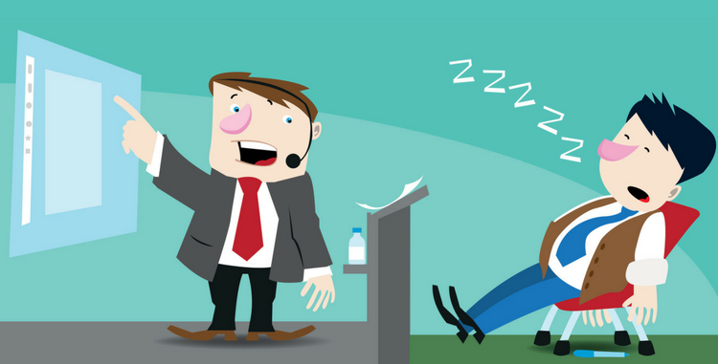
Bad vs. Good Presentation
Watch this video and assess the presentations:
https://www.youtube.com/watch?v=V8eLdbKXGzk

Slide 21
For those who want more:
tips and tricks
Watch videos on Expert Academy YouTube channel
PUBLIC SPEAKING SKILLS:
There you will find many useful tips and tricks for preparing and delivering your presentation, such as:
How to start and end a presentation;
Presentation body language;
Overcoming public speech stress and anxiety;
Storytelling tips for presentations...

Slide 22
Assessment criteria
Mark | Descriptor | Marking criteria
92.01-100% | Excellent (5,521-6.00pts) | The presentation is excellent with the student consistently demonstrating an excellent knowledge and understanding of the topic with the use of highly relevant and appropriate information-materials that have been critically analysed and evaluated. Ideas are presented in a clear, concise, coherent and structured way with excellent depth and detail and highly appropriate conclusions. The presentation is within the specified length with excellent use of language that is easy to understand. Use of supporting materials i.e. visual aids etc. is excellent and supports the main ideas of the presentation. Verbal communication is of an excellent level with volume, pace, diction and gestures highly considered. The student is highly consistent in their preparation, organisation and their engagement with the audience including; eye contact, and excellent listening skills and addressing audience questions with confidence and accuracy.

Slide 23
Assessment criteria
Mark | Descriptor | Marking criteria
75.01-92% | Very Good (4,501 – 5,5pts) | The presentation is very good with the student consistently demonstrating a very good knowledge and understanding of the topic with the use of relevant and appropriate information-materials that have been critically analysed and evaluated. Ideas are presented in a clear, concise, coherent and structured way with very good depth and detail and highly appropriate conclusions. The presentation is within the specified length with very good use of language that is easy to understand. Use of supporting materials i.e. visual aids etc. is very good and supports the main ideas of the presentation. Verbal communication is of a very good level with volume, pace, diction and gestures considered. The student is consistent in their preparation, organisation and their engagement with the audience including; eye contact, and very good listening skills and addressing audience questions with confidence and accuracy.

Slide 24
Assessment criteria
Mark | Descriptor | Marking criteria
58.01-75% | Good (3.481-4,5pts) | The presentation is good with the student demonstrating good knowledge and understanding of the topic with the use of relevant and appropriate information-materials that have been mostly critically analysed and evaluated. Ideas are presented in a clear, concise, coherent and structured way with good depth and detail and appropriate conclusions. The presentation is within the specified length with good use of language that is easy to understand. Use of supporting materials i.e. visual aids etc. is good and supports the main ideas of the presentation. Verbal communication is of a good level with volume, pace, diction and gestures considered. The student is consistent in their preparation, organisation and their engagement with the audience including; eye contact, good listening skills and addressing audience questions with confidence and accuracy.

Slide 25
Assessment criteria
Mark | Descriptor | Marking criteria
50.01-58% | Pass (3,001 – 3.48pts) | The presentation is adequate with the student inconsistently demonstrating their knowledge and understanding of the topic. Mostly, but not always, relevant and appropriate information-materials have been used. Ideas are presented but are not consistently clear or have a logical structure and some conclusions are reached. The presentation is not within the specified length and the use of language is not always easy to understand. Use of supporting materials i.e. visual aids etc. is not always appropriate or limited. Verbal communication is adequate with inconsistencies in volume, pace, diction and sometimes distracting gestures. The student is inconsistent in their preparation and organisation. Their engagement with the audience including: eye contact, etc. is inconsistent and so are the listening skills resulting in difficulty addressing audience questions.

Slide 26
Assessment criteria
Mark | Descriptor | Marking criteria
1-50% | Fail (0-3pts) | The presentation is inadequate and the student demonstrates limited or no understanding of the topic. Limited or inappropriate information-materials have been used. Ideas presented are not in a logical structure and lack conclusions. The presentation is not within the specified length and the use of language is not appropriate or relevant. Supporting materials i.e. visual aids etc. are not appropriate or are limited. Verbal communication is poor with issues of volume, pace, diction and distracting gestures-postures. The student is not prepared. Their engagement with the audience including: eye contact, etc. is limited, and their listening skills are poor resulting in uneasiness and an inability to address audience questions.

Slide 27
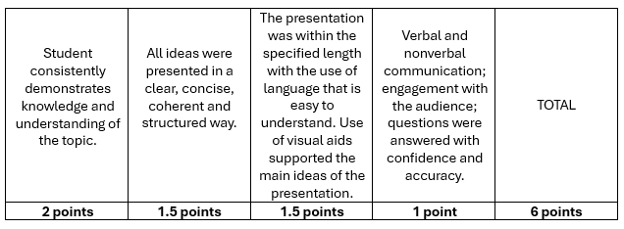
Points distribution

Slide 28
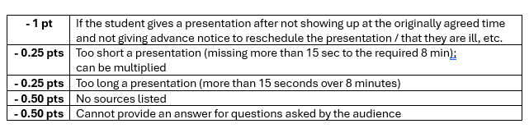
Deduction of points

Slide 29

For those who want more:
TED talks
https://www.ted.com/talks/amy_cuddy_your_body_language_may_shape_who_you_are
https://www.ted.com/talks/julian_treasure_how_to_speak_so_that_people_want_to_listen

Slide 30
#neverstoplearning

