Slide 1
Management
LO1

Slide 2
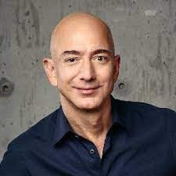
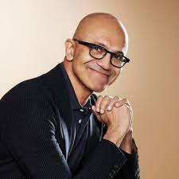

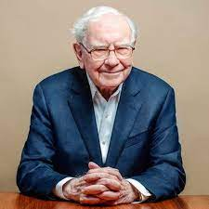

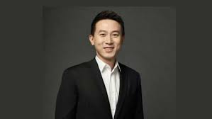
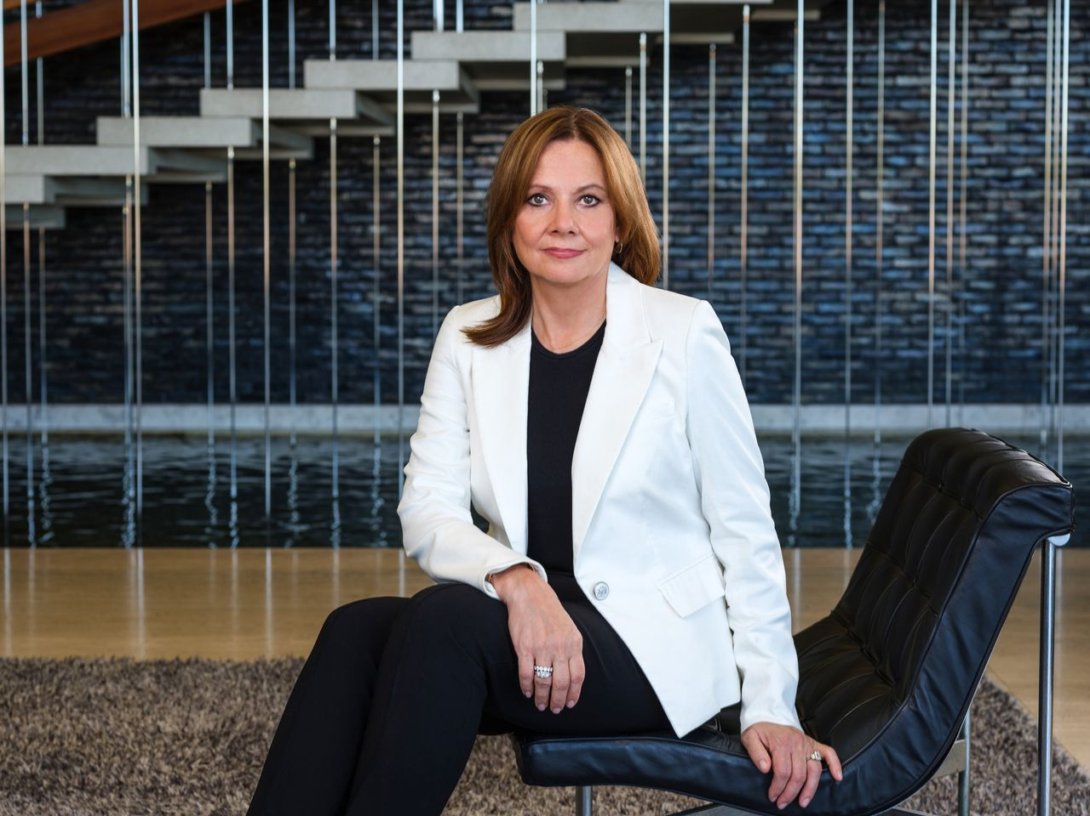
CEOs

Slide 3
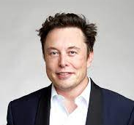
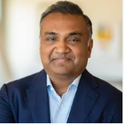
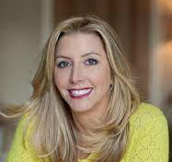
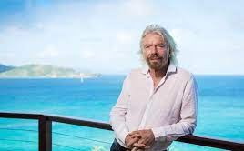
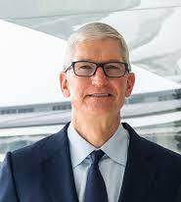
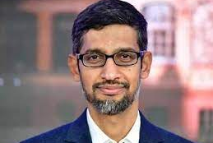
CEOs
https://www.ceotodaymagazine.com/top-50-ceos/

Slide 4
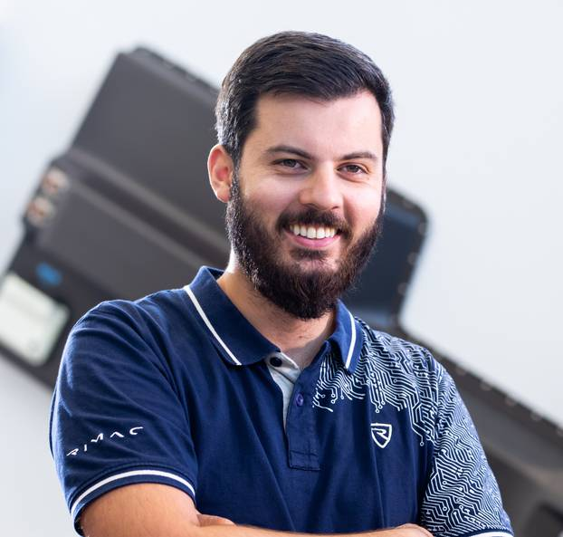

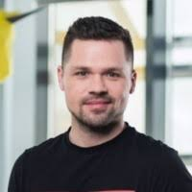
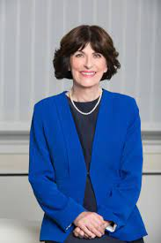
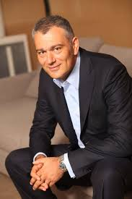

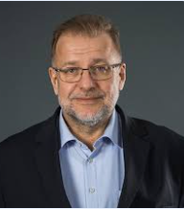
CEOs
"Unicorn" is a term used in the venture capital industry to describe a privately held startup company with a value of over $1 billion.

Slide 5
Basic terminology
A businessman, businesswoman or businessperson - someone who works in their own business or as a manager in an organisation.
An entrepreneur - an individual who creates a new business, bearing most of the risks and enjoying most of the rewards.
A founder - a person who founds or establishes something, as a company or institution.
Business leaders - successful business people, especially heads of large organisations.

Slide 6
Basic terminology
A business empire - a large group of companies mainly owned by one person or family
People in charge of big business empires may be referred to, especially by journalists, as magnates, moguls or tycoons.
These words often occur in combinations such as:
media magnate
property mogul
software tycoon

Slide 7
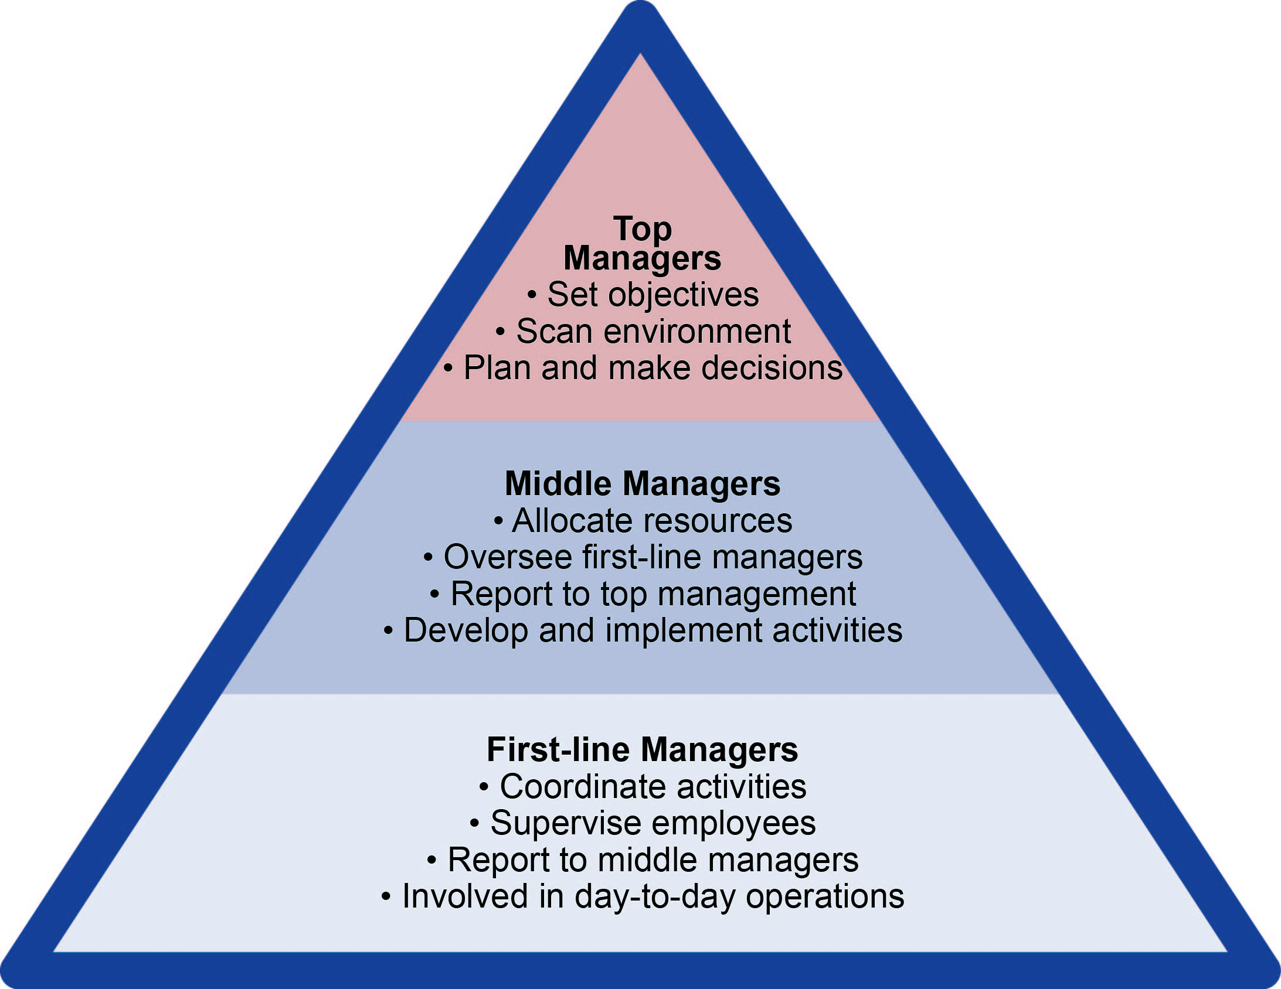
3 Types of Managers
Typically, managers are classified into three levels:
→ top-level managers or senior managers
→ middle-management
→ supervisors.

Slide 8

Top-level managers or senior management
At this level, managers are responsible for charting the company's path. Once that's in place, they convey it to all employees. For senior managers, the ability to inspire is crucial, as is possessing a strategic understanding of the company and industry.

Slide 9
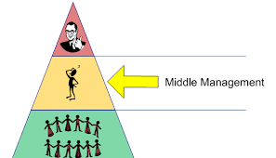
Middle-management
Middle managers require strong problem solving skills, as they work to implement the strategy outlined by senior management. People in middle management might oversee an entire department or a large team within a department.

Slide 10
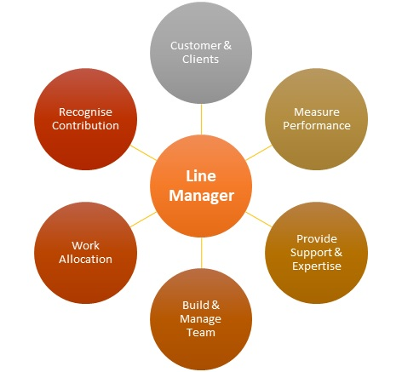
Supervisors
Direct supervisors manage employees.
They're responsible for making sure work is done on time and correctly.
They also inform middle management of any issues and set an example for employees.

Slide 11
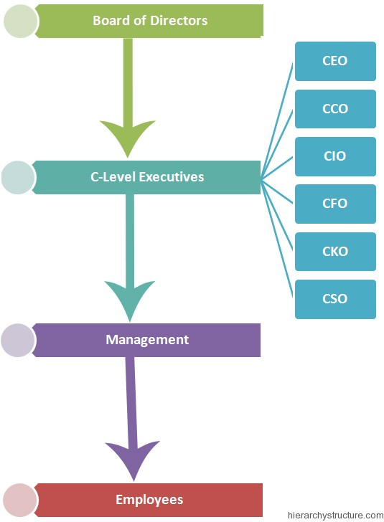
Corporate Executive Job Titles
• C-level jobs refer to high-ranking executive titles with the "C" standing for Chief.
• Executives in C-level positions are the most powerful and influential people in an organization.
• They make more important decisions, have a more demanding workload, and thus have high salaries.

Slide 12
Most Well-Known C-Level Positions
The most powerful and influential people in an organization
Chief executive Officer (CEO) is responsible for the overall path of the company. A CEO will be praised when the company is successful, and also held responsible if there are failures or setbacks.
Chief Financial Officer (CFO) oversees the company's financials. Along with budgeting, accounting, and reporting, this can also involve forecasting and investing.
Chief Operations Officers (COO) is in charge of day-to-day operations at the company, and often oversees the Human Resources Department.

Slide 13
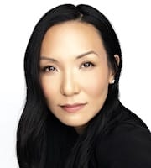
CMO
Chief Marketing Officer
manages the development and execution of a company's advertising and marketing, tasked with increasing sales by utilizing research on pricing, competitive analysis, market research, marketing communications, advertising, and PR.
Marian Lee
CMO of Netflix

Slide 14
Vice presidents in business
In business, “Vice President" refers to a senior management position.
A vice president usually reports directly to the president or CEO of the company and is a member of the executive management team.
https://www.apple.com/leadership/

Slide 15
Hierarchy of vice presidents
Rank | U.S. Executive Officer | U.K. Executive Officer
1 | President | Managing Director
2 | Deputy President or FEVP or SEVP or EVP | Deputy Managing Director
3 | Executive VP, Group VP | Executive Director
4 | Senior VP | Director
5 | Corporate VP or Vice President | Deputy Director

Slide 16
Vice presidents
Deputy President (DP)
First Executive Vice President (FEVP)
Senior Executive Vice President (SEVP)
Executive Vice President (EVP)
Senior Vice President (SVP)
Corporate Vice President (CVP)
Vice President (VP)
Assistant Vice President (AVP) or Executive Director

Slide 17
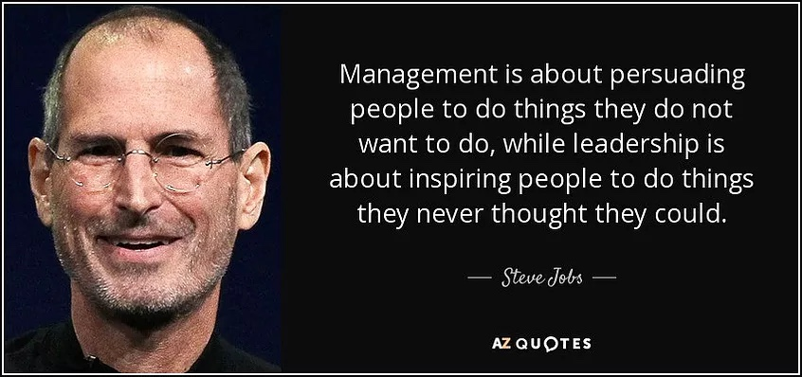
Leaders vs Managers

Slide 18
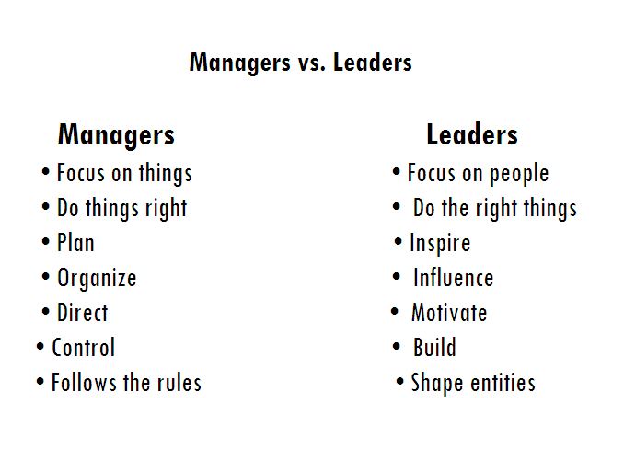
Agree or disagree?

Slide 19
For those who want more
https://www.ted.com/talks/simon_sinek_how_great_leaders_inspire_action?referrer=playlist-how_leaders_inspire
https://www.ted.com/talks/roselinde_torres_what_it_takes_to_be_a_great_leader?referrer=playlist-how_leaders_inspire
https://www.ted.com/talks/stanley_mcchrystal_listen_learn_then_lead?referrer=playlist-how_leaders_inspire
https://www.youtube.com/watch?v=W8RmWPqBiBo
https://www.youtube.com/watch?v=rtgN27z0oi0

Slide 20
Source:
Mascull, B (2014): Business Vocabulary in Use – Intermediate, Cambridge University Press
Pinterest

Slide 21
#neverstoplearning

