Slide 1
FUTURE FORMS

Slide 2
WILL
AN OFFER: I’ll help you.
A PROMISE: I’ll pay you back next week.
AN INVITATION: Will you go out with me?
A PREDICTION: Croatia will win the game.
AN INSTANT DECISION: I’m thirsty. I think I’ll make some tea.

Slide 3
BE GOING TO
AN INTENTION:
Mary is going to spend six weeks in the States.
A PREDICTION BASED ON THE PRESENT SITUATION:
It’s nearly nine now. We’re going to be late.

Slide 4
PRESENT TENSES
PRESENT SIMPLE
PRESENT CONTINUOUS
A TIME TABLE:
The game starts at 3:00 pm.
IN A SUB CLAUSE:
We must get there before the
game starts.
FUTURE ARRANGEMENT:
We’re having a party next
week.

Slide 5
FUTURE CONTINUOUS
AN ACTION OVER A FUTURE PERIOD:
This time next week we’ll be sitting on the beach.
THE RESULT OF A ROUTINE OR ARRANGEMENT:
Peter and Laura will be cleaning the house tomorrow. They
always do it on Saturday.

Slide 6
BE
BE TO
BE ABOUT TO
AN OFFICIAL ARRANGEMENT:
The conference is to take place in April.
Note: This is rather formal!
THE VERY NEAR FUTURE:
The players are on the field.
The game is about to start.

Slide 7
FUTURE PERFECT
SOMETHING THAT WILL BE OVER IN THE FUTURE:
A: What time will you be home?
B: I’ll have finished here by half past eight, so I should be home about nine.

Slide 8
WOULD / WAS GOING TO
LOOKING FORWARD FROM THE PAST:
At half time we thought Croatia would win.
At half time we thought Croatia were going to win.

Slide 9
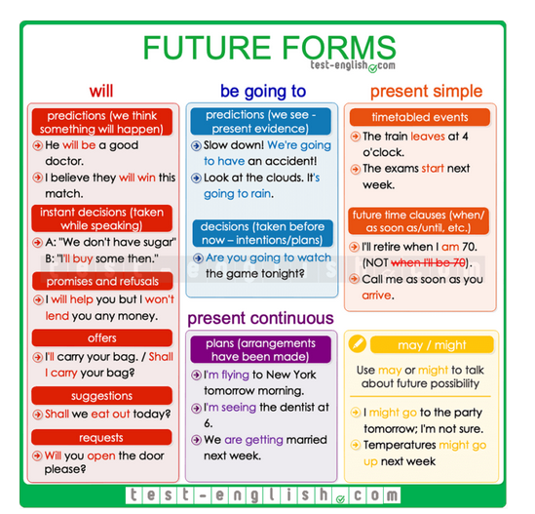
QUICK REMINDER

Slide 10
Let’s revise!
https://test-english.com/grammar-points/b1/future-forms/
https://test-english.com/grammar-points/b2/future-forms-expressing-future-time/
https://test-english.com/grammar-points/a2/will-vs-be-going-to/
https://test-english.com/grammar-points/b2/ways-express-future/

Slide 11
#neverstoplearning

