Slide 1
MODAL VERBS

Slide 2
TYPES OF VERBS
There are 4 types of verbs:
Main verbs – A “main” verb expresses an action, event, or state (e.g. play, run, learn, swim, go, be, have, do).
Linking verbs (copular verbs) – A type of verb that describes the subject of a sentence (e.g. seem, be, become, appear, taste)
Auxiliary verbs – Also known as “helper verbs,” these work alongside a main verb to express different tenses and grammatical moods. Only three: be, have & do.
Modal verbs – These help us express possibility, intent, ability, or necessity.

Slide 3
MODAL VERBS
Modal verbs are a type of auxiliary verbs which are verbs that cannot be used on their own. They need to be accompanied by another (main) verb. Sometimes modal verbs are called modal auxiliaries.

Slide 4
Modal verbs
a type of auxiliary verb that is used to express
  Necessity
  Obligation and advice
  Permission
  Certainty
  Probability
  Possibility
  Ability

Slide 5
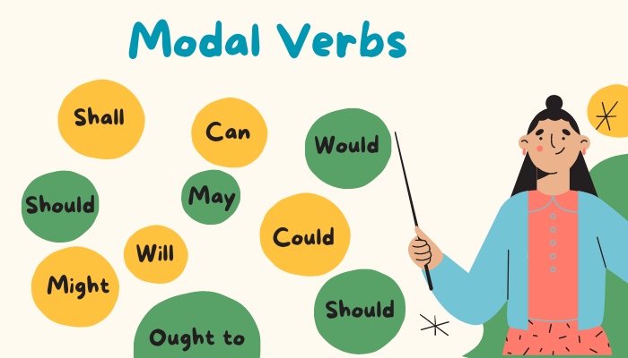
Can you think of any modal verbs?

Slide 6
NECESSITY / OBLIGATION
MUST – when the speaker feels the necessity
I must go on a diet. I’m getting overweight.
HAVE (GOT) TO – when the necessity is outside the speaker
I have to go on a diet. The doctor has told me to.
NEEDN’T – lack of necessity is felt by the speaker
You needn’t take me to the station. I can walk.
• DON’T HAVE TO – it results from the situation
You don’t have to take me to the station. Mary is giving me a lift.
• MUSTN’T – we use it to tell someone NOT TO DO something
Student’s must not use dictionaries in the examination.

Slide 7
OBLIGATION AND ADVICE
SHOULD & OUGHT TO – to say what is the right thing or the best thing to do
They should/ought to build more hospitals.
• HAD BETTER – to say what is the best thing to do in a particular situation (stronger than should!)
You’re ill. You had better see a doctor.
• BE SUPPOSED TO – what people expect to happen because it is the normal way of doing things
This jacket is supposed to have been cleaned, but it looks dirty.

Slide 8
PERMISSION
GIVING PERMISSION = CAN or MAY
Any person over 18 years may/can apply to join the club.
REFUSING PERMISSION = CANNOT/ CAN’T or MAY NOT
Customers cannot/may not bring their own food into this café.
ASKING PERMISSION = CAN, COULD or MAY
Can/Could/May I take your umbrella?
THE PERMISSION DOES NOT DEPEND ON THE SPEAKER = BE ALLOWED TO
Are we allowed to leave early?

Slide 9
CERTAINTY
• WILL – expresses a prediction
There’s someone at the door. – That’ll be the postman.
MUST – speaker sees something as logically true
There must be some mistake.
CAN’T – speaker sees something as logically impossible
The bill can’t be so much.

Slide 10
PROBABILITY
SHOULD & OUGHT TO
We should know / ought to know the result soon.
They should have / ought to have our letter by now.

Slide 11
POSSIBILITY
MAY & MIGHT
This old picture may / might be valuable.
That may not / might not be a bad idea.
• CAN & COULD
We can / could have a party.
If we’re short of money, I can / could sell my jewellery.

Slide 12
ABILITY
CAN (present)
Can you play the piano?
• COULD (past)
Nicola could play chess when he was six.
• BE ABLE TO
Being able to speak a foreign language is a great advantage.
I haven’t been able to sleep recently.
Applicants for the job must be able to speak two foreign languages.

Slide 13
Let’s give it a go
Nicole can drive but she hasn’t got a car.
I used to be able to stand on my head, but I can’t do it now.
You’ve been travelling all day. You must be tired. You should go to bed immediately.
A successful marketing campaign could increase our income.
Take an umbrella. It might rain later.

Slide 14
Look at these clouds. I think it can/might/must rain.
This is impossible! It can’t be/mustn’t be/may not be the answer.
Well done! You may be/must be/might be very pleased!
I’ve no idea where Jane is. She could be/must be anywhere!
I suppose it’s possible. I might/can/must come to your party.
I’m not sure. I must not/may not be able to get there in time.
That can’t be/mustn’t be/may not be David. He hasn’t got a bike.
Lisa isn’t here yet. She can be/must be on her way.
There’s someone at the door. It can be/could be the postman.
Sorry, I can’t /may not come out. I have to do my homework.

Slide 15
Similar or different meaning?
You’d better go.
You don’t have to press this button.
You should have a rest.
You must be crazy!
You must be here at 8:00.
You mustn’t do that!
You shouldn’t eat so much.
We have to work harder.
I’d better write my letters.
I ought to leave now.
You should go.
You mustn’t press this button.
You ought to have a rest.
You should be crazy!
You have to be here at 8:00.
You don’t have to do that!
You ought not to eat so much.
We must work harder.
I must write my letters.
I have to leave now.
S
D
S
D
S
D
S
S
D
D

Slide 16
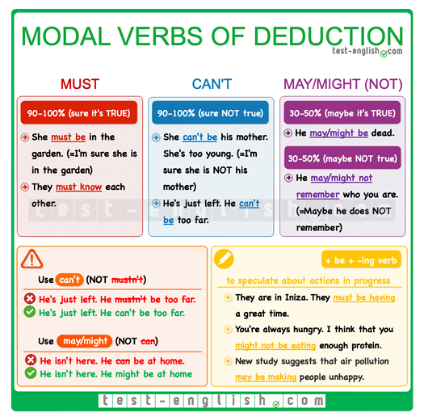
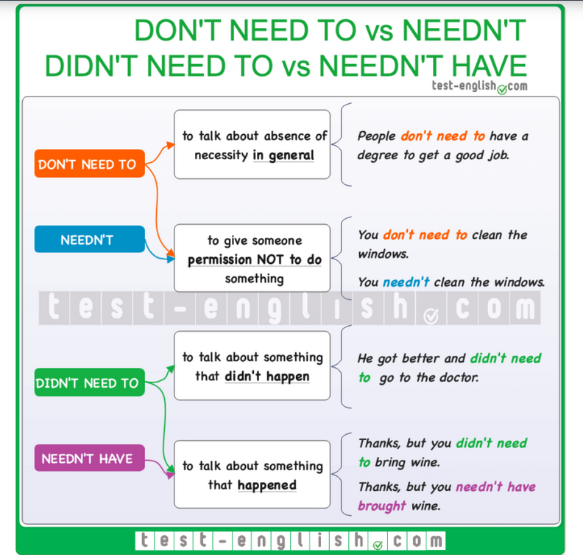
Summary chart

Slide 17
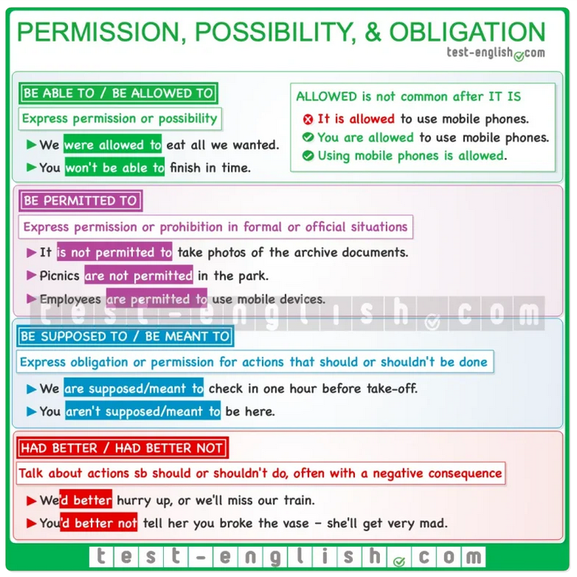
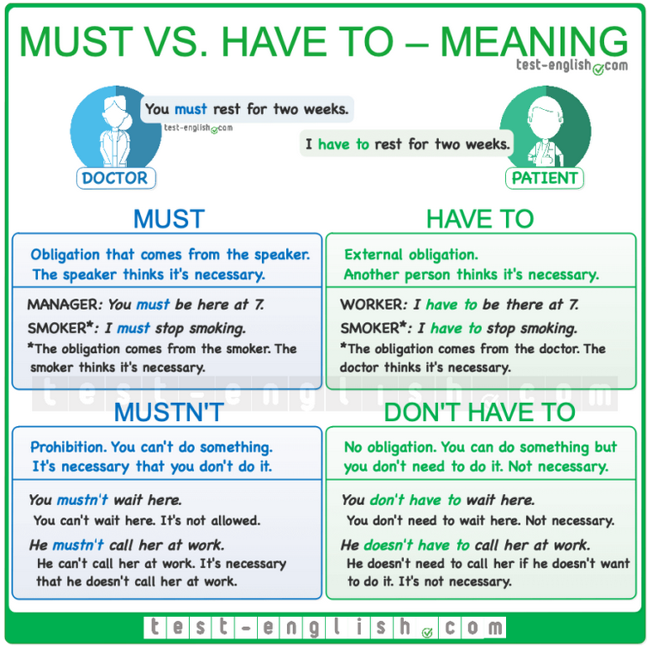
Summary chart cntd.

Slide 18
Let’s revise!
https://www.callanschool.info/images/noticias_pdf/primary-auxiliaries.pdf
https://test-english.com/grammar-points/b1/modal-verbs-of-deduction/
https://www.english-grammar.at/online_exercises/modal-verbs/m016.htm

Slide 19
#neverstoplearning

