Slide 1
Osnove marketinga
Predavanje br. 10
Halida Sarajlić, MBA
Notes:
Ažurirati naziv kolegija.

Slide 2
TEMATSKE CJELINE
Tjedan nastave | Cjelina | Tjedan nastave | Cjelina
Week 1 | Marketing: creating customer value and engagement | Week 9 | Pricing: understanding and capturing customer value; pricing strategies
Week 2 | Analysing the marketing environment | Week 10 | Marketing channels: delivering customer value
Week 3 | Managing marketing information to gain customer insights | Week 11 | Integrated marketing communications strategy
Week 4 | Consumer markets and buyer behaviour | Week 12 | Advertising and public relations
Week 5 | Business markets and business buyer behaviour | Week 13 | Direct, online, social media and mobile marketing
Week 6 | Customer-driven marketing strategy: creating value for target customers | Week 14 | Creating competitive advantage
Week 7 | Products, services and brands: building customer value | Week 15 | Social responsibility and ethics
Week 8 | Developing new products and managing the product life cycle
I1
I2
I4
I3
I2

Slide 3
ŠTO SMO NAUČILI PROŠLI PUT
Marketinški miks/splet – Proizvod
Brend/marka
Životni ciklus proizvoda

Slide 4
DANAŠNJE TEME
Knjiga: Kotler, P., Armstrong, G, Wong, V. and Saunders, J. (2020) Principles of Marketing 8th European edn, Harlow: Pearson Education Limited.
Poglavlja:
Pricing: understanding and capturing customer value
Pricing strategies: aditional considerations
Definiranje cijena
Glavne strategije cijena
Cjenovne strategije za nove proizvode
Cjenovne strategije unutar 4P

Slide 5

Izvolite šalicu kave. Koliko ste je spremni platiti?
~ Dan Ariely

Slide 6
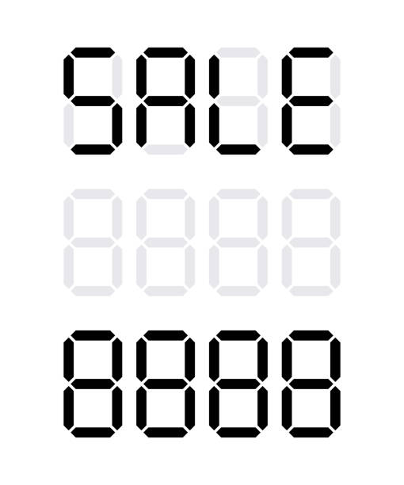
01
Definiranje cijena

Slide 7
Cijene ne postoje isključivo radi same cijene. One su alat za provođenje strategije.

Slide 8
Što stoji iza „cijene”?
Iznos novca naplaćen za proizvod ili uslugu.
Zbroj svih vrijednosti od kojih korisnici odustaju kako bi ostvarili koristi od posjedovanja ili korištenja proizvoda ili usluge.
Jedini element u marketinškom miksu koji generira prihod.
Najfleksibilniji element marketinškog miksa

Slide 9
Koji su preduvjeti uspješnog postavljanja cijena
KONZISTENTNA STRATEGIJA
JASNI CILJEVI I NJIHOVI PRIORITETI
POZICIONIRANJE
ADEKVATNA
STRATEGIJA
CIJENA

Slide 10
Koji su preduvjeti uspješnog postavljanja cijena
PONUDITI NAJBOLJU ORGANSKU KOZMETIKU NA TRŽIŠTU
OSTVARITI 25% UDJELA NA TRŽIŠTU U RH
VISOKA KVALITETA-VISOKA CIJENA
ADEKVATNA
STRATEGIJA
CIJENA?

Slide 11
02
Glavne strategije cijena

Slide 12
Poduzeća biraju između strategija cijena baziranih na troškovima, vrijednosti i konkurenciji (cost-based, value-based, competition-based pricing).
Notes:
Ovo su glavne cjenovne strategije.

Slide 13
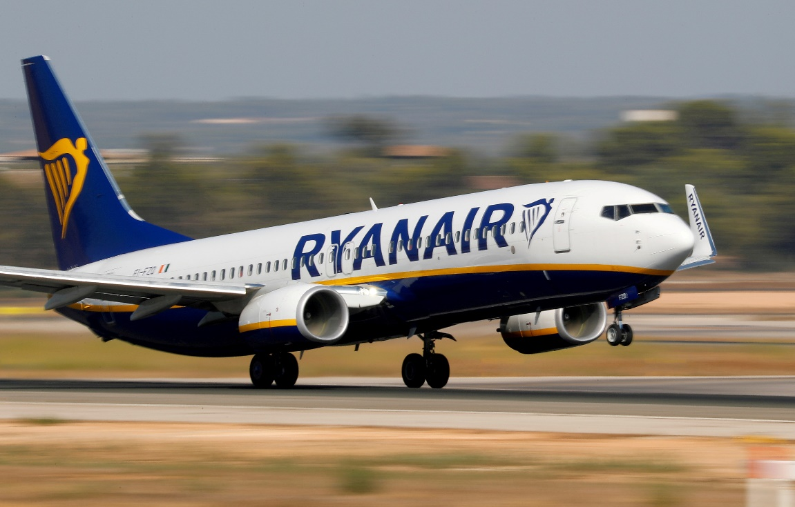

Cijena bazirana na troškovima ili vrijednosti?
A
B
Ryanair
Steinway&Sons piano

Slide 14
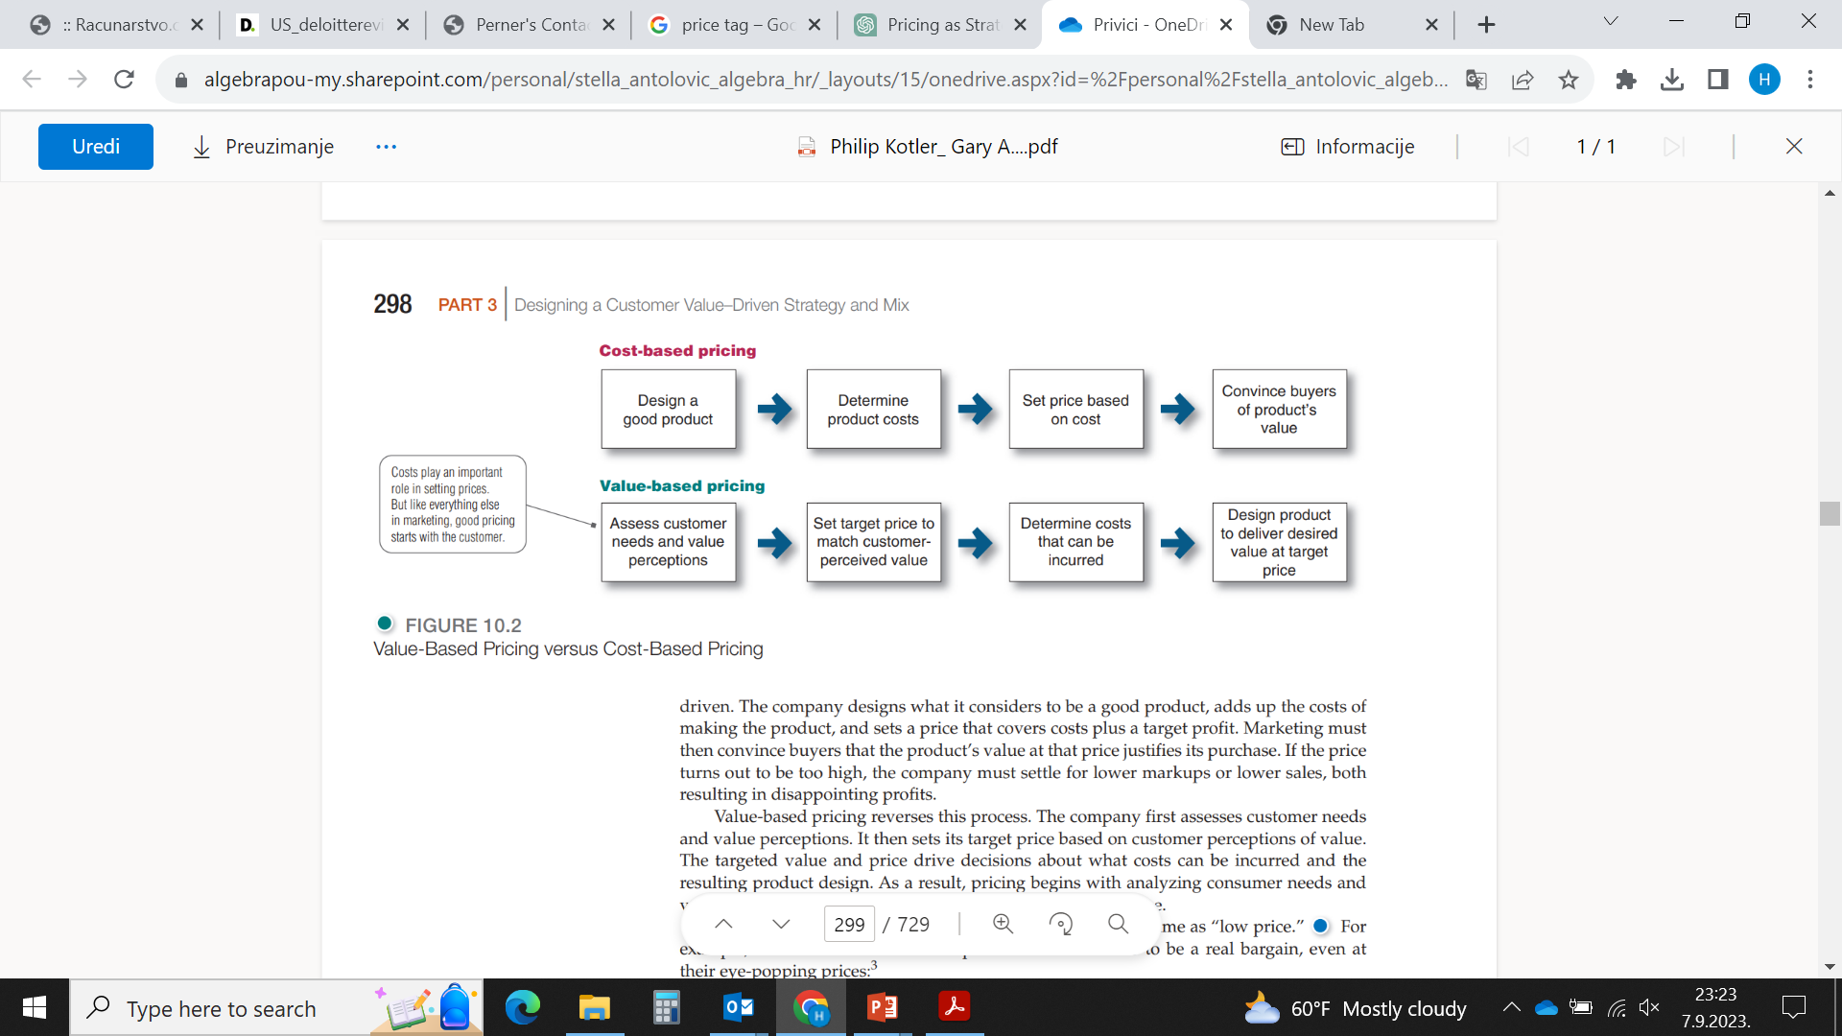
Cijena bazirana na troškovima (cost-based)

Slide 15

Vrste troškova
Fiksni troškovi
Troškovi koji se ne mijenjaju s razinom proizvodnje ili prodaje.
Varijabilni troškovi
Troškovi koji se direktno mijenjaju s razinom proizvodnje.

Slide 16
Cijena bazirana na troškovima vs. cijena bazirana na vrijednosti (cost-based vs. value-based pricing)

Slide 17
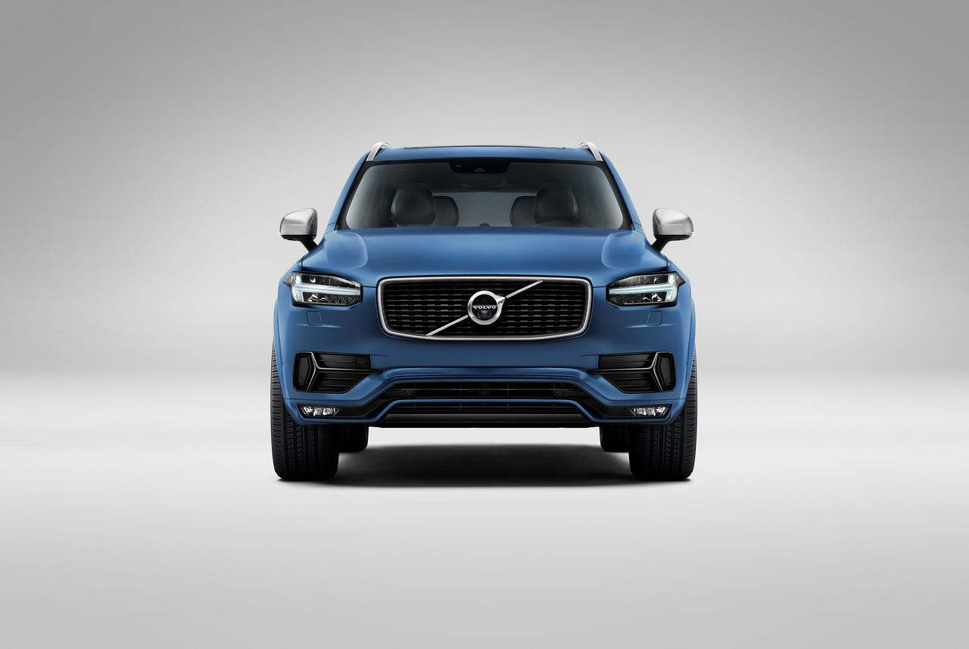
Cijena bazirana na vrijednosti dolazi u dva oblika
Good-value pricing
Ponuda upravo prave kombinacije kvalitete i dobre usluge po poštenoj (fer) cijeni.
Value-added pricing
Dodavanje vrijednosnih značajki i usluga kako bi se diferencirala ponuda tvrtke i naplaćivala viša cijena.
Notes:
Good-Value Pricing
Recent years have seen a shift in consumer attitudes toward price and quality.
Increasingly, consumers want to know that they are getting good value for their money.
In response, many companies have changed their pricing approaches to bring them
in line with changing price and value perceptions. More and more, marketers have
adopted the strategy of good-value pricing—offering
the right combination of quality and good service at a fair
price.
In many cases, this has involved introducing lessexpensive
versions of established brand name products or
new lower-price lines. For example, Kroger carries three lowpriced
product lines—Heritage Farm, Check This Out, and
Psst, which offers thrift-conscious customers rock-bottom
prices on grocery staples such as chicken, toilet paper, and
sugar. Good-value prices are a relative thing—even premium
brands can launch value versions. Mercedes-Benz released
its CLA Class, entry-level models starting at $31,500. From its
wing-like dash and diamond-block grille to its 208-hp turbo
inline-4 engine, the CLA Class gives customers “The Art of
Seduction. At a price reduction.”
Value-Added Pricing
Value-based pricing doesn’t mean simply charging
what customers want to pay or setting low
prices to meet competition. Instead, many companies
adopt value-added pricing strategies.
Rather than cutting prices to match competitors,
they add quality, services, and value-added features
to differentiate their offers and thus support
their higher prices.
For example, Philips has relied on its
investments in meticulous research and innovation
based on customer insights to offer greater
value. Philips’s lighting division, for instance,
works on creating energy-efficient solutions for
home and office users. More than 20 percent of the world’s total electricity is used by lighting these days, and 75 percent of current
urban lighting is energy inefficient. As the public sector in many countries invests
heavily in more energy-efficient technologies, Philips is surging ahead with its innovative
lighting solutions. One of its latest offerings is connected LED lighting systems
and services, which it claims will save energy as well as enable their customers to work
more efficiently and productively. The company intends to win the consumer market
in professional lighting systems and is gearing up to do this by driving more innovation
and by becoming more customer centric.

Slide 18
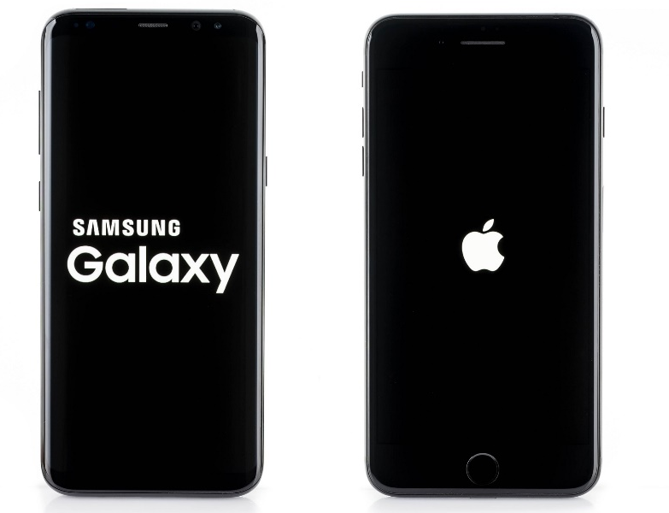
Cijena bazirana na konkurenciji (competition-based pricing)
temeljeno na strategijama, cijenama, troškovima i marketinškim ponudama konkurenata
potrošači temelje svoje procjene vrijednosti proizvoda na cijenama koje konkurenti naplaćuju za slične proizvode
poduzeće može postaviti više (ako se može po nečemu razlikovati od konkurencije), niže (ako ima niže troškove) ili slijediti cijene konkurenata
Notes:
https://www.esrgear.com/blog/should-i-get-an-iphone-or-a-samsung-galaxy/
Go above the price of your competitors – this strategy can be used when you decide to increase your revenue and even try to increase sales by setting a higher price compared to your competitors. Even though it might not sound like an intuitive move at the first glance, setting a higher price can help you with your brand’s image. But you need to be careful – if you want to charge more, you need to offer more, so think about extra features and premium options your service or product can offer.
Following competitors’ prices – you can set your prices to be equivalent to the prices of your competitors. When you do this, the price as a factor is eliminated, so the focus is moved to the brand itself and on features, the product can offer. So, if you can offer more than your competitors, this might be a good strategy for you.
Go below the price of your competitors – here you need to be careful. If you are new and trying to get your part of the market share or just trying to survive in a competitive market environment, this pricing method might help you. However, it is a risky move, since you have to consider your profit margin, and you don’t want the lower price to negatively affect your brand’s image.
Example (https://www.price2spy.com/blog/competitive-pricing/): Let’s take two of the most successful smartphone brands at the moment. Apple and Samsung are competing for the customer’s attention and their marketing and pricing strategies are worth very serious studying. We will just take a quick look and see what they do with their prices. Since the prices in this industry are very dynamic and change over time, we will take the prices on the release dates, to avoid any inconvenience. Also, we need to have in mind that Apple and Samsung don’t release their phone at the same time. Apple usually releases its most popular phones in October, while Samsung does this in January. Disregarding the fact that it’s not the same year, we will take the shortest period between the two releases and compare the phones Apple released in October 2020. (iPhone 12, iPhone 12 Pro, and iPhone 12 Max – released in November) and phones Samsung released in January 2021 (Galaxy S21, S21+, and S21 Ultra). Since Samsung was the one who released its products later, they had the chance to look at Apple’s prices.
With the S21 and S21+, Samsung decided to go a bit below the price of iPhones 12 and 12 Pro. On the other hand, Samsung felt more comfortable with S21 Ultra and decided to go with the price of £1,329 which is considerably more expensive than Apple’s most premium phone in this series – the iPhone 12 Pro Max cost £1,099 at launch. This can be seen as Samsungs message that they are offering a phone with better features than Apple offered a few months before.

Slide 19
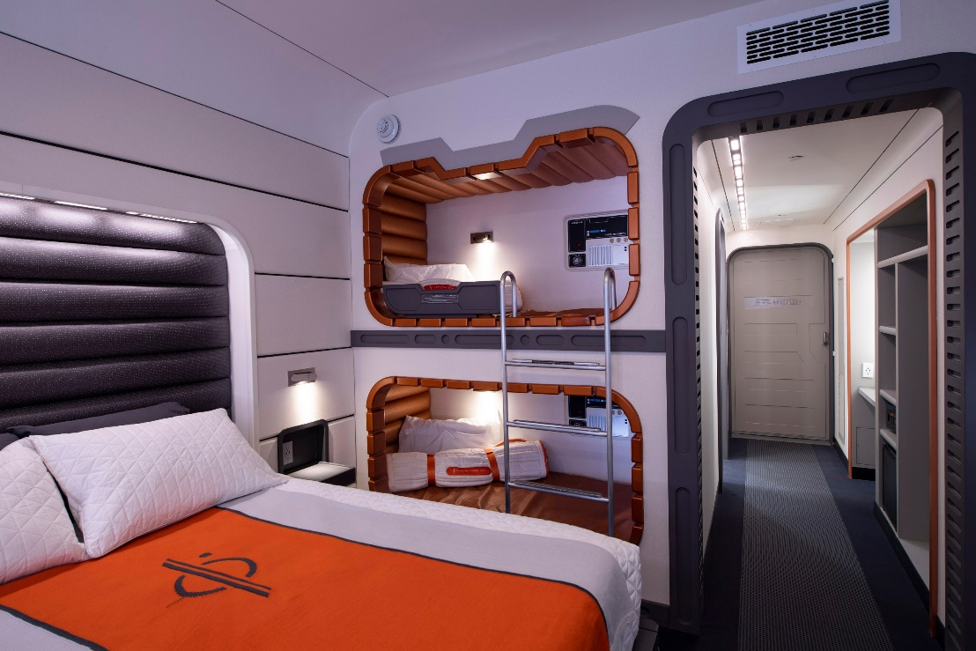
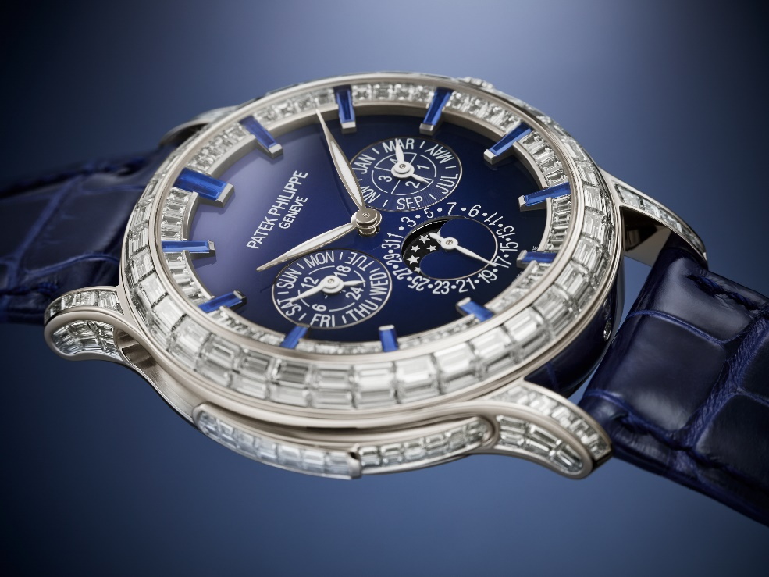
U konačnici, potrošač je taj koji odlučuje je li cijena dobra ili nije…
Disney Star Wars hotel
Patek Philippe Watch
Notes:
https://www.cntraveller.com/article/star-wars-hotel
https://www.gq.com/story/patek-phillippe-2022-new-releases
Disney star Wars hotel je imao jako visoke cijene za odsjedanje u tematskom hotelu u sklopu Disneylanda. Ciljan skupina ga nije „prihvatila”, te je nakon godine dana zatvoren. Noćenje za 4-članu obitelj je iznosilo cca. 5100 Eura.

Slide 20
03
Cjenovna strategija za nove proizvode

Slide 21
Kako odrediti cijenu novim proizvodima
Strategija „pobiranja vrhnja” (Market-skimming pricing)
Postavljanje više cijene za novi proizvod kako bi se postigli maksimalni prihodi od segmenata koji su spremni platiti visoku cijenu. Poduzeće ostvaruje količinski manje prodajnih transakcija, ali su one profitabilnije.
Strategija penetracije tržišta (Market-penetration pricing)
Postavljanje niskih cijena za novi proizvod kako bi se privukao veliki broj kupaca i postigao veliki udio na tržištu.

Slide 22
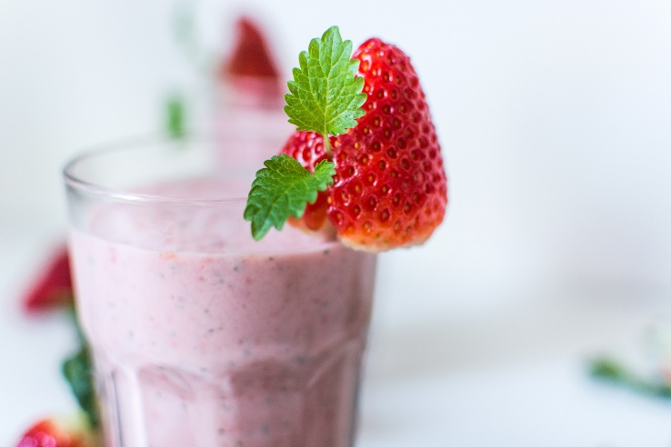

KOJU BISTE STRATEGIJU ODABRALI?
Vaša kompanija razvila je novi shake za doručak namijenjen mršavljenju koji se pokazao uspješnim u testnoj fazi na tržištu. Korisnici su doživjeli prosječan gubitak težine od 1 kg tjedno. Posjedujete patent na proizvod. Trošak proizvodnje shakea relativno je nizak (0,05 € po 25 grama – ukupni proizvodni troškovi). Svaki shake sadrži 200 grama.
Notes:
https://www.eatingwell.com/article/290841/do-weight-loss-shakes-really-work/
Ovo je case iz Kotlera. Polaznici trebaju u grupama ili samostalno (ovisno o grupi) razmisliti i pojasniti koju strategiju za nove proizvode bi odabrali i zašto.

Slide 23
04
Cjenovne strategije unutar marketinškog miksa

Slide 24
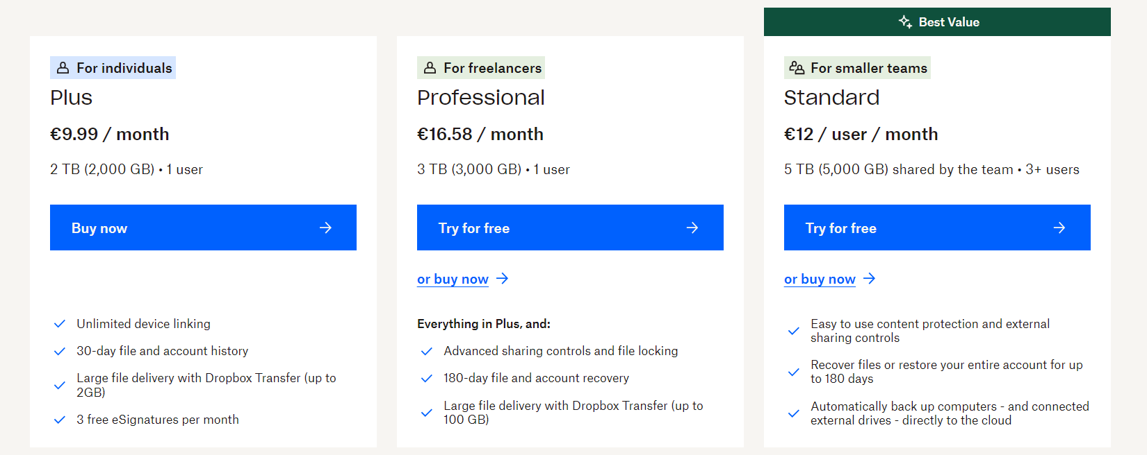
Strategija cijena proizvodne linije
Postavljanje cijena između proizvoda unutar liniji proizvoda
Temelji se na razlikama u troškovima između proizvoda, na procjenama različitih značajki od strane kupaca te cijenama konkurenata.
Notes:
Dropbox cloud storage.
Companies usually develop product lines rather than single products. In product line
pricing, management must determine the price steps to set between the various products
in a line. The price steps should take into account cost differences between products in the
line. More important, they should account for differences in customer perceptions of the
value of different features.
For example, Microsoft offers full lines of Surface tablets, laptops, and PCs, from the
ultra-portable Surface Go tablet starting at $399, to Surface Pro tablet/laptops starting at
$899, to Surface Book combination laptops starting at $1,149, to the Surface Studio all-inone
PC starting at $2,999. Then each of these lines features a range of prices depending on
the chosen configuration. For example, an upgraded Surface Go can cost as much as $679,
and a fully featured Microsoft Surface Studio 2 runs as much as $4,799. Microsoft’s task is
to establish perceived value differences that support price differences for different buyers
and uses.

Slide 25
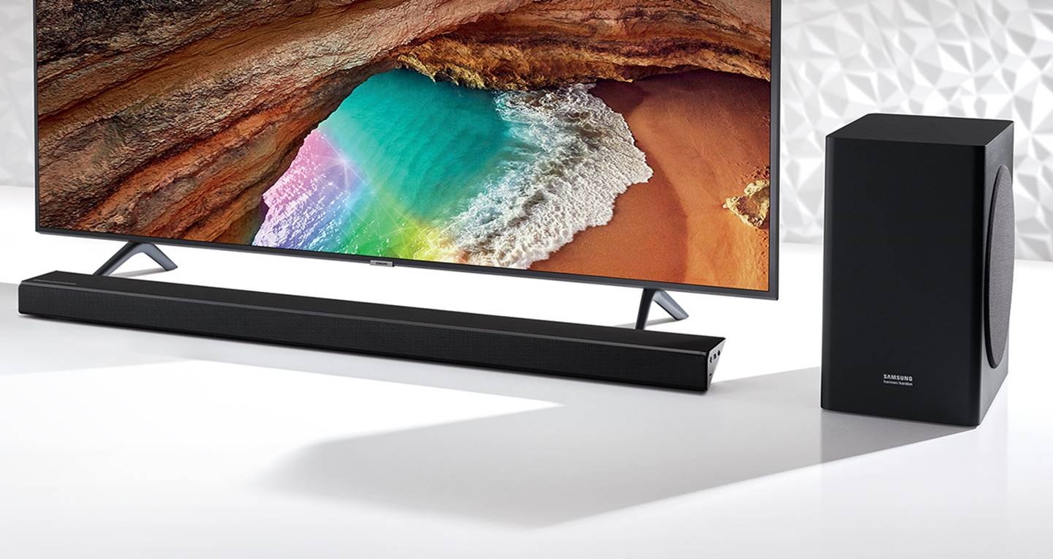
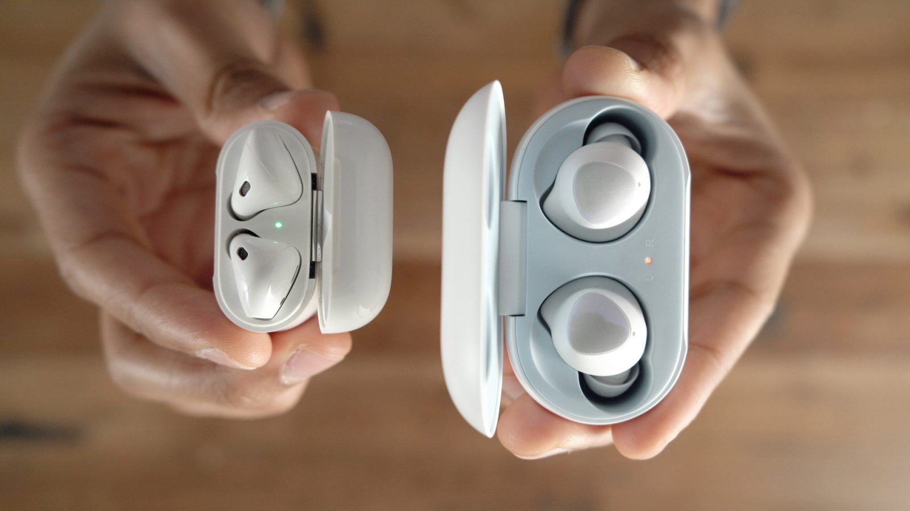
Strategija opcionalnog proizvoda
Notes:
https://www.bassheadspeakers.com/best-soundbars-for-samsung-tv/
Primjer su TV i soundbar te iPhone i Air Pods.
Many companies use optional-product pricing—pricing optional or accessory products
along with the main product. For example, a car buyer may choose to order a remote engine
start system and premium sound system. Refrigerators come with optional ice makers.
And when you order a new laptop, you can select from a bewildering array of processors,
drives, docking systems, software options, and service plans. Pricing these options
is a sticky problem. Companies must decide which items to include in the base price and
which to offer as options.

Slide 26

By-product strategija (strategija „nusproizvoda”)
Postavljanje cijene za nusproizvode kako bi se pomoglo pokriti troškove njihovog zbrinjavanja i učiniti cijenu glavnog proizvoda konkurentnijom.
Notes:
Producing products and services often generates by-products. If the by-products have no
value and if getting rid of them is costly, this will affect the pricing of the main product. Using
by-product pricing, the company seeks a market for these by-products to help offset the
costs of disposing of them and help make the price of the main product more competitive.
The by-products themselves can even turn out to be profitable—turning trash into
cash. For example, Americans eat some nine billion chickens a year but not the feet.
Chinese, on the other hand, consider chicken feet (or what the industry calls “chicken
paws”) to be a real delicacy. That solves a lot of problems for poultry processors such as
Perdue Farms, which once couldn’t give the feet away and even had to pay to dispose of
them. But thanks to the huge demand in China, chicken feet are now a huge profit center.
Perdue sells some $40 million of the otherwise value-less by-product to China annually.
Interestingly, the opposite is true for pork ribs. European meatpackers sell most of their
pork products to China. But the Chinese only want full-flesh cuts such as loins and pork
bellies; they’re not interested in the bones. So the European packers sell the ribs as byproducts
to U.S. foodservice chains at a bargain.

Slide 27
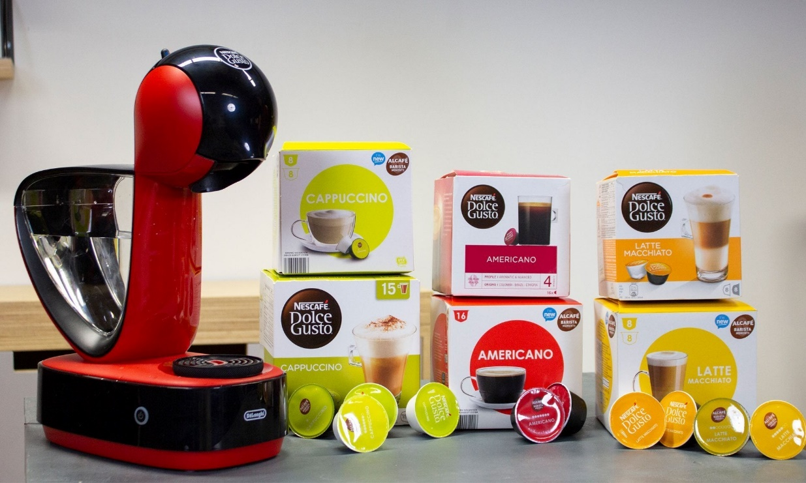

Strategija „captive-product”
postavljanje cijene za proizvode koji se moraju koristiti zajedno s glavnim proizvodom (two-part pricing)
Notes:
Companies that make products that must be used along
with a main product are using captive-product pricing.
Examples of captive products are razor blade cartridges,
printer cartridges, single-serve coffee pods, e-books, and
video games. Producers of the main products (razors, ereaders,
printers, single-cup coffee brewing systems, and
video-game consoles) often price them low and set high
markups on supplies and supplemental products. For
example, Nintendo makes little or no profit on its Switch
video game consoles. The company spends an estimated
$257 on parts alone to make each Switch, which then
sells at retail for only $299.99. That means that Nintendo
might probably loses money on the consoles themselves.
However, it hopes to more than make up for thin console
margins through sales of Switch video games, which yield
much higher unit sales and margins. For example, whereas
Nintendo sold about 32 million Switch consoles last year, it
sold more than 163 million higher-margin game units.4
Captive products can account for a substantial portion
of a brand’s sales and profits. For example, Gillette has
long sold razor handles at low prices and made its money
on higher-price replacement blade cartridges. “The razor business is all about the blades,” says an analyst. “Get consumers hooked on your razor,
and they buy the highly profitable refill blades forever.” Last year, Gillette sold well over
half a billion dollars’ worth of refill blades at prices ranging up to a hefty $5 per cartridge.
However, companies that use captive-product pricing must be careful. Finding the
right balance between the main-product and captive-product prices can be tricky. Even
more, consumers trapped into buying expensive captive products may come to resent the
brand that ensnared them. For example, Gillette has lost market share in recent years as
price-fatigued customers have shifted to lower-priced private-label upstarts such as Dollar
Shave Club and Harry’s. To compete, it was recently forced to slash cartridge prices across
the board by 15 to 20 percent.5
In the case of services, captive-product pricing is called two-part pricing. The price of
the service is broken into a fixed fee plus a variable usage rate. Thus, at Six Flags and other
amusement parks, you pay a daily ticket or season pass charge plus additional fees for
food and other in-park features.

Slide 28
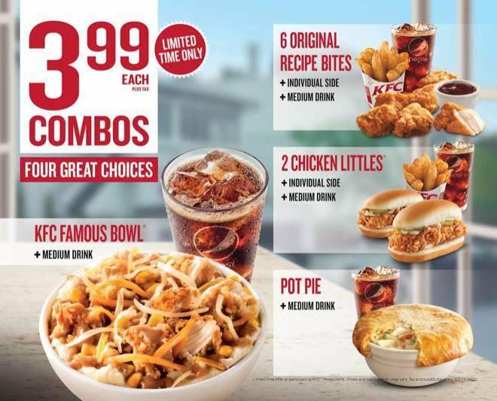
Oblikovanje cijene „bundle” proizvoda
Kombinacija nekoliko proizvoda i ponuda u jednom paketu, po sniženoj cijeni
Notes:
Using product bundle pricing, sellers often combine several products and offer the bundle
at a reduced price. For example, fast-food restaurants bundle a burger, fries, and a soft drink at
a “combo” price. Microsoft Office 365 subscriptions are sold as a bundle of software products,
including Word, Excel, PowerPoint, and Outlook. And Comcast, AT&T, Spectrum, Verizon,
and other telecommunications companies bundle TV, phone, and high-speed internet services
at a low combined price. Price bundling can promote the sales of products consumers might
not otherwise buy, but the combined price must be low enough to get them to buy the bundle.

Slide 29
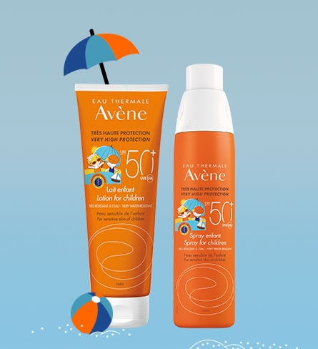
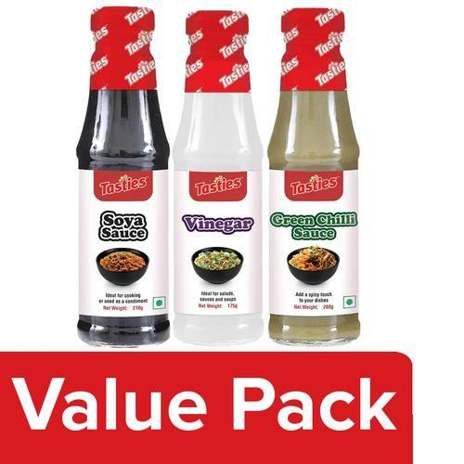
Zašto poduzeća koriste „bundle” ponude?
Promocija novog proizvoda
Rješavanje zaliha
Povećanje iznosa novca kojeg korisnik treba izdvojiti
Notes:
https://www.bigbasket.com/pd/1215899/tasties-green-chilli-sauce-200-g-soya-sauce-210-g-vinegar-175-g-combo/https://www.parfumerija-lana.hr/
https://www.eau-thermale-avene.com.hr/uv-zastita-od-sunca/djeca
Kratki case za polaznike (možda preko Kahoota ispitati ili dati im samo da razmisle u grupama ili samostalno). Rješenja: Promocija novog proizvoda; Rješavanje zaliha; Povećanje out-of-pocket money koji korisnik treba izdvojiti.

Slide 30
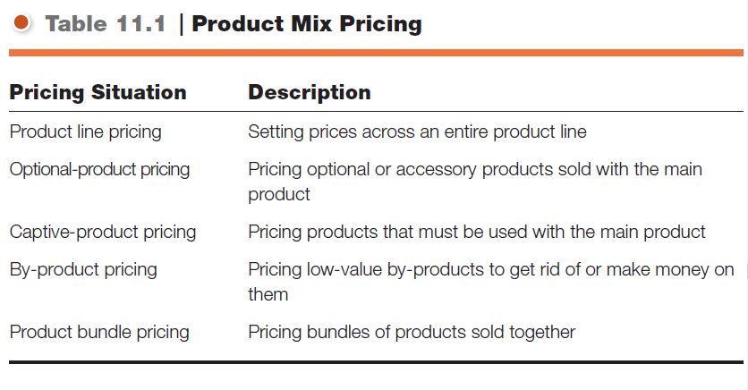
Cjenovne strategije unutar 4P - sažetak
Zadatak
Zamislite da ste menadžer proizvodnje u kompaniji koja proizvodi prirodne sokove. Proizvodite tri vrste sokova: jabuka, naranča i mješavina bobica. Troškovi proizvodnje variraju, a kao nusproizvodi nastaju pulpa i kožice. Vaš zadatak je predložiti strategiju cijena za glavne proizvode i nusproizvode tako da maksimizirate profit, ali i ostvarite konkurentne cijene na tržištu.
Što biste s nusproizvodima učinili?

Slide 31
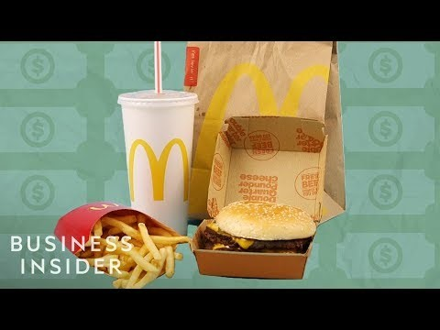
Video
Notes:
https://www.youtube.com/watch?v=VooHiweb1sw&ab_channel=BusinessInsider

Slide 32
05
Strategije prilagodbe cijena

Slide 33
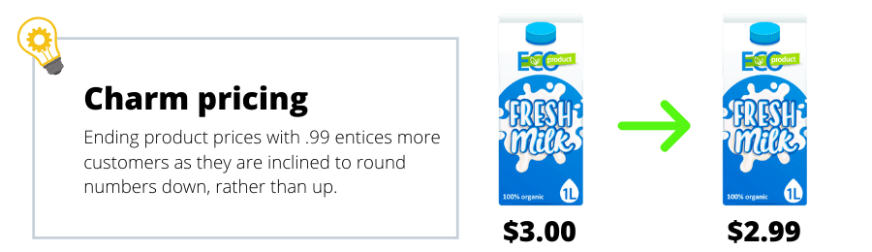
Psihološko određivanje cijena
Notes:
https://conjointly.com/blog/pricing-psychology/
Primjeri psiholoških cijena.

Slide 34
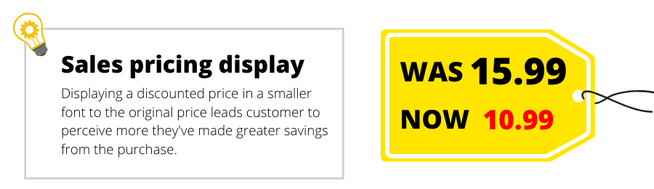
Psihološko određivanje cijena
Notes:
https://conjointly.com/blog/pricing-psychology/
Primjeri psiholoških cijena.

Slide 35
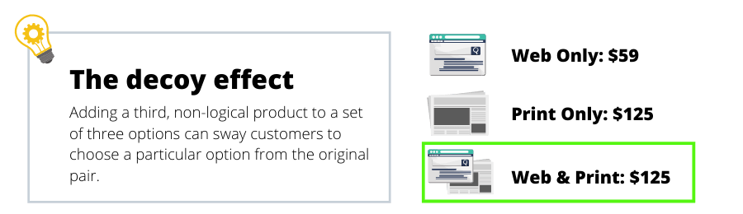
Psihološko određivanje cijena
Notes:
https://conjointly.com/blog/pricing-psychology/
Primjeri psiholoških cijena.

Slide 36
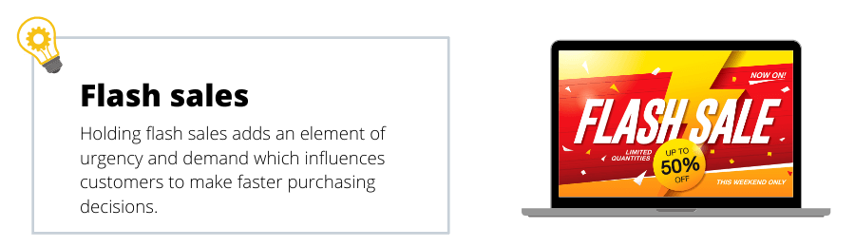
Psihološko određivanje cijena
Notes:
https://conjointly.com/blog/pricing-psychology/
Primjeri psiholoških cijena.

Slide 37
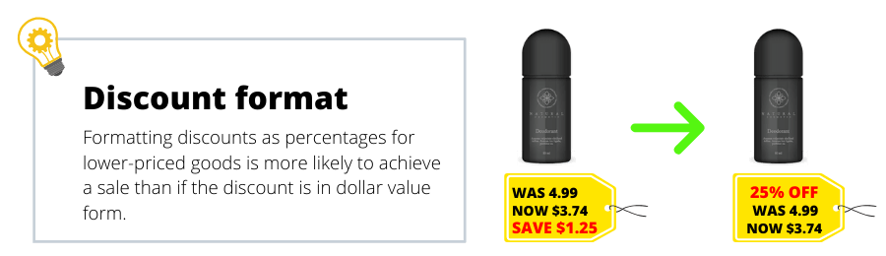
Psihološko određivanje cijena
Notes:
https://conjointly.com/blog/pricing-psychology/
Primjeri psiholoških cijena.

Slide 38
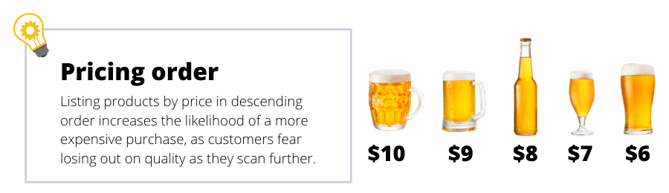
Psihološko određivanje cijena
Notes:
https://conjointly.com/blog/pricing-psychology/
Primjeri psiholoških cijena.

Slide 39

Video
Notes:
https://www.youtube.com/watch?v=c_yOcEXqnZs&t=1s

Slide 40
OSNOVE MARKETINGA
Notes:
Ažurirati naziv kolegija.

