Slide 1
LO 2: FUTURE FORMS
- Future Simple
- Be going to
- Present Simple
- Present Continuous
- Future Continuous
- Future Perfect Simple
- Future Perfect Continuous

Slide 2
WILL (Future Simple)
AN OFFER: I’ll help you.
A PROMISE: I’ll pay you back next week.
AN INVITATION: Will you go out with me?
A PREDICTION: Croatia will win the game.
AN INSTANT DECISION: I’m thirsty. I think I’ll make some tea.

Slide 3
BE GOING TO
AN INTENTION:
Mary is going to spend six weeks in the States.
A PREDICTION BASED ON THE PRESENT SITUATION:
It’s nearly nine now. We’re going to be late.

Slide 4
PRESENT TENSES
PRESENT SIMPLE
PRESENT CONTINUOUS
A TIMETABLE/ SCHEDULE:
The game starts at 3:00 pm.
The train leaves at 7:30 am.
IN A SUB-CLAUSE:
We must get there before the
game starts.
FUTURE ARRANGEMENT:
We’re having a party next
week.

Slide 5
WILL BE +ING (Future Continuous)
1. instead of the present continuous for future events already planned or decided.
We’ll be coming next weekend. = We’re coming next weekend.
We’ll be leaving at 8 a.m. tomorrow.= We’re leaving at 8 a.m.
2. to ask politely about future arrangements.
Will you be going home this summer?
3. to talk about situations or actions that will be in progress at a particular time in the future.
This time next week, we’ll be travelling to Paris.
Tomorrow at 10, you’ll be doing your exam.

Slide 6
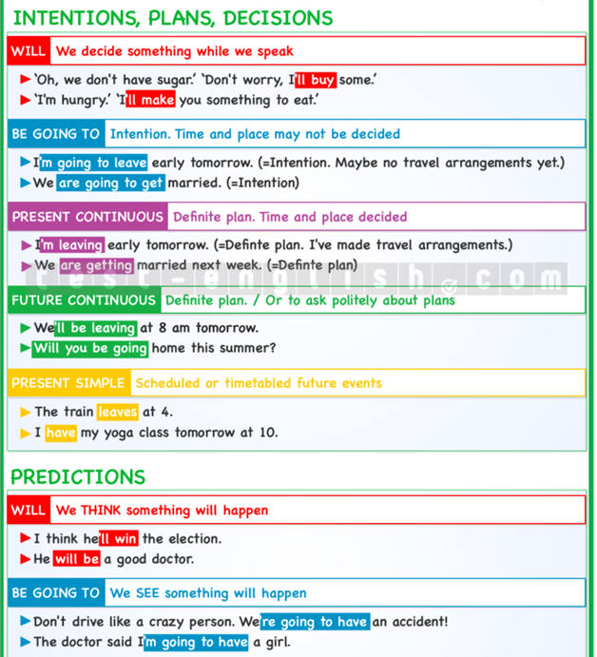
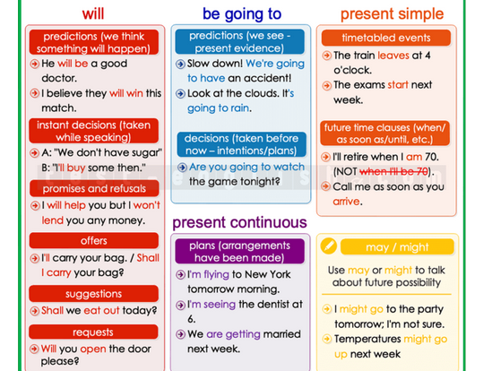
QUICK REMINDER

Slide 7
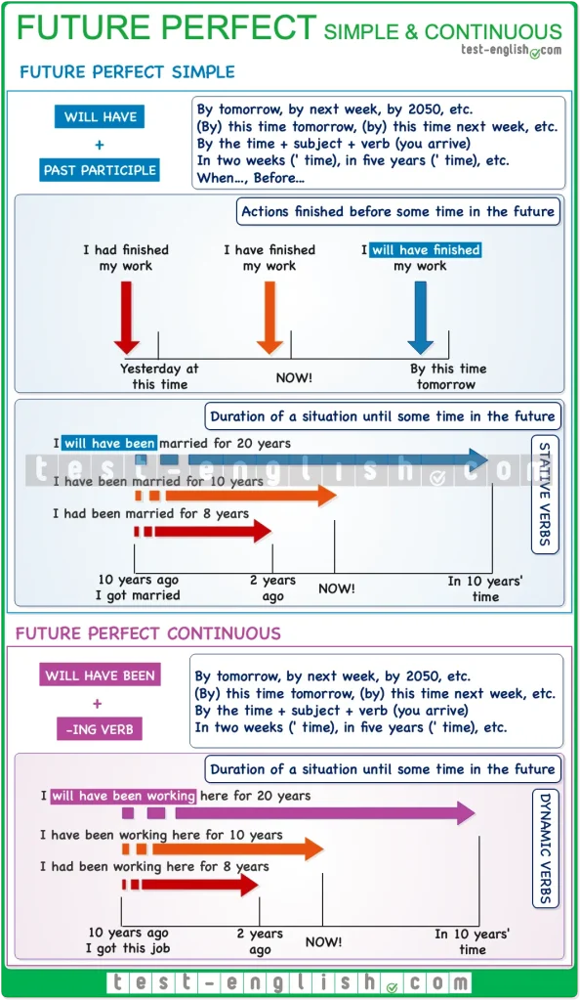
FUTURE PERFECT

Slide 8
Practice makes perfect ☺
https://test-english.com/grammar-points/b1/future-forms/
https://test-english.com/grammar-points/b2/future-forms-expressing-future-time/
More homework exercises available on IE ☺

Slide 9
#neverstoplearning

