Slide 1
ENGLISH FOR IT
Instructions for attending courses and taking exams
academic year 24/25
Notes:
Ažurirati naziv kolegija.

Slide 2


Slide 3
Organization of lectures and practical classes
Course coordinator: | Tihana Banko | tihana.banko@algebra.hr
Course assistant: | Ana Gudelj | ana.gudelj@algebra.hr
Conducting classes: | Lectures | 1 hour per week Total: 15 hours
 | Practical classes | 2 hours per week Total: 30 hours
 | TOTAL | 3 hours per week AS PER SCHEDULE (65 min + break 10 min + 60 min)

Slide 4
Course information
4 ECTS credits = 120 student working hours
  15 hours of lectures
  30 hours of practical classes
  75 hours of working from home
Obligatory course

Slide 5
Course objective
use of correct professional terminology in IT
use of correct grammar in business conversations
English is the only foreign language that students learn at Algebra University College. This module teaches students the correct English terminology and grammar used in different business situations with an emphasis on the IT industry. This modules prepares students for all other modules of this study programme that use English terminology and language skills.
It is important for students to take this module to develop their English language skills, which are necessary in the IT industry. English is the main language of computer science and the knowledge students acquire in this module will contribute to the overall skillset for their future employment. This module will expose students to a particular experience when dealing with business situations in the IT industry, both in written and oral form.

Slide 6
Learning outcomes
Outcome | MINIMAL LEARNING OUTCOMES (upon the successful completion of the module, a student will be able to:) | DESIRED LEARNING OUTCOMES (upon the successful completion, a student should be able to:)
I1 | Use technical terminology from the professional literature in given exercises | Use technical terminology from the professional literature in everyday communication
I2 | Use simple grammatical structures in given exercises | Use simple grammatical structures in everyday communication
I3 | Hold a simple presentation in English by using professional language | Hold a complex presentation in English on a specific professional subject
I4 | Integrate technical terminology into new contexts in English in given exercises | Integrate technical terminology into new contexts in English in everyday communication
I5 | Use more complex grammatical structures in English in given exercises | Use more complex grammatical structures in English in everyday communication
I6 | Write a simple summary of a professional text in English | Write a comprehensive summary of a professional text in English

Slide 7
Thematic units of lectures
 | TOPIC
Week 1 | Introduction to the course obligations and literature, Presentation Guidelines
Week 2 | Computer essentials - hardware
Week 3 | Inside a computer system – processing and memory
Week 4 | Input and output devices
Week 5 | Operating systems
Week 6 | Application software – word processing, spreadsheets and databases
Week 7 | Jobs in IT industry
Week 8 | Revision for the midterm exam
Week 10 | The Internet– web pages, hosting, pricing, e-commerce
Week 11 | Interactions – Enterprise social media, video conferencing, netiquette
Week 12 | Webdesign and architecture
Week 14 | Program design, computer languages and Java
Week 15 | Networks and Internet security
Week 16 | New technologies and future trends
Week 17 | Revision for the final exam

Slide 8
Thematic units of practical classes
 | TOPIC
Week 1 | Test on the students’ prior knowledge of English
Week 2 | Present Simple and Continuous
Week 3 | Modal verbs
Week 4 | Future forms
Week 5 | Gerunds and infinitives
Week 6 | Relative clauses
Week 7 | Past Simple and Past Continuous
Week 8 | Revision for the midterm exam
Week 10 | The Conditionals
Week 11 | The Passive Voice
Week 12 | The Present Perfect Tense
Week 14 | The Past Perfect Tense
Weeks 15 and 16 | Reported Speech
Week 17 | Revision for the final exam

Slide 9
Literature
Obligatory:
Hill, D. (2012). English for Information Technology 2. Pearson Education ELS.
Algebra Student’s Grammar Handbook (available on IE)
Recommended:
Remacha Esteras, S. (2008). Infotech – English for computer users. CUP Cambridge
Gourlay L., Hullock P. (2006). English for IT and the Internet.Thomson (Language Teaching Publication Series)
Marks, J. (2007). Check your English vocabulary for computers and information technology. A&C Black Publishers Ltd, London.
Olejniczak, M. (2011). English for Information Technology 1. Pearson Education ELS.
Butterfiled, A. Ngondi, G.E. & Kerr, A. (Ur.) (2016). A Dictionary of Computer Science 7th Edition. OUP.
Murphy, R. (2019). English Grammar in Use. CUP.
Additional:
Bernstein, J. (2018) Computers Made Easy: From Dummy to Geek. [s.l.] Independently published.
Frick, E. (2019) Information Technology Essentials: An Introduction to Information Technology. [s.l.] Frick Industries LLC.

Slide 10
What is necessary to get a signature?
In order to obtain the right to a signature, it is necessary to participate in class at the percentage rate prescribed by the Book of Regulations on studies and studying.
Lectures and practical classes participation
At least 50 % of physical presence in lectures | At least 60 % of physical presence in practical classes
Whoever fails to obtain a signature will have to enroll in the same course the following year, to pay the enrollment and does not have the right to take the exam.

Slide 11
Passing this course
A course has 6 defined learning outcomes.
In order for students to pass a course, they need to achieve at least 50% of credits of the total credit amount within each of the learning outcome.
If students fail to achieve at least 50 % of credits of a learning outcome, they can retake that learning outcome during the next exam period.
The learning outcome evaluation methods:
  Midterm exam
  Exam
  Schoolwork
  Presentation

Slide 12
How the points are allocated to specific learning outcomes
Outcome | Midterm | Exam | Presentation | Schoolwork | MAX
I1 | 15 |  |  | 6 | 21
I2 | 15 |  |  | 6 | 21
I3 |  |  | 6 |  | 6
I4 |  | 15 |  | 6 | 21
I5 |  | 15 |  | 6 | 21
I6 |  | 10 |  |  | 10
TOTAL | 30 | 40 | 6 | 24 | 100

Slide 13
Grading
Number of points achieved | Grade
0,00 – 50,00 | 1 (insufficient)
50,01 – 58,00 | 2 (sufficient)
58,01 – 75,00 | 3 (good)
75,01 – 92,00 | 4 (very good)
92,01 – 100,00 | 5 (excellent)

Slide 14
Presentation (LO3)
Presentation weighs 6 points and is obligatory part of the course.
Without the presentation grade (which must be minimum 3 points), you cannot pass this course.
Instructions and guidelines for Presentation are published on InfoEduca.
Presentations are held according to a prearranged schedule published on MS Teams – make sure you DO NOT MISS your time slot!

Slide 15
Schoolworks
Schoolworks are short quizzes done in practical classes:
Week 4 (21.-26.10.24) – 6 points- vocabulary (LO1)
Week 7 (11.-16.11.24) – 6 points – grammar (LO2)
Week 12 (16.-21.12.24) – 6 points – vocabulary (LO5)
Week 16 (13.-18.01.25) – 6 points – grammar (LO4)
If you are not present in class when the schoolwork is conducted, you cannot make it up later.

Slide 16
IMPORTANT!
SCHOOLWORKS are not obligatory, BUT…..
​
The number of points gained in SW does not allow students to pass the written exam, but they are a chance to get the highest grade!
It is not possible to make up for the missed SW after the end of the course.

Slide 17
Summary (LO6)
Writing a summary is a separate outcome that is written during the second midterm exam / final exam.
Instructions for writing a summary will be published in due time under teaching materials on Infoeduca.​

Slide 18
Exams
According to the academic calendar 2024 /25 exam weeks are:
25.11.-30.11.2024 - MIDTERM
27.1.-15.2.2025 - EXAM
The exam schedule will be published in due time on IE.

Slide 19
IT IS IMPORTANT to follow all announcements and reminders on IE and to respect all submission deadlines.

Slide 20
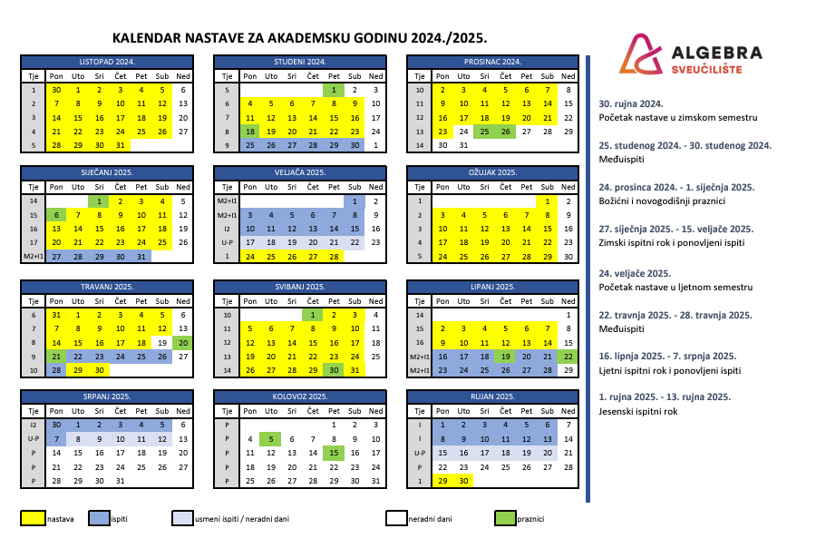

Slide 21
Academic standard of conduct
  In written and oral communication it is necessary to follow the rules of business communication appropriate for the academic level.
  It is necessary to abide by the strictly defined deadlines for task submissions (homework, seminar papers, projects, etc…).
    Every task, homework, project etc…, submitted after the defined deadline will not be evaluated nor graded.
  Only those students who can confirm their attendance, will be considered as present.
    Signing other students, or registering their card is not allowed and may be subject to disciplinary action. The teacher will delete the student's attendance if they determines that the student is registered and is not present at the class.

Slide 22
Rules of conduct during classes
  One has to come to class on time.
  Upon entering the classroom, student registers for classes with a card and then sits in an accessible place for work.
  Disruption of class and inactive class participation is not allowed.
    Continuous breaking of this rule is sanctioned by reporting students to the Disciplinary Board.

Slide 23
Exams
Each course complies with the 3 + 1 rule.
  This means that a student can take an exam a maximum of 4 times.
    3 regular exams – included in the tuition fee
    1 extraordinary exam – 4th registration of exam is charged extra, pursuant to the Decision on Reimbursement of Expenses
  The deadline for passing an exam is 12 months from the day of enrolment in the course.
  If a student fails to pass a course within 12 months, they must re-enrol in the course and retake all learning outcomes defined in the course.
Keep track of deadlines for registering and cancelling exams on IE
  If you failed to register an exam on time, you cannot take neither the written nor the oral exam and you can not defend your project.
  If a student registers for multiple examination periods of the same course, after obtaining a satisfying grade, they must cancel theit registration for all subsequent examination periods of that course. Otherwise, an insufficient (1) will be recorded in Infoeduka for that student.

Slide 24

All rules apply to all students ☺
In case you do not have the attendance grade
→ You cannot get the signature to take the exam → you need to re-enroll the course next year
2. In case you do not have enough points to pass a learning outcome
→ do not ask teachers to award undeserved points→re-apply for the exam → learn it!→ do better!
3. In case you need points for a higher grade→ read No. 2☺

Slide 25


Food for thought:
QUOTES ABOUT LANGUAGE LEARNING

Slide 26
Break a leg!
#neverstoplearning

