Slide 1
Database normalization

Slide 2
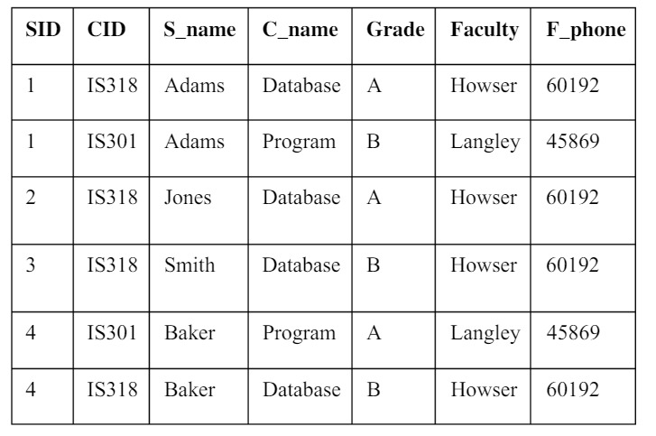
Exercise 1
In which normal form is this table?
Why?
Notes:
1NF

Slide 3
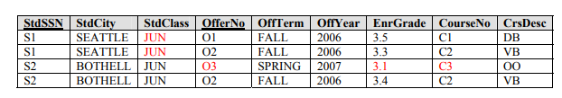
Exercise 2
Based on this table
provide examples of >
The insertion anomaly
The update anomaly
The deletion anomaly
Notes:
The insertion anomaly: Occurs when extra data beyond the desired data must be added to the database. For example, to insert a course (CourseNo), it is necessary to know a student (StdSSN) and offering (OfferNo) because the combination of StdSSN and OfferNo is the primary key. Remember that a row cannot exist with NULL values for part of its primary key.  The update anomaly: Occurs when it is necessary to change multiple rows to modify ONLY a single fact. For example, if we change the StdClass of student S1 (JUN), two rows, row 1 and 2 must be changed. If S1 was enrolled in 10 classes, 10 rows must be changed.  The deletion anomaly: Occurs whenever deleting a row inadvertently causes other data to be deleted. For example, if we delete the enrollment (EnrGrade) of S2 in O3 (third row), we lose the information about offering O3 and course C3 because these values are unique to the table (cell). Furthermore O3 is a primary key.

Slide 4
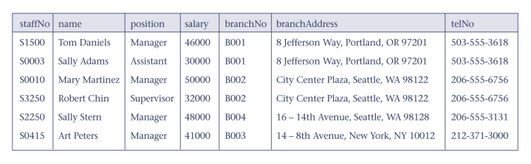
Exercise 3
Normalize the following table:

Slide 5
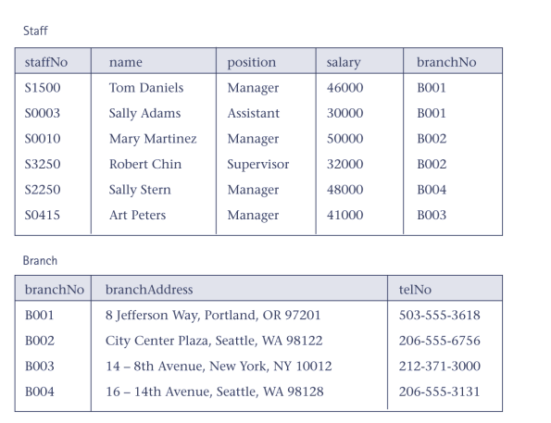
Exercise 3

Slide 6
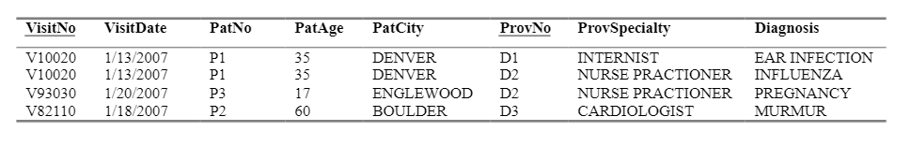
Exercise 4
Create a version of this table(s) in 1NF,2NF and 3 NF

Slide 7
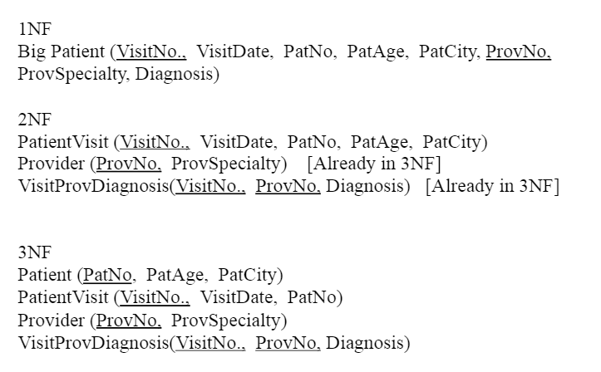
Exercise 4
Create a version of this table(s) in 1NF,2NF and 3 NF

Slide 8
Exercise 5
Work in pairs:
  Make an example of table in 0NF or 1NF and give it to your
  neighbor
  Exchange chaotic tables and compare results

