Slide 1
ENGLISH FOR IT
Week 4 VOCABULARY
Input devices

Slide 2
Today you will:
Describe input devices
Identify different keys on a keyboard and explain their functions
Learn about OCR
Describe mouse actions
Discuss speech recognition software
Talk about scanner functions
Learn some more IT initialisms

Slide 3

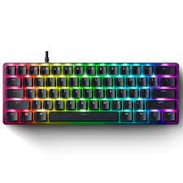

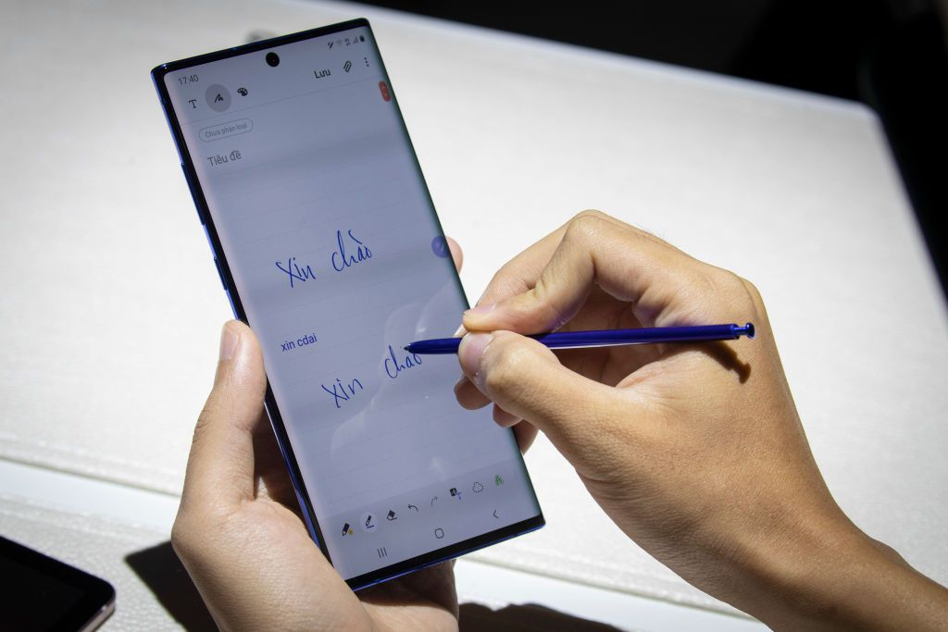
Listen to a computer technician describing 3 input devices. Write down which device he’s talking about.
_______________________
2. _______________________
3. _______________________
Notes:
Keyboard, mouse, stylus/ light pen

Slide 4
Read and write the name of the input device
The most basic input device to enter data on the system or any other device with the help of the keys.
A hand-supported input device that allows users to move the cursor on the screen. It works on a flat surface with a wheel between the left and right buttons. Laptops have a touchpad with the same function.
A pen-like structure allowing users to select on the screen and even draw on it. Photocells and optical systems are inbuilt inside the small tube allowing the flow of signals to the CPU.
A common accessory for notebooks and laptops, that works as a replacement for a mouse. With a similar structure, it has a half- inserted ball which the fingers move to send signals for cursor movement. It is kind of stationary, taking very little space. It comes in a ball, button, and square shape as well.
It works like a photocopy machine as an input device to make information available on a PC from paper.

Slide 5
Check your answers
The most basic input device to enter data on the system or any other device with the help of the keys. | KEYBOARD
A hand-supported input device that allows users to move the cursor on the screen. It works on a flat surface with a wheel between the left and right buttons. Laptops have a touchpad with the same function. | MOUSE
A pen-like structure allowing users to select on the screen and even draw on it. Photocells and optical systems are inbuilt inside the small tube allowing the flow of signals to the CPU. | STYLUS / OPTICAL PEN / LIGHT PEN
A common accessory for notebooks and laptops, that works as a replacement for a mouse. With a similar structure, it has a half- inserted ball which the fingers move to send signals for cursor movement. It is kind of stationary, taking very little space. It comes in a ball, button, and square shape as well. | TRACK BALL
It works like a photocopy machine as an input device to make information available on a PC from paper. | SCANNER

Slide 6
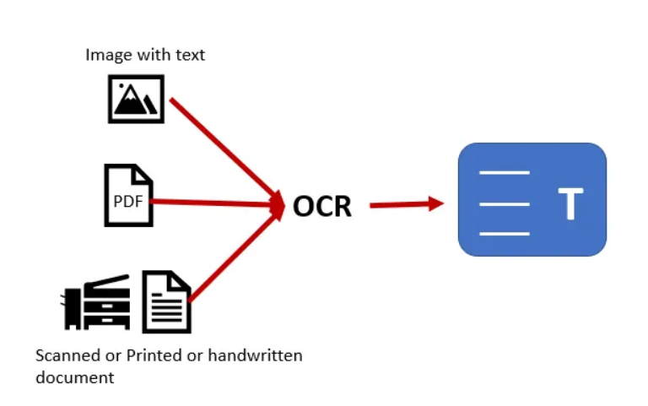
Optical Character Recognition / Reader (OCR)
OCR (optical character recognition or optical character reader) is the electronic or mechanical conversion of receipt images, receipt paper, and handwritten or printed text into machine-encoded text using software. In other words, transforming physical documents into digital data.

Slide 7
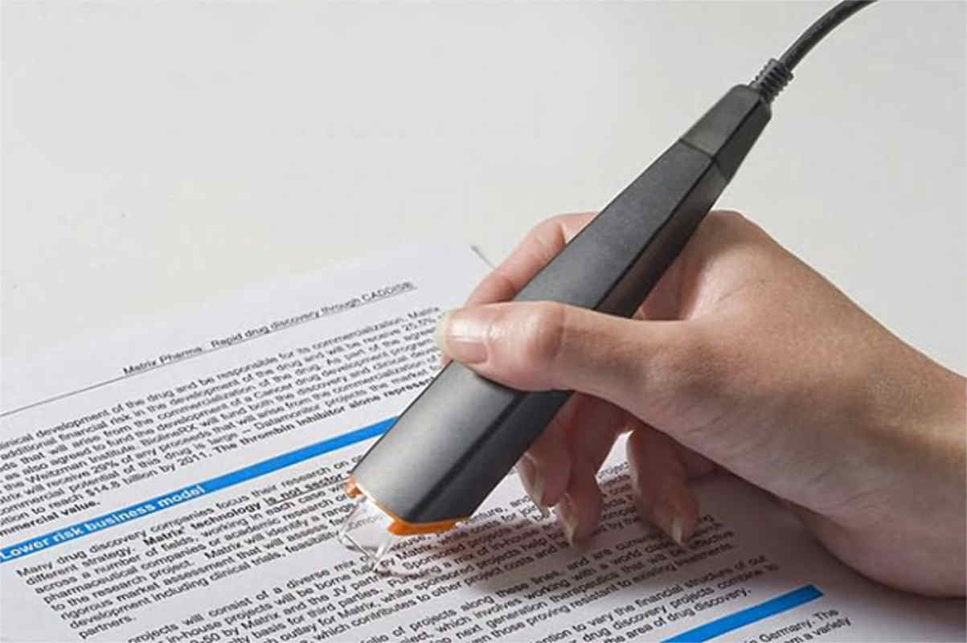
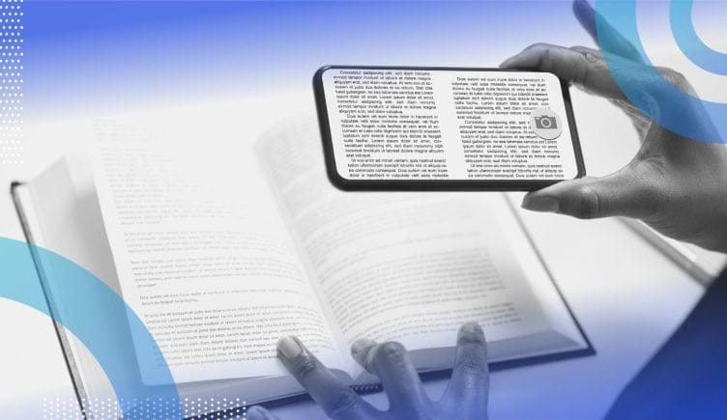
Optical character recognition devices
Do you use OCR and what for? Which apps do you use? What are the benefits of OCR?

Slide 8
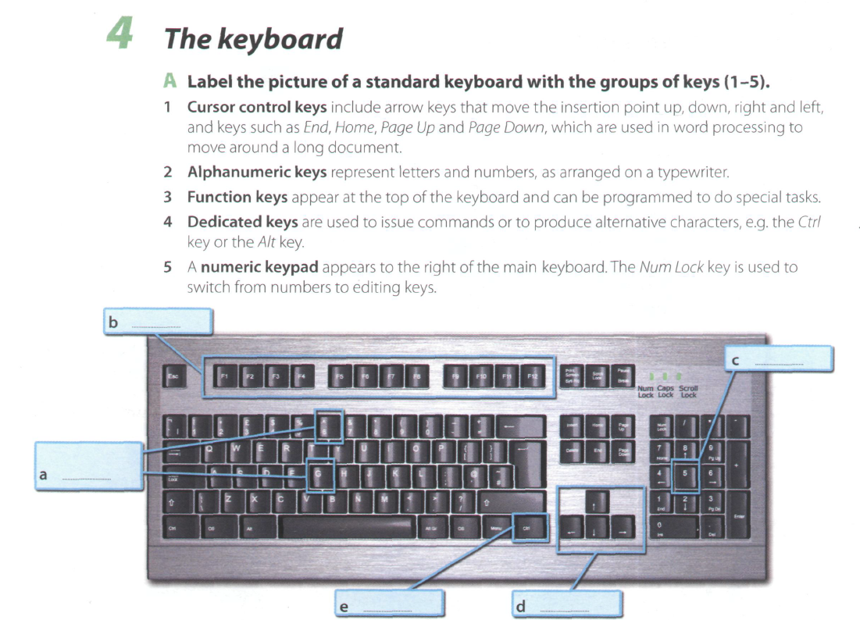

Slide 9
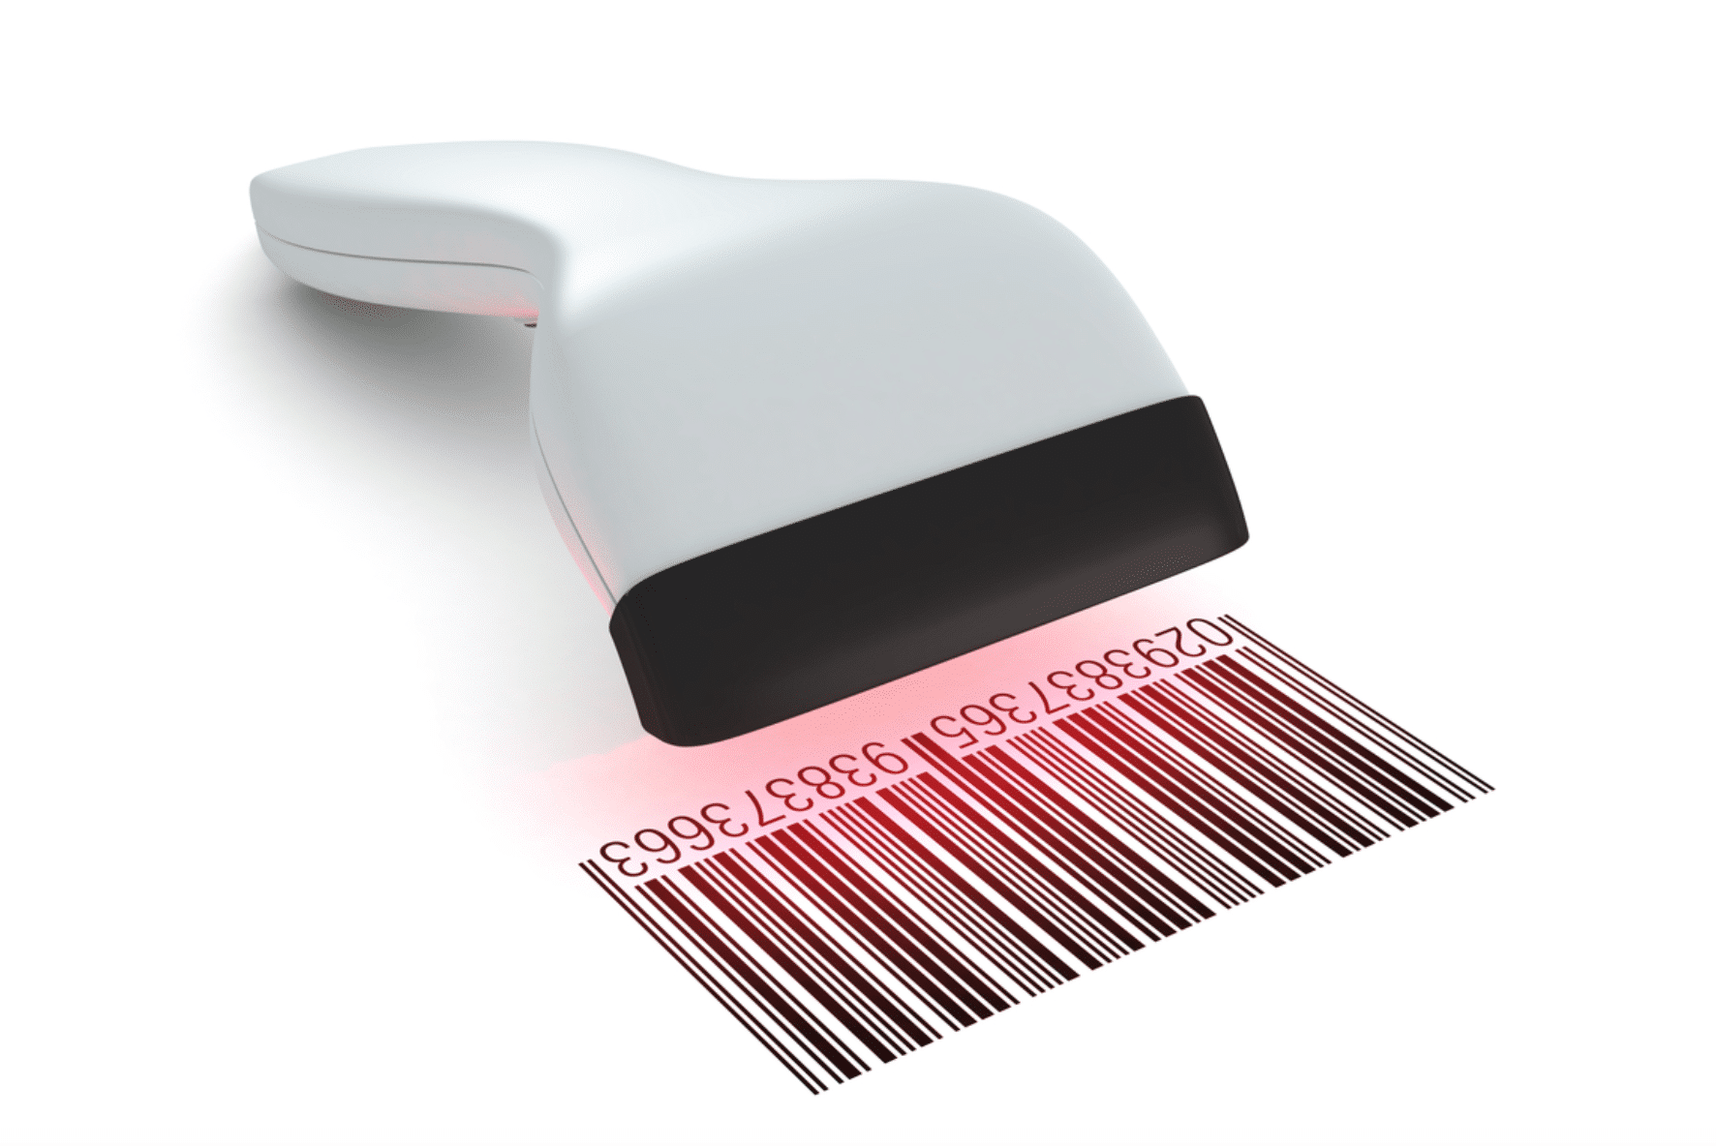
Bar code reader
Bar Code Reader is a reading device used to read barcode data like on goods, books, etc. It can be a handheld scanner or a stationary one but they both scan the image by converting it to alphanumeric value on the computer.

Slide 11
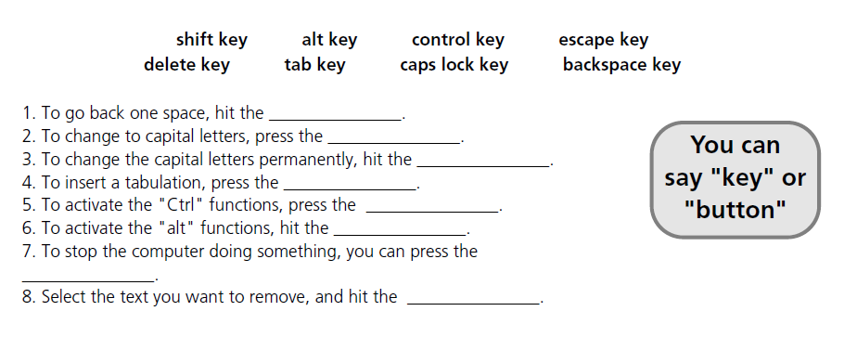

Slide 13
Speech recognition systems. Listen and answer.
Do you use voice commands?
In what situations?
Notes:
The keyboard and the mouse
By using high quality headset microphone
Around 98%
By reading aloud sample text for a few minutes
Proper names, abbreviations and unusual words

Slide 14
Scanners
Notes:
Photocopier
Computer
OCR (optical character recognition)
Text, colored pictures and even small 3D objects
35mm slides
Small pictures and logos

Slide 15
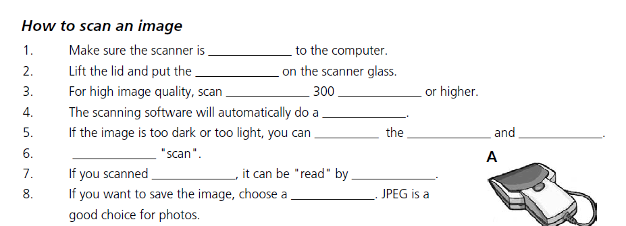
Complete the text.
Use: click, OCR software, connected, contrast, text, original, file format, preview, at, dpi, brightness, adjust

Slide 16
Check your answers:
Connected
Original
At / dpi
Preview
Adjust / brightness / contrast
Click
Text / OCR software
File format

Slide 17
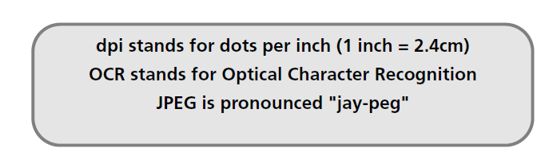
More initialisms
Do you know what JPEG’s short for and why? Google it!
Notes:
JPEG (Joint Photographic Experts Group) Named as a Group of Experts in Still Photography, this name refers to a standard in data compression for still images.
In particular, the work of the group has been developed with images encoded with the ITU-R 601 standard. JPEG uses DCT compression and offers data compression of between 2 and 100 times the original size.

Slide 18
Resources:
Remacha, Infotech – Units 5, 6 (pp 22-28) https://www.academia.edu/28436822/Infotech_english_for_computer_users_Students_Book_4th_Edition
Marks, Vocabulary Book – 1.4, 1.5, 1.6 (pp 10 12) https://www.scribd.com/document/266312924/Check-Your-English-Vocabulary-for-Computers-and-Information-Technology
https://data-flair.training/blogs/input-output-devices-of-computer/

Slide 19
#neverstoplearning

