Slide 1
ENGLISH FOR IT
Weeks 10 VOCABULARY
Jobs in ICT

Slide 2
In this lesson, you will:
identify jobs in ICT and discuss their responsibilities
discuss personal qualities and professional skills needed for a particular job in ICT
understand and respond to job adverts
revise present perfect and past simple tense
go through a sample CVs and application letter in preparation for your homework

Slide 3

Listen to 6 people introducing themselves. What jobs do they do?
database administrator
helpdesk supervisor
project manager
software developer
support technician
systems analyst

Slide 4
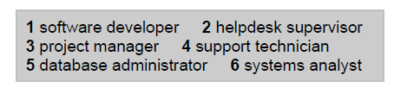
Check your answers

Slide 6
Check your answers
hardware engineer
software engineer
blog administrator
DTP operator
network administrator
webmaster
computer security specialist
help desk technician

Slide 7


Slide 8
Check your answers
Speaker 1: webmaster
Speaker 2: help desk technician
Speaker 3: hardware engineer
Speaker 4: computer security specialist

Slide 12
A LETTER OF APPLICATION
Read the letter of application on page 131 and answer these questions:
Complete the application letter with :
for
since
ago
until

Slide 13

Senior Programmer.
She saw the advertisement in “The Times”.
She has been working as a software engineer for the last 3 years.
She has written programs in COBOL (for commercial use) and in C (for large retail chains).
She spent 3 months in Spain 2 years ago.
1. until 2. For 3. since 4. ago

Slide 16
Check your answers
Computer Sciences
Analyst programmer for a year
general commercial use
IBM mainframes
Microsoft Access and dBase 5
wants something more demanding and with more responsibility; wants to learn about a new industry

Slide 20
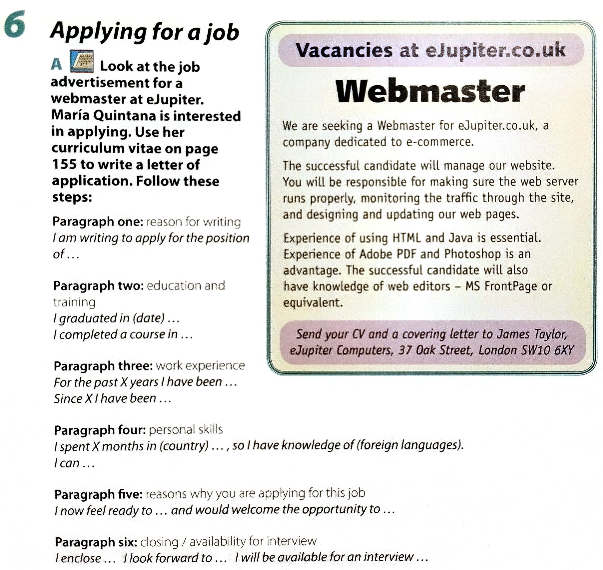

Slide 21
Resources:
Remacha, Infotech –Unit 26 (pp 129-133) https://www.academia.edu/28436822/Infotech_english_for_computer_users_Students_Book_4th_Edition
Hill, English for Information Technology 2. Pearson Education ELS - Unit 1 (pp 4-5), https://pdfcoffee.com/qdownload/english-for-information-technology-2-10-pdf-free.html

Slide 22
#neverstoplearning

