Slide 1
ENGLISH FOR IT
Weeks 11 VOCABULARY
The Web and the Internet

Slide 2
In this lesson, you will:
Understand the difference between the Web and the Internet
Study vocabulary related to the Internet and email
Understand how the Internet works
Understand the anatomy of an email
Recognize basic features of a typical webpage

Slide 3
Discuss in pairs/groups
How would you define the Internet?
What is the difference between the Internet and the Web?
List all the things you can use the Internet and the Web for.

Slide 4
Check your answers
The Internet (or Net) is a global network of computer networks, which allow organizations and individuals to share all sorts of information and computer resources
You can use the Internet to send and receive email, explore the Web, transfer files, have online conversations, take part in online forums, use remote computers.
You can use the Web to find, stream and download games, music or videos, to buy products online, to search for information etc.

Slide 5
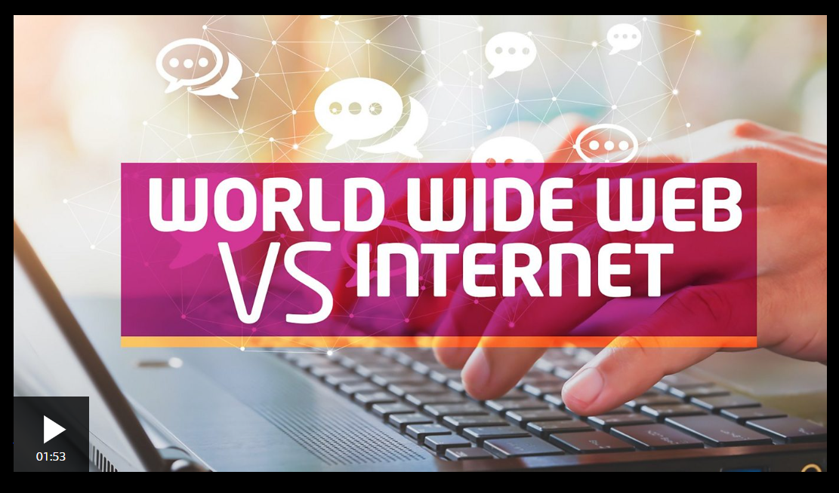
https://www.bbc.co.uk/newsround/av/47523993

Slide 6

Complete these notes in pairs.
Then, listen to the shop assistant explaining the customer about the Internet and check your answers.

Slide 7
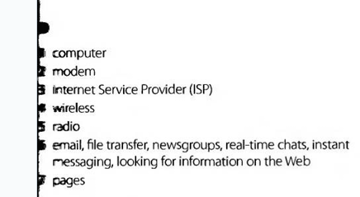
Key

Slide 8
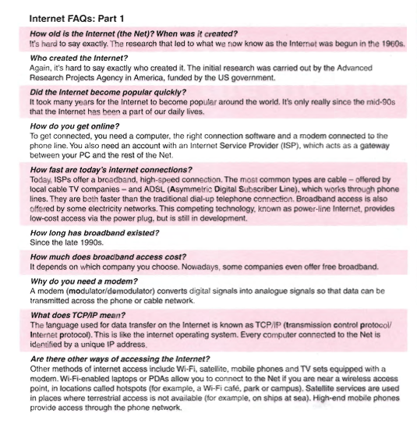

Slide 10
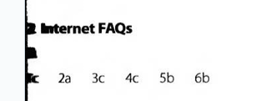
Key

Slide 12

Key

Slide 13
What’s the word?
____________ is a system used to distribute email to many different subscribers at once.
______________is a program used for displaying web pages.
______________ means to connect to a computer by typing your username and password.
_______________ is a series of interrelated messages on a given topic.
________________ is a program for reading Usenet newsgroup.

Slide 14
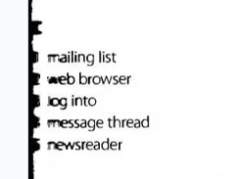
Key

Slide 15
Read the text on page 83 and check the anatomy of an email

Slide 18
Read the text on page 84

Slide 20
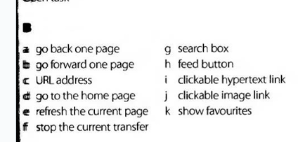
Key

Slide 21
More vocabulary practice
3.1 The Internet: the basics (pp 50-51);
3.2 Internet browsers (p 52);
3.3 Search engines (p 53)

Slide 22
Resources:
Remacha, Infotech –Unit 16 (pp 79-81, 83);Unit 17 (p 84) https://www.academia.edu/28436822/Infotech_english_for_computer_users_Students_Book_4th_Edition
Marks: Vocabulary Book – 3.1 The Internet: the basics (pp 50-51); 3.2 Internet browsers (p 52); 3.3 Search engines (p 53): https://www.scribd.com/document/266312924/Check-Your-English-Vocabulary-for-Computers-and-Information-Technology
https://www.bbc.co.uk/newsround/av/47523993

Slide 23
#neverstoplearning

