Slide 1
STANDARDS IN INTERNET TECHNOLOGY APPLICATION
Excercise 11+13

Slide 2
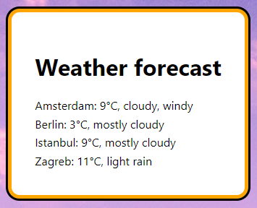
Task 02
Create an application that will show
cities and their weather forecasts in the
unordered list.
List of the cities with their forecasts is
available in the „cities” variable.

Slide 3
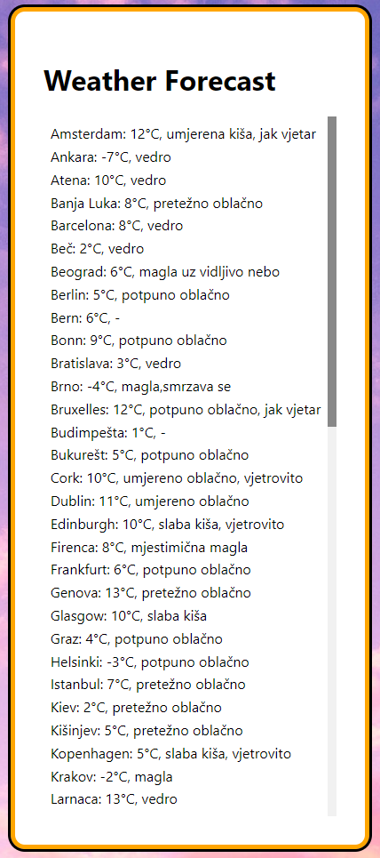
Task 03
Create an application that will show
cities and their weather forecasts in the
unordered list.
List of the cities with their forecasts is
available at the following URL:
http://www.fulek.com/VUA/KS/GetPrognozaGradovaJSON

Slide 5
Naslov ponekad može biti i na crnoj pozadini
Podnaslov u boji

Slide 6
Hvala na pažnji!

