Slide 1
4
LONG TAIL STRATEGY, KEYWORDS, SEO & AI

Slide 2
Go big with content marketing by going small with your niche.

Slide 3
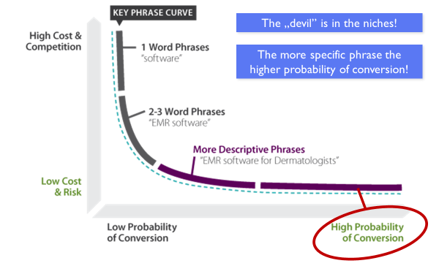
KEYWORDS UNDERSTANDING

Slide 4
LONG TAIL STRATEGY
Long tail keywords are longer, more specific phrases (usually 3+ words) that have:
LOWER monthly search volume, BUT
HIGHER conversion rates
LOWER competition

Slide 5
LONG TAIL STRATEGY
Example:
Short tail: "sneakers" (high competition)
Mid tail: "nike sneakers"
Long tail: "nike air running shoes women's size 8"

Slide 6
LONG TAIL STRATEGY
Why long tail is powerful:
People searching for specific phrases are often closer to making a purchase
It's easier to rank for them due to lower competition
They often have better conversion rates because they target a specific need
The secret is that long tail keywords make up about 70% of all internet searches. Although each individually has low volume, together they bring significant traffic.

Slide 7
LONG TAIL STRATEGY
The secret is that long tail keywords make up about 70% of all internet searches. Although each individually has low volume, together they bring significant traffic.
Bonus tip: Long tail is particularly useful for new websites that are just starting to position themselves because it's easier to break through with specific phrases than generic terms.

Slide 8
MAIN QUESTION ABOUT KEYWORDS…
In English, the issue is different since English doesn't have cases like Croatian. However, English has its own variations of words:
Singular vs. Plural ("mountain bike" vs. "mountain bikes")
Different word forms ("ride" vs. "riding" vs. "rides")
Possessive forms ("bike's features")
Google handles these variations similarly to how it handles Croatian cases - intelligently and contextually

Slide 9
MAIN QUESTION ABOUT KEYWORDS…
Croatian
BASIC RULE:
Google understands different word variations in both English and Croatian
„brdski bicikl/mountain bike," „brdski bicikli/mountain bikes," „brdski biciklizam/mountain biking"
It recognizes these are all part of the same topic

Slide 10
MAIN QUESTION ABOUT KEYWORDS…
For Croatian
BUT STATISTICS SHOW:
The basic form („brdski bicikl/mountain bike") is most commonly used in searches
Best practice is to use this basic form in key places (title, meta description, H1)

Slide 11
MAIN QUESTION ABOUT KEYWORDS…
PRACTICAL ADVICE:
Use the basic form in main SEO elements
Feel free to use different variations in the text - it's more natural for reading
Avoid "keyword stuffing"

Slide 12
MAIN QUESTION ABOUT KEYWORDS…
MODERN SEO:
Focus is on search intent
Natural language is more important than strict repetition of the same word form
In short: You don't need to strictly stick to the same word form - Google is smart enough to understand context!

Slide 13
MAIN QUESTION ABOUT KEYWORDS…
The key difference between English and Croatian SEO in this regard is that Croatian has more complex word variations due to its case system, but Google has been optimized to handle both languages' peculiarities effectively.

Slide 14
ZADATAK:
Odredite PET TEMA/TOPICS
I ZA ISTE NAPIŠITE 10 KLJUČNIH RIJEČI

