Slide 1
COMPUTER TOOLS IN VISUAL COMMUNICATION
EXERCISE | Adjustment layers
^{Week 5}
Notes:
Ažurirati naziv kolegija.

Slide 2
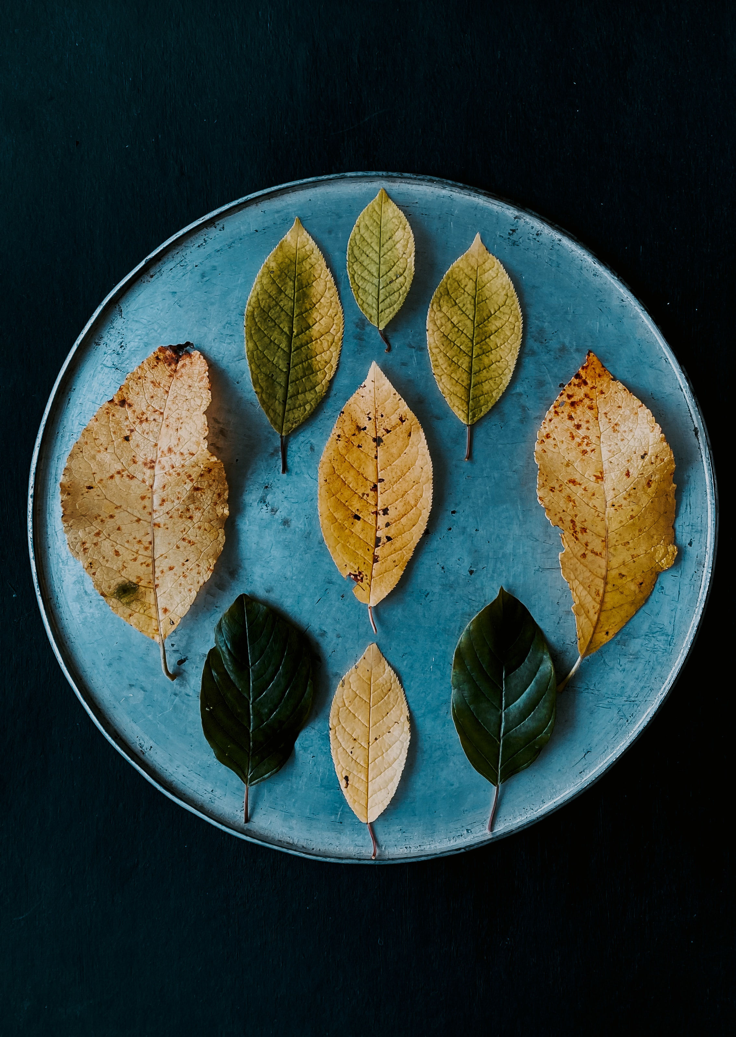


Slide 3
Using DIFFERENT adjustment and fill layers, and blending modes please chenge image „exercise_adjustment layers” similar to example on the previous slide
Your final image doesn’t need to be an exact copy of the example image, jus please follow the general idea, and turn look and feel of the image to Autumn colors

Slide 4
Thank you!
☺​

