Slide 1
3rd meeting with mentor
January, 2024
Academic year 2023/2024
Notes:
We greet the students, wait for them to settle in the classroom, have a short casual conversation.

Slide 2
Reminder:
@
Communication must take place via algebra.hr email
Notes:
Some students still send emails from their private emails or racunarstvo.hr email, but a large number of these emails go to SPAM. In addition, in order to protect their personal data, it is necessary for us to use that email.

Slide 3
Information
Winter exam period starts on January 29th and end on February 17th
  There are no classes during that week, only exams
The prerequisite for taking the exam is to fill out the survey, digital signature and register for the exam in Infoeduka on time
Notes:
Let's remind the students that the end of semester is close and that they should prepare for the winter exam period.
They probably know, but they still need to be told, that there are no classes during the winter exam period.
In order for the student to be able to take the exam, he must fill out the survey, get the digital signature and register the exam in Infoeduka on time
More about digital signature will be on next slide…

Slide 4
Digital signature
The conditions for exercising the right to a digital signature are the achievement of minimum attendance, and if there are other conditions defined for a digital signature in the case, the achievement of that condition as well
  Additional requirements are prescribed in the instructions for attending and passing the course and are listed in the introductory presentation
In the event that the student did not achieve the minimum attendance, and the reason for this is exceptional circumstances that are acceptable, one should act in accordance with the Decision on acceptable and unacceptable exceptional circumstances (available on web site)

Slide 5
Courses from the winter semester you can take:
On 2 deadlines in winter exam period (January-February 2024)
On 1 deadline in summer exam period (June-July 2024)
On 1 deadline in autumn exam period (September 2024)
  On the mentioned exam dates, you can take learning outcomes that you have not passed so far
If you do not pass the course by the deadline in September at the latest, then you must re-enroll and repeat it in next academic year
Notes:
Remind students that the winter term is not the last term in which they can pass the course.
Students must pass the course within 12 months of enrolling in the course. There are 4 deadlines for this. (They also had M1, but it is not counted as term). Therefore, the courses they enrolled in the winter semester of this academic year should be passed by the beginning of the winter semester of the next academic year, no later than the deadlines in September of the current academic year. At all these deadlines, students can take the learning outcomes that have not passed, which means that they can divide the material into smaller units.

Slide 6
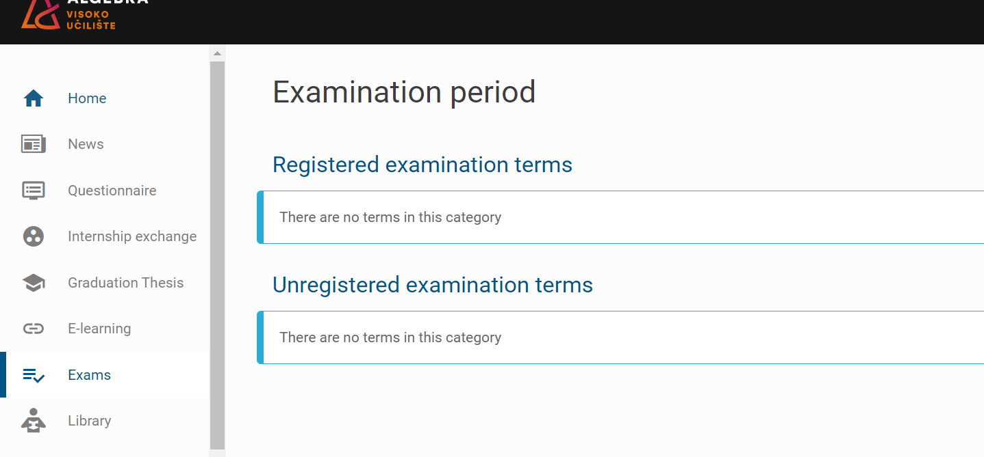
Notes:
Under the exams menu, the exam deadlines for intermediate exams and exams will be visible, and exams are registered there.
I can also see what is the deadline for registration and the deadline for deregistering the exam. If they did not register or deregister for the exam on time, there is no possibility to change anything later.
Nothing prevents students from registering for the exam 10-15 days earlier or immediately as soon as the deadlines open, they do not have to wait until the last minute.

Slide 7




GOLDEN RULE 3
You can’t apply for exams late. You can’t turn in your papers late. Look at your calendar, keep track of your obligations, finish them on time, and we promisse you’ll get a nice reward: your own success.
Notes:
All exams must be registered in Infoeduca on time, because without registration it is not possible to take the exam. If someone forgot to register for the exam, or was late to do it on time, unfortunately they cannot take the exam. Subsequent registrations for the exam are not possible, because for the organization of the exam it is necessary to know in time how many students will take which exam.
Also, assignments, term papers and projects must be submitted on time, subsequent submissions cannot be accepted.
Why? Because time is also one of the elements that make up the grade. It is not the same whether someone had 1 day or 10 days available to complete the task.
And because completing assignments on time is one of the academic and professional standards.

Slide 8

Materials for the preparation of the midterm exam
Literature
Teaching materials published in Infoeduka
Notes:
Till now, students should definitely have had the literature for the course. However, if there is someone who has not got it, send them to the Student Office.

Slide 9
Passing the course
In order for students to pass a course, they need to achieve at least 50% of credits of the total credit amount within each of the learning outcome.
If students fail to achieve at least 50 % of credits of a learning outcome, they are required to take the learning outcome during the next exam period.
The number of points cannot be compensated by an oral exam or in any other way that is not prescribed by the points structure
Notes:
They should already know this, but remind them that they must pass each learning outcome;
Ask them if they have information about which learning outcomes go into the first intermediate exam...

Slide 10



Don’t forget – what to bring to exam?
some kind of identification document (student card, passport, ID card, or other official document with the picture to prove your identity)
bring a pencil if you are writing the exam on paper
if a calculator is needed, bring a calculator, because you are not allowed to use your cell phone during the exam

Slide 11

Instructions for writing the exam
Exams can be written in two ways:
  Paper-pencil
  On the computer
The time for writing the exam is limited, the allocated time for writing a particular learning outcome is always indicated, and the total time for writing your exam is the sum of these times
Students themselves must take care to submit the exam on time, because the exam submitted after the allocated time will not be taken into consideration nor will it be graded
Notes:
So far, we have had a certain number of problems with submitting exams outside of time, and then there are complaints from students that they did not know that they had to submit on time, and that they thought that the guards should have warned them about the time, and that they were "only" late by one, five, ten or I don't know how many minutes, and the like.
That's why they should be clearly told that they have to take care of the time themselves (we finally have digital clocks in the classrooms whose batteries don't die right in the middle of the exam, so students can keep track of their time without a cell phone).

Slide 12
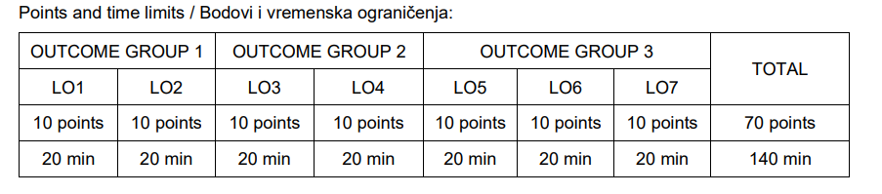
Example

Slide 13
Instructions for writing the exam
It is necessary to read the instructions carefully and act in accordance with the instructions
  Read the instructions before starting the exam and follow the instructions
It is especially important to follow the instructions for computer-based exams that are given in a specific way
  The use of mobile phones is not allowed while writing the exam, not even just to check the time
Notes:
On the next three slides there are some examples of instructions; you don't have to read these instructions or interpret them to the students, just somehow remind them that they have to read these instructions carefully, read them first, and then do as the instructions say

Slide 14
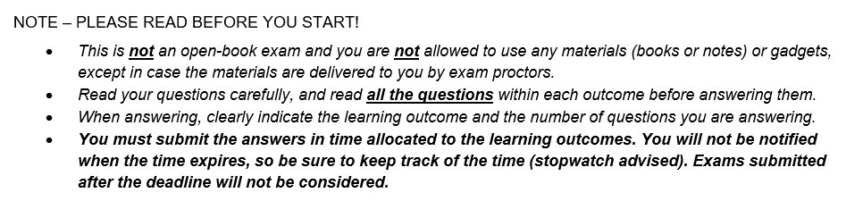
Example

Slide 15
Example
All files created by solving the exam (except files created by solving Outcome 1) are saved in the folder named name_surname_group, and this folder is compressed and delivered via the system https://results.vua.cloud.
Anything that is not properly named and saved will not be viewed or scored. Documents should be created in Office where you are logged in with your account from the @algebra.hr domain. Documents that will not be created and saved in the specified manner will not be viewed or scored.

Slide 16
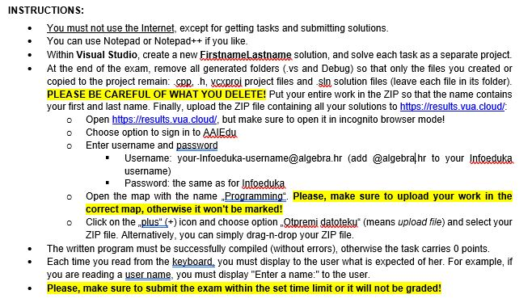
Example

Slide 17
Some important information about exams
If the student does not take the exam and has not de-registered, the exam is recorded as a failure (i.e. it is counted as appearing for the exam that the student did not pass) - therefore, if the student cannot take the exam, he/she should be de-registered
During the exam, the student will have to tell the person who supervises the exam which learning outcomes he is taking, and the it will be recorded - so take a close look at which learning outcomes you will write
Students themselves are obliged to monitor the time for submitting the exam, the guards do not have the ability to monitor and remind students when they should submit the exam
Notes:
Since you are all teachers at the same time, you are familiar with all the "challenges" we have with exams, so feel free to expand this information, if you feel it is necessary.

Slide 18
Some important information about exams
Unless otherwise stated in the exam instructions, the use of mobile phones, literature and other aids is not permitted during the exam
The use of illegal means results in the cancellation of the exam, interruption of the writing of the exam and reporting to the disciplinary committee
In case of suspicion of copying, the teacher has the right (but not the obligation) to invite students to verify the exam, and if the students do not respond to the verification, the case will be resolved by the disciplinary committee

Slide 19

All information about exams
All information is published in the Infoeduka system in notifications
Read the notifications carefully and regularly to register for the exams on time

Slide 20
Aftre winter exam period….
If you have successfully passed the course, return the books to the Student Office
Follow the information about the submission of the digital enrollment form for summer semester
Notes:
After the winter exam period, students who have successfully passed the course should return the books to the Student Office so that they can be used by other students.If they have not passed the course, they can keep the books until they pass it.
Instruct them to regularly follow the notifications on IE regarding the submission of the digital enrollment form in order to enroll in the summer semester.
If there are open questions, listen. What you can - answer. What you can't do, write it down somehow, and you'll let me know.

Slide 21

Next meeting…
Workshops with experts will be organized in the summer semester
Some of the topics will be methods for easier and faster learning, time management, personality traits...
Notes:
This is also the last meeting with the mentor.
Workshops with experts are planned for the summer semester. Their focus will be on time management, methods for easier and faster learning, personality traits or something in that direction.
Information about the workshops will be communicated via Infoeduka. Remind the students that although there will be no formal meetings like this, they can still contact you if they have a problem.

Slide 22
Thank you for attention!

