Slide 1


The basics of
Memory management in C-like languages
Dominik Despot, 1RP3, UC Algebra

Slide 2

The what
The why
The how

Slide 3

The "WHAT"

Slide 4
WHAT IS MEMORY MANAGEMENT

Slide 5


double pi=3.14;
return n;
int value;
goto top;
cout << „Hello world”;
while(true){
};
if(a>3)

Slide 6

Memory management in c-like languages

Slide 7
What is memory management?
Memory management is the act of preserving memory in order to write a more efficient program.

Slide 8
The "WHY"

Slide 9
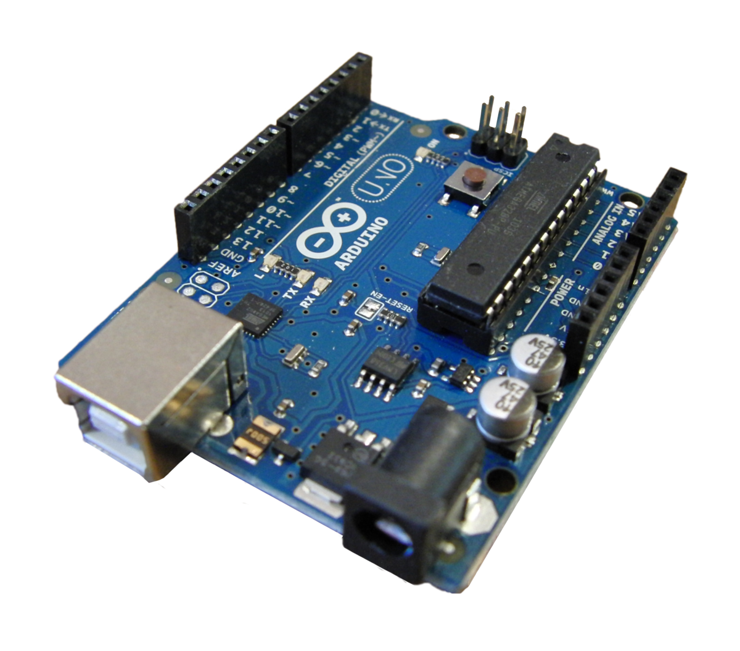
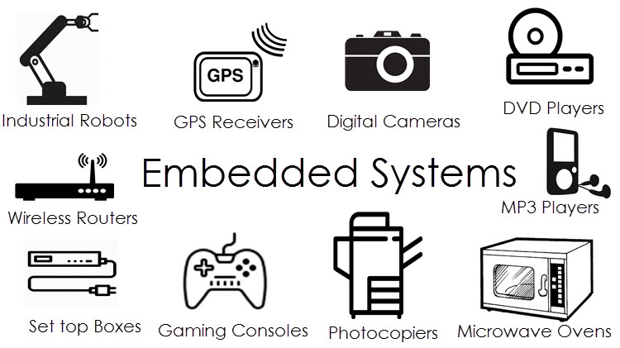
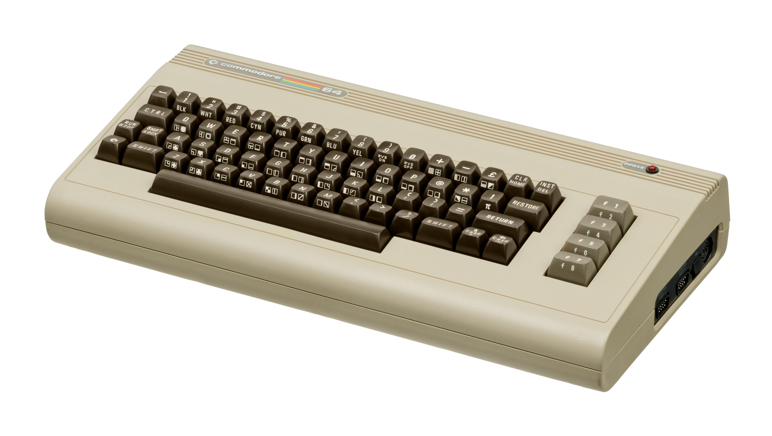
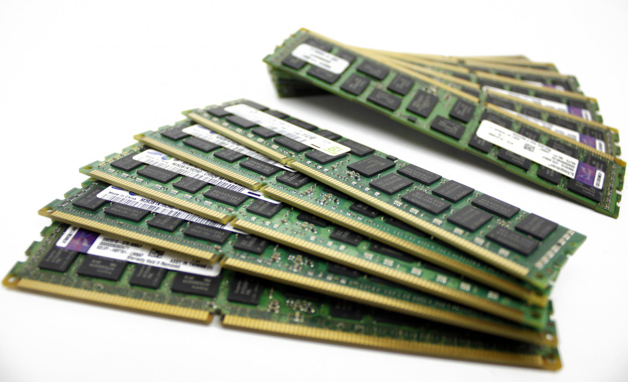
Limitations
Embedded systems
Microcontrollers
Older systems
Physical limitations

Slide 10
EFFICIENCY
Read this line:
May hereby a student by the name of John of this fine establishment be so kind as to pick up the spherical object intended for use as an outdoor playing object for a variety of sports, some of which include football, basketball...
Read this line:
Can you please pick up the ball, John?

Slide 11
The "HOW"

Slide 12
1. Get rid of redundant code

Slide 13
2. Delete variables after you’re done with them

Slide 14
3. Write code in functions

Slide 15
4. Use pointers, not local variables

Slide 16
5. Use the correct data type

Slide 17
6. Use the correct array size

Slide 18
7. Allocate memory dynamically

Slide 19
Example program
Display the average of these 3 numbers:
  18,20,35

Slide 20
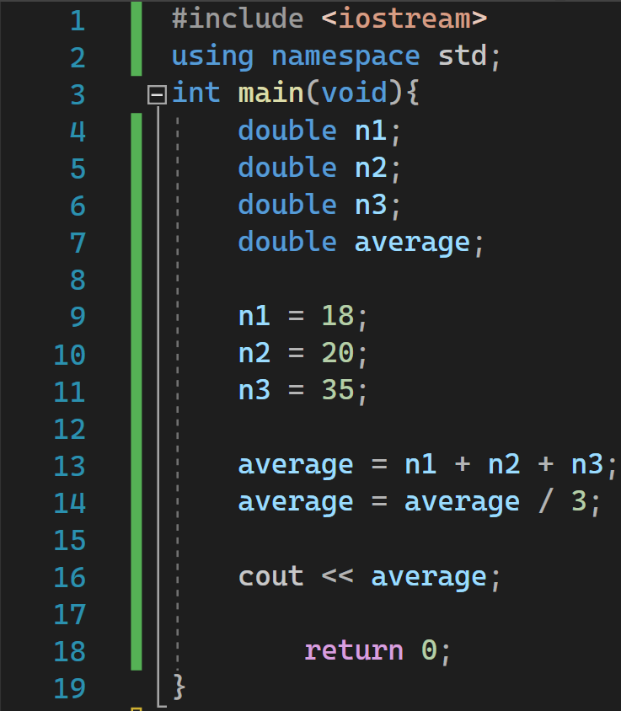

Slide 21
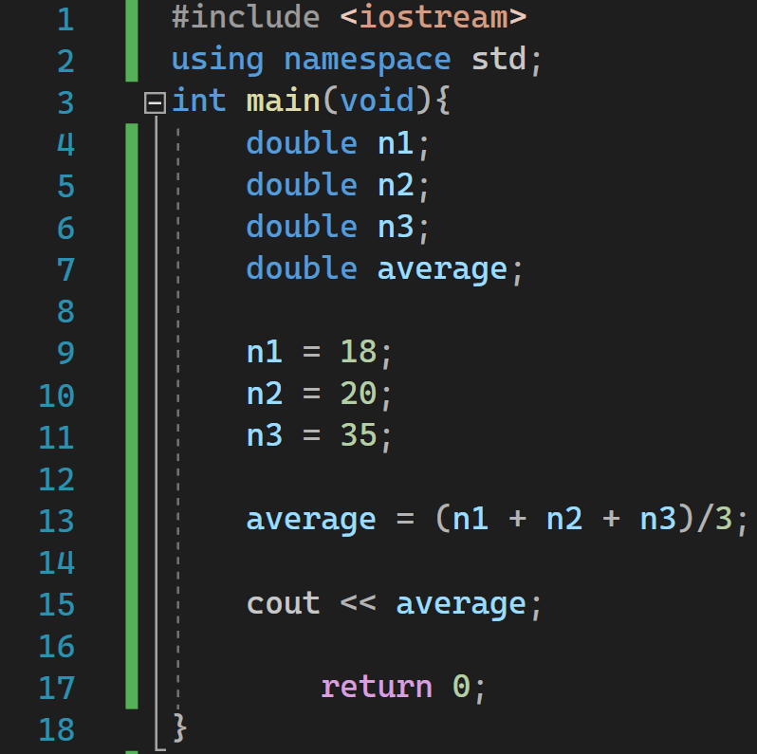

Slide 22
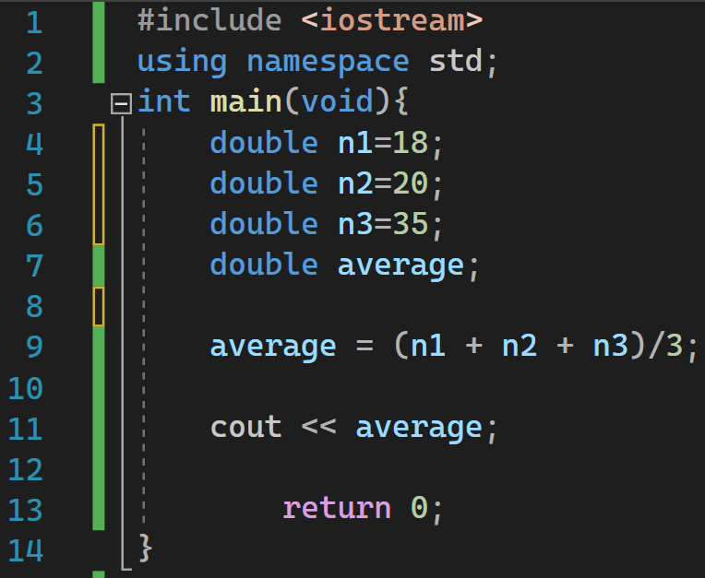

Slide 23
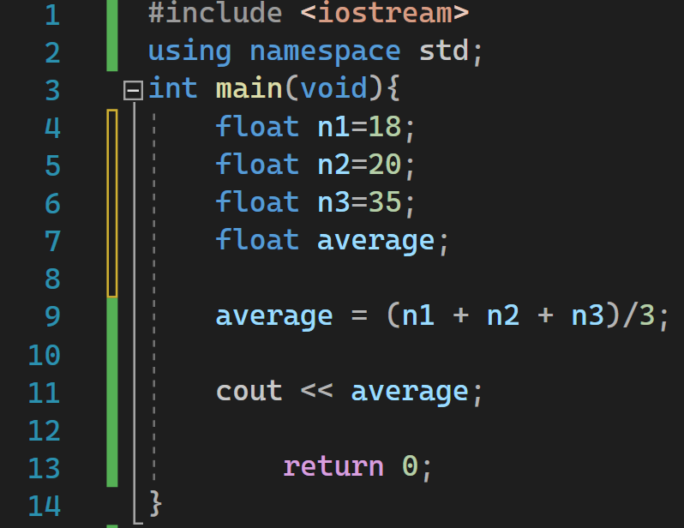

Slide 24
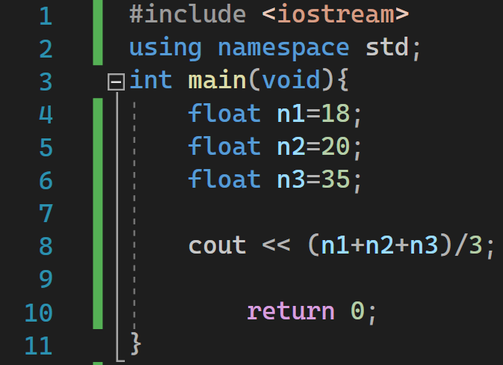

Slide 25
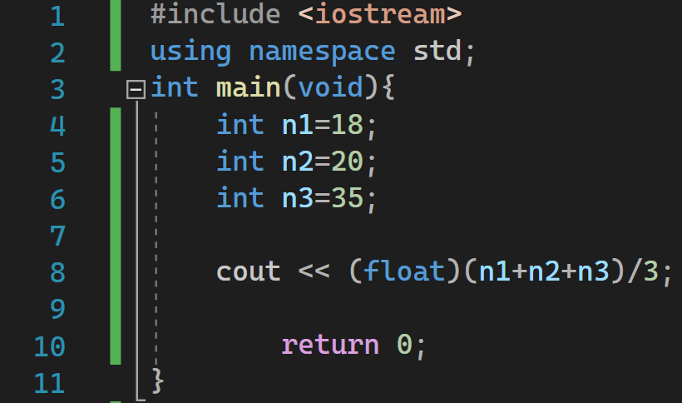

Slide 26
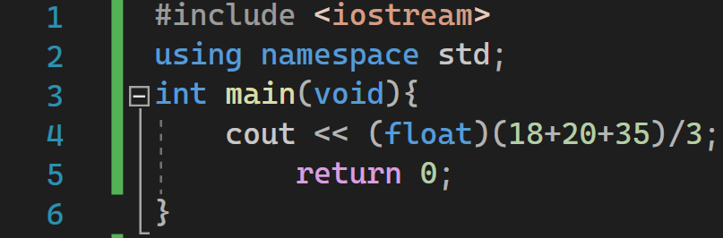

Slide 27
Comparison

Slide 28



Slide 29

Thank you for your attention
Dominik Despot, 1RP3, UC Algebra
20.10.2022

