Slide 1
Arm and Arm architecture primer
Predavanje 09

Slide 2
Instruction Set Architecture
• Execute high-level languages directly.
• Execute complex instructions (CISC).
• Tailor instruction set for pipelined and high-performance implementations.
Expose the instruction pipeline to the compiler so it can optimize code and help simplify the hardware (RISC). We will explore this approach.
• Provide additional explicit information about the dependencies between instructions. E.g., VLIW or
• Specify individual data transfers, e.g., Transport Triggered Architectures (TTA)

Slide 3
Instruction Set Architecture
• The best instruction set is the one that yields the “best” implementation.
• Changing the instruction set is difficult and happens infrequently .
• The factors that influence instruction set design do change over time, e.g., applications, programming languages, compiler technology, transistor budgets, and the underlying fabrication technology.
• We need to take care not to include “features” that will be regretted later.

Slide 4
The RISC Approach
• The RISC approach aims to ensure that we make the common-case fast by carefully selecting the most useful instructions and addressing modes, etc.
• Instructions are designed to make good use of the register file.
• A RISC ISA is designed to ensure a simple high-performance implementation is possible.

Slide 5
Instruction Set Architecture
Common features of RISC instruction sets:
  • Fixed length instruction encodings (or a small number of easily decoded formats)
  • Each instruction follows similar steps when being executed.
  • Access to data memory is restricted to special load/store instructions (a so-called load/store architecture).

Slide 6
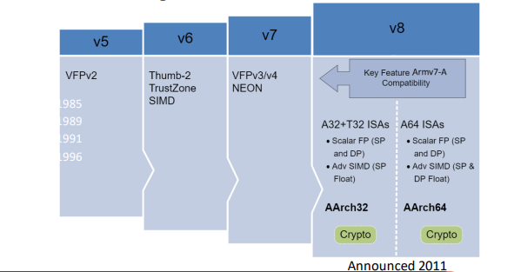
Arm1: The First Arm Processor (1985)
• Arm: Advanced RISC Machine (Arm)
• The first Arm processor was designed by Sophie Wilson and Prof. Steve Furber. It was inspired by early research papers from Berkeley and Stanford on RISC.
• Arm1
• 25,000 transistors
• 3-stage pipeline
• 8 MHz clock
• No on-chip cache

Slide 7
AArch64 – How Does It Differ from Older Arm ISAs?
• Conditional execution mostly dropped
• No free shifts in arithmetic instructions
• Program counter not a part of integer register set
• No load/store multiple instructions
• Adopts a more regular instruction encoding

Slide 8
A64 Instructions
• 64-bit pointers and registers
• Fixed-length 32-bit instructions
• Load/store architecture
• Simple addressing modes
• 32 x 64-bit general-purpose registers (including the R31 the zero/stack register)
• The PC cannot be specified as the destination of a data processing instruction or load instruction.

Slide 9
AArch64 - Registers
In the AArch64 Execution state, each register (X0-X30) is 64-bits wide.
The increased width (vs. 32-bit) helps to reduce register pressure in most applications.
Each 64-bit general-purpose register (X0 - X30) also has a 32-bit form (W0 - W30). Zero register – X31

Slide 10
AArch64 – Load/Store Instructions
DR – load data from an address into a register.
STR – store data from a register to an address.
LDR X0, <addr> ; load from <addr> into X0
STR X0, <addr> ; store contents of X0 to <addr>
In these cases, X0 is a 64-bit register, so 64-bits will be loaded or stored from/to memory.

Slide 11
AArch64 – Addressing Modes
Base register only: Address to load/store from is a 64-bit base register.
  LDR X0, [X1] ; load from address held in X1
  STR X0, [X1] ; store to address held in X1
Base plus offset: We can add an immediate or register offset (register indexed).
  LDR X0, [X1, #8] ; load from address [X1 + 8 bytes]
  LDR X0, [X1, #-8] ; load from address [X1 – 8 bytes]
  LDR X0, [X1, X2] ; load from address [X1 + X2]
  LDR X0, [X1, X2, LSL #3] ; left-shift X2 three places before adding to X1
Pre-indexed: source register changed before load
  LDR W0, [X1, #4]! ; equivalent to: ADD X1, X1, #4 LDR W0, [X1]
Post-indexed: source register changed after load
  LDR W0, [X1], #4 ; equivalent to: LDR W0, [X1] ADD X1, X1, #4

Slide 12
AArch64 – Data Processing
• Values in registers can be processed using many different instructions:
  • Arithmetic, logic, data moves,bit field manipulations, shifts,conditional comparisons, etc.
• These instructions always operate between registers, or between a register and an immediate.
Example loop:
MOV X0, #<loop count>
Loop:
LDR W1, [X2]
ADD W1, W1, W3
STR W1, [X2], #4
SUB X0, X0, #1
CBNZ X0, loop

Slide 13
AArch64 - Branching
B <offset>
PC relative branch (+/- 128MB)
BL <offset>
Similar to B, but also stores return address in LR (link register), likely a function call
BR Xm
Absolute branch to address stored in Xm
BRL Xm
Similar to BR, but also stores return address in LR
RET Xm or simply RET
- Similar to BR, likely a function return
- Uses LR if register is omitted
Subroutine calls: The Link Register (LR) stores the return address when a subroutine call is
made. This is then used at the end of our subroutine to return back to the
instruction following our subroutine call.

Slide 14
AArch64 – Conditional Execution
The A64 instruction set does not include the concept of widespread predicated or conditional execution (as earlier Arm ISAs did). The NZCV register holds copies of the N, Z, C, and V condition flags. A small set of conditional data processing instructions are provided that use the condition flags as an additional input.
Only the conditional branch is conditionally executed.
  • Conditional branch
  • Add/subtract with carry
  • Conditional select with increment, negate, or invert
  • Conditional compare (set the condition flags)

Slide 15
B.cond
  Branch to label if condition code evaluates to true, e.g.,
  CMP X0, #5
  B.EQ label
CBZ/CBNZ – branch to label if operand register is zero (CBZ) or not equal to zero (CBNZ)
TBZ/TBNZ – branch to label if specific bit in operand register is set (TBZ) or clear (TBNZ)
  TBZ W0, #20, label ; branch if
  (W0[20]==#0b0)
CSEL – select between two registers based on a condition
CSEL X7, X2, X0, EQ ; if (cond==true) X7=X2, else X7=X0
There are also variants of this that cause the second source register to be incremented, inverted, or negated.

Slide 16
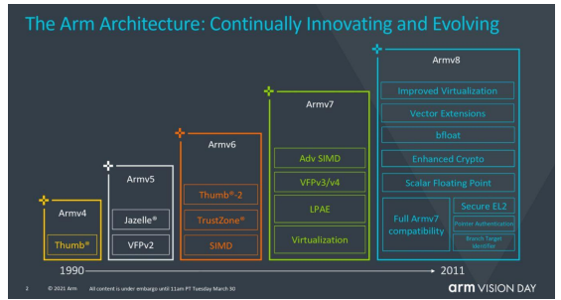
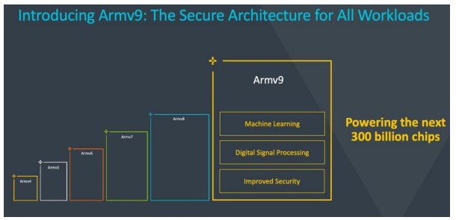
Armv9 architecture
• Launched in 2021
• Focus on :
  • security (Arm CCA, Confidential Compute Architecture)
  • AI, SVE2 (Scalable Vector Extension)
  • Total compute design
• In a way, you could say that Armv8 was a bit
desktop-computer oriented (ARM designs for
desktop computers
and servers prove that point)
• In a way, you could say that Armv9 is more leaning
towards supercomputing, architecture-wise –
for SC, for HPC
• Reason is very simple – design demands and needs,
as we discussed numerous times before
• We’re going to further demonstrate this as we
move towards parallelism and memory as when
we cover those topics it’s going to become even
more obvious why

Slide 17
Pipeline, rizici u pipeline strukturama i utjecaj na performanse
PREDAVANJE 10

Slide 18
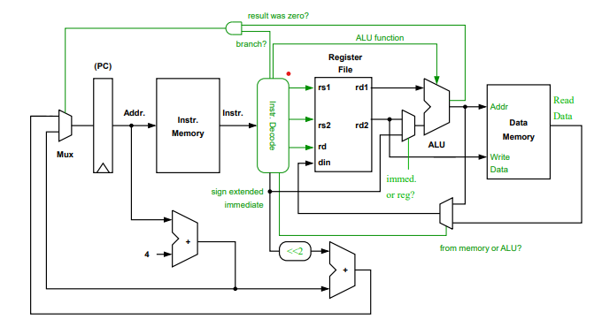
Pojednostavljeni procesor
Naš procesor izvršava jednu instrukciju po ciklusu dakle ima Clocks Per Instruction (CPI) faktor točno 1
Minimalni ciklus definiran je kao najgori put kroz sve logičke sklopove i memoriju, na što su pribrojene oscijalcije i mogući pomaci zbog utjecaja pripocesora, napona i temperature(Process, Voltage, and Temperature, poznat kao “PVT”)

Slide 19
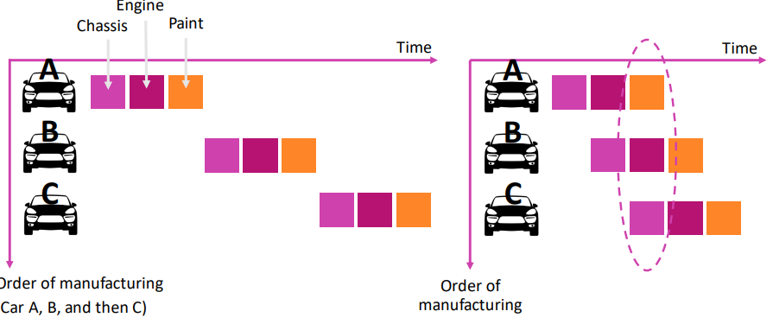
Što je Pipelining?
Pokušavamo preklopiti različite faze rada kako bi iskoristilii vremenski paralelizam u samom procesu
How are latency and throughput affected?

Slide 20
Pipelining i održavanje ispravnosti rada sustava
• We can break the execution of instructions into stages and overlap the execution of different instructions.
• We need to ensure that the results produced by our new pipelined processor are no different to the unpipelined one.
• What sort of situations could cause problems once we pipeline our processor?

Slide 21
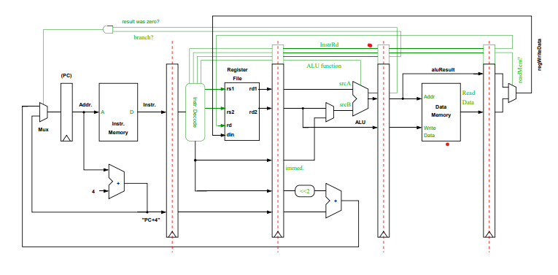
Pipelining Our Processor
• We can insert pipelining registers into our processor to divide the logic into different pipeline stages.
• If added carefully, the worst-case delay between any two registers will be reduced.
• We will also need to be careful to pipeline our control signals so that decoded control information accompanies each instruction as they progress down the pipeline

Slide 22
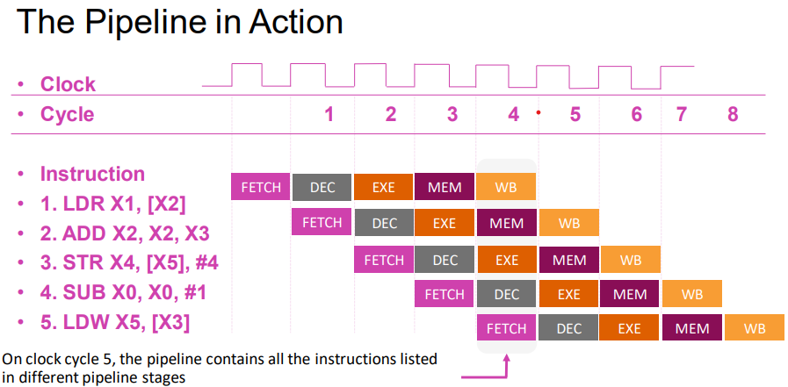
• We’ve simply taken our original datapath and added pipelining registers. (Note: its behavior is now different to our unpipelined processor – ’ v )
• This has created a 5-stage pipeline:
  • FETCH – access our instruction memory.
  • DECODE – decode our instruction and read the source registers.
  • EXECUTE – perform an ALU operation, calculate a memory address, or compute a branch target address.
  • MEMORY – access our data memory.
  • WRITEBACK – write to the register file

Slide 23
An Ideal Pipeline
In the ideal case, when our pipeline never stalls, our CPI will equal 1 (and IPC = 1).
If we need to stall the pipeline, our CPI will increase, e.g.: If we must stall for 1 cycle for 20% of instructions, and 3 cycles for 5% of instructions, our new CPI would be:
  Pipeline CPI = ideal pipeline CPI + pipeline stalls per instruction = 1 + 1*0.20 + 3*0.05 = 1.35
Note: to make the best use of pipelining, we should avoid stalling as much as possible. (without increasing our clock period!) Remember:
  Time = instructions executed×Clocks Per Instruction (CPI)×clock period

Slide 24
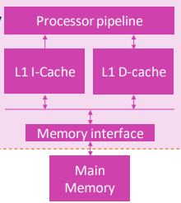
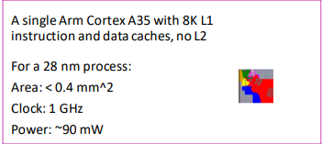
Stalling to Access Memory
The latency of accessing off-chip memory (DRAM) is typically 10-100 times higher than our pipelined processor’s clock period
In order to avoid stalling, we must use on-chip caches.

Slide 25
Pipeline Hazards
• Pipelining allows new instructions to start while others are still in the pipeline, i.e., the execution of instructions is overlapped.
• There may be cases where an instruction must wait and not move forward in the pipeline to ensure correctness. These cases are known as pipeline hazards:
  • Structural hazard – arise from resource conflicts
  • Data hazard – arise from the need to ensure we always respect inter-instruction data dependencies
  • Control hazard – are caused by instructions that change the PC, i.e., branches and jumps (details in next module)

Slide 26
Structural Hazard
• Instructions may need to stall in order to wait for access to a shared resource, e.g.:
  • A functional unit that is not pipelined
  • A register file read port or register file write port
  • A memory
• Why permit any structural hazards?
  • Designing for the worst-case may reduce the average (common) case performance, i.e., the added complexity may reduce our CPI but increase our clock period.
  • Adding support for the worst-case may be too costly (e.g., in terms of power and area). We may have strict budgets or may want to use these limited resources elsewhere.

Slide 27
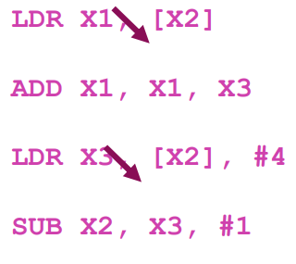
Data Dependencies – True Data Dependencies
Prava podatkovna ovisnost – poznata kao i Read-After-Write (RAW) ovisnost.
Zamislimo dvije instrukcije, instrukciju i nakon koje slijedi instrukcija j.
  Ako j koristi rezultat instrukcije i onda kažemo da je j podatkovno ovisna o i.

Slide 28
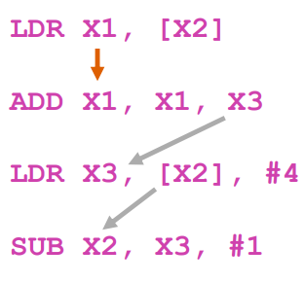
Data Dependencies – Name Dependencies
Imenovana ovisnost ili ovisnost o imenu, može postojati i ako se dvije upute odnose na isti registar.
Za razliku od stvarnih ovisnosti o podacima, podaci se ne prenose između instrukcija:
  Izlazna ovisnost (crvena strelica)
  • Anti-ovisnost (zlatna strelica)

Slide 29
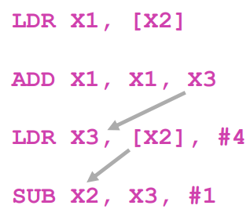
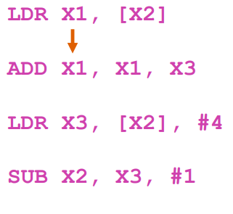
• Izlazna ovisnost (crvena strelica). Poznata i kao Write-After-Write (WAW) ovisnost
• Moramo se pobrinuti da ne presložimo pisanje u isti registar odnosno da ne mijenjamo red kojim se sadržaj registra mijenja. To bi značilo da bi naknadne upute mogle dobiti pogrešnu vrijednost podataka.
• Anti-ovisnost (zlatne strelice). Poznata i kao ovisnost o pisanju nakon čitanja (WAR) Opet, moramo biti oprezni da ne pobrišemo registar čija je trenutna vrijednost još uvijek potrebna ranijim instrukcijama.
• Npr. ne možemo zakazati STR instrukciju prije instrukcije ADD.

Slide 30
Podatkovni rizici
Podatkovni rizik stvara se kad god se paralelno izvršava j instrukcija ć j krš j đ ovisnosti pojedinih instrukcija.
Read After Write (RAW) – nastala istinskim ovisnostima o podacima, tj. Pokušava pročitati izvorni registar nakon što mu je vrijednost već promijenjena idučom instrukcijom
Write After Write (WAW) –proizveden izlaznim ovisnostima, odnosno j pokušava pisati u odredište registar prije nego što ga zapiše i.
Write After Read (WAR) – nastao kao posljedica anti-ovisnosti, i.e., j piše po odredičnom registru prije nego ga je i pročitao

Slide 31
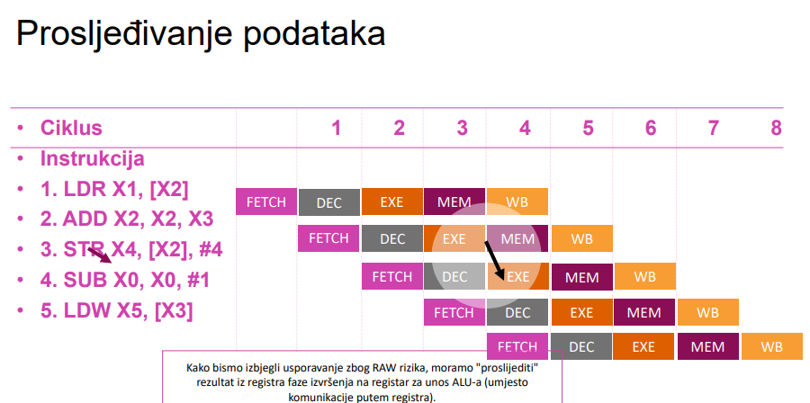
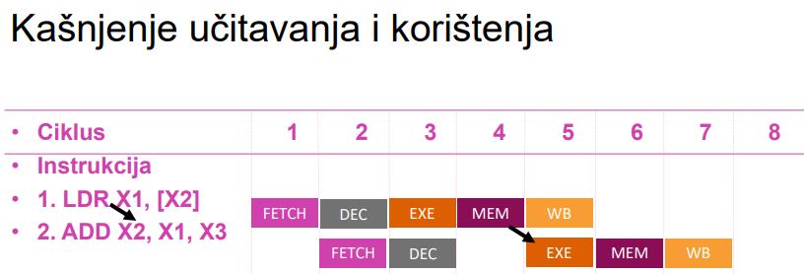
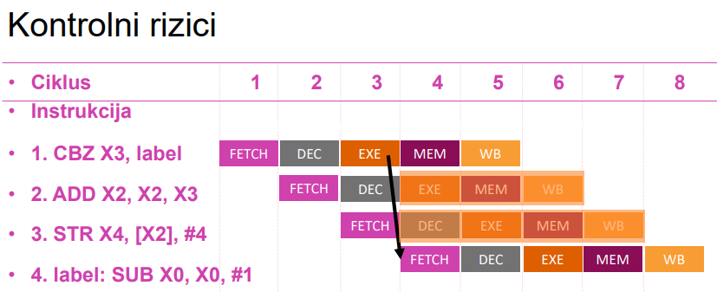
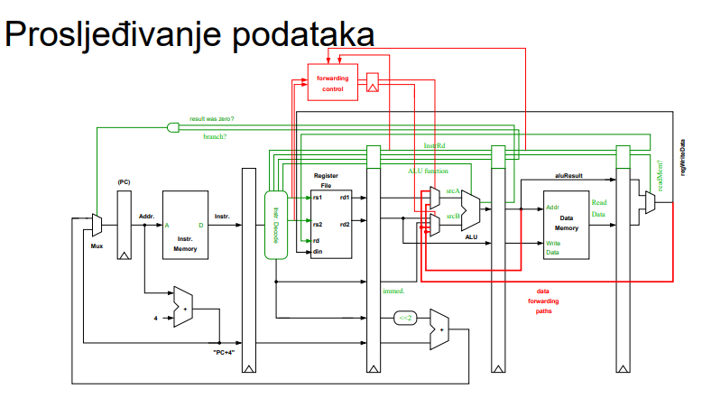
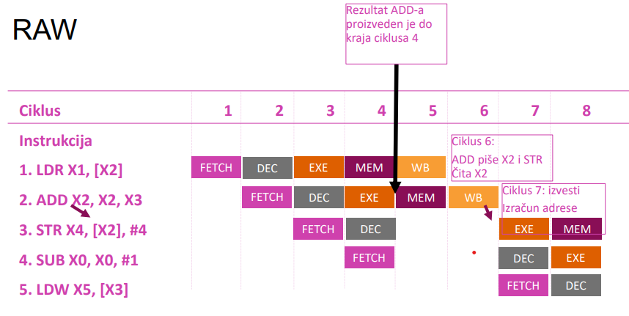
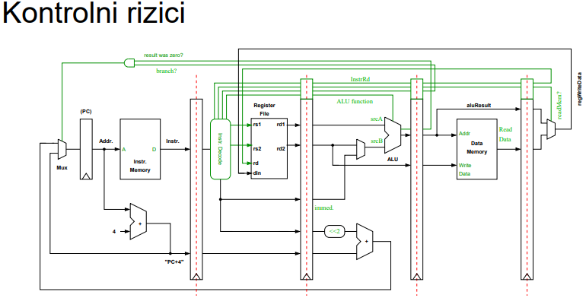

Slide 32
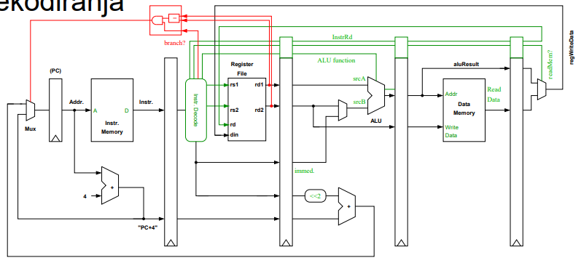
Kontrolni rizici – Procjena grananja u fazi dekodiranja
• Da bismo smanjili troškove grananja, mogli bismo procijeniti grananje u fazi dekodiranja.
• Neizvršeno grananje uključuje samo 1 mrtvi ciklus
• Potencijalni rizici za podatke
  • Ako instrukcija neposredno prije grananja piše u registar koji se testira pri grananju, moramo pričekati jedan ciklus (tj. dok ova instrukcija ne generira svoj rezultat).
  • Također će nam trebati staze za proseljeđivanje od faza EXE i MEM do faze dekodiranja.

Slide 33
Pipeline i performanse
Pipeline CPI
  Pipeline CPI = idealni CPI + strukturna čekanja + čekanja zbog podatkovnih rizika + kontrolna čekanja
  Stalls can be reduced by using a combination of compiler (e.g., scheduling) and hardware techniques.
  Hardware techniques typically increase the area and complexity of our processor. Consequently, power consumption typically grows quickly (not just linearly) as we try to boost the performance of our processor.

Slide 34
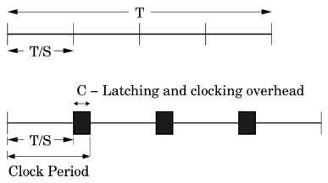
Analitički model izvedbe
• Konstruirajmo jednostavan a a čk model
performansi piplinea.
Počinjemo kritičnim putem kašnjenja T
• Podijelite ga u S faza kašnjnja T / S.
• Onda dodajemo vremensko kašnjenje ciklusa C
koje nastaje zbog upravljanja. Time dobivamo T/S+C.
Pipeline CPI = idealni CPI + čekanja u pipelineu zbog
instrukcija
Freq = 1 / (trajanje ciklusa) = 1 / (T/S + C)
Propusnost = Freq / CPI
Pretpostavimo da se zastoji javljaju frekvencijom B,
a njihov trošak je proporcionalan dubini pipelinea, recimo (S-1):
Propusnost = 1 / (1+(S-1)b) x 1 / (T/S+C)

Slide 35
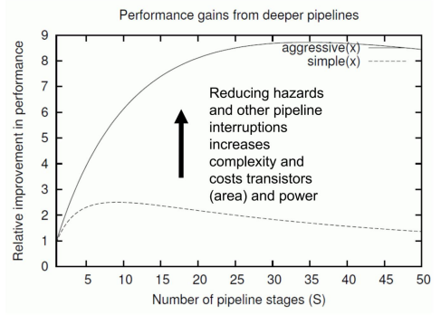
Optimalna dubina pipelinea
T = 5 ns, kašnjenje zbog prekida (S-1)
Jednostavni pipeline dizajn
C= 300 ps
Pipeline prekid svakih 6 instrukcija
Agresivni dizajn pipelinea
C = 100 ps
Pipeline kasni svakih 25 instrukcija

Slide 36
Tipične duljine pipelinea
• Jezgre optimizirane za manju površinu mogu imati 2-3 faze.
• Jednostavni, učinkoviti skalarni pipelineovi obično se provode s 5-7 faza.
• Jezgre s višim performansama, koje postižu više instrukcija u jednom ciklusu, mogu imati 8-16 faza.
• Duljine pipelineova za procesore opće namjene dosegle su vrhunac od 31 faze s Intelovim Pentiumom 4 2004. godine.
Zaš su se smanjili od 2004. umjesto da se povećavaju?

Slide 37
Sažetak
Pipelining je često učinkovit i efikasan način za pooljšanje performansi. Naravno, moramo paziti da se dobici od bržeg ciklusa ne izgube zbog troškova kašnjenja u pipelineu.
Moramo se pobrinuti da:
  1. Instructions stižu bez kašnjenja:
    • Osigurati učinkovito rukovanje grananjem
    • pokušati smanjiti stopu promašaja predmemorije instrukcija.
  • 2.Dostava podataka – minimiziranje broja promašaja u predmemoriji podataka.
  3. Smanjiti zastoje u pipelineu zbog strukturnih i podatkovnih rizika.

Slide 38
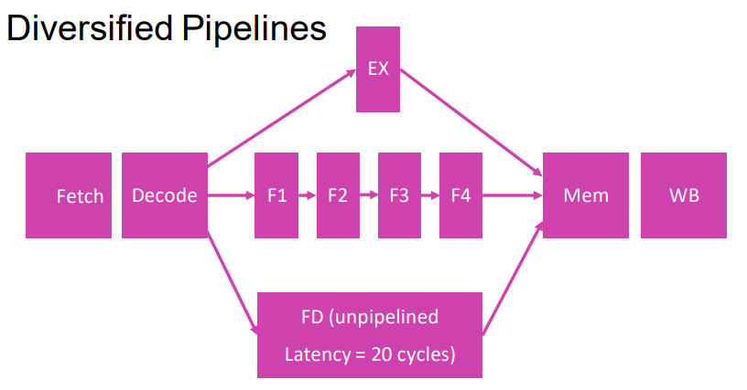
Raznoliki pipelineovi i Studija slučaja za Arm10
• It is impractical to require that all instructions execute in a single cycle.
• We also want to avoid sending all instructions down a single long pipeline.
•We can instead introduce multiple (or “diversified ”) execution pipelines.
• Could this introduce new hazards?

Slide 39
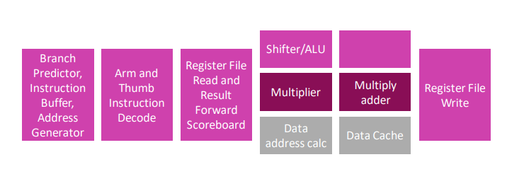
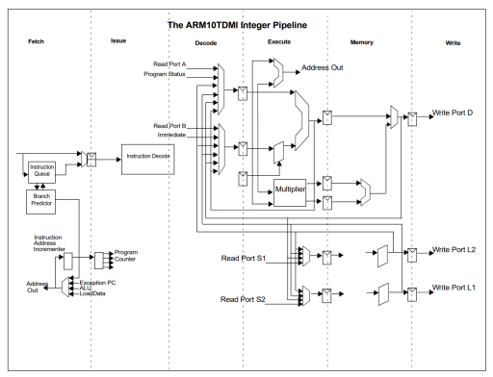
Example: Arm10 Pipeline (1999)
Arm10 Pipeline Hazards
• ALU instructions need not necessarily wait for load/store operations in the load/store pipeline to complete, i.e., they may bypass or overtake them if they are independent.
• Data Hazards
• We cannot allow all ALU instructions to bypass memory instructions. We must respect dependencies.
• RAW (i.e., the ALU operation requires the result from a load) or a WAW hazard
• Structural Hazards
• Load/store or multiply pipeline is occupied. • Check for hazards late.
• The use of interlocks is minimized by checking for hazards late, not simply in the decode stage.

Slide 40
Napredni pipeline: Predviđanje grananja, iznimke i ograničenja u pipelining konceptu
PREDAVANJE 11

Slide 41
Upravljački hazardi
1. Moramo odlučiti događa li se grananje ili ne
2. Ako se grananje događa moramo izračunati i prebaciti odredišnu adresu.

Slide 42
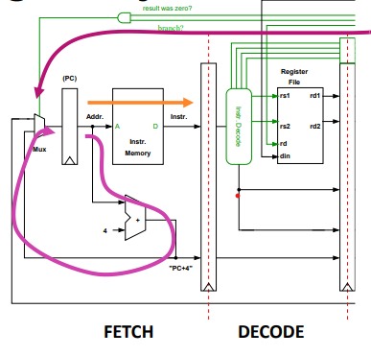
Kako želimo realizirati grananje?
U procesoru koji sadrži pipelineove, željeli bismo izračunati sljedeću vrijednost brojača programa (PC) paralelno s čitanjem naše memorije s instrukcijama.
U stvarnosti ovo je netrivijalno jer se grananja mogu računati kasnije u procesu pipelinea te se rezultat njihovog grananja ne zna do tog trenutka.

Slide 43
Kako bismo željeli rukovati grananjem?
• Opcija 1: Pretpostavimo da se grananje nije dogodilo
• Opcija 2: Izračunamo grananje što je ranije moguće
• Opcija 3: Pričekamo na grananje
• Opcija 4: Predviđanje grananja

Slide 44
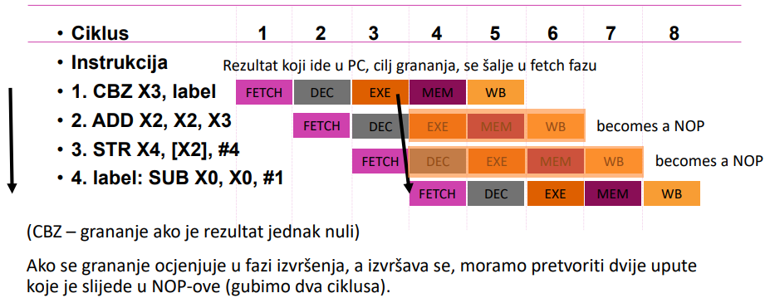
Pretpostavimo da se grananje nije dogodilo
Ako procijenimo granu u fazi izvršenja, izgubili bismo dva ciklusa svaki put kad bismo naišli na grananje koje trebamo izvršiti.
Ako pretpostavimo da su 20% instrukcija grananja, i 60% moramo izvršiti, a također pretpostavimo i da je CPI 1:
  CPI od grananja koja su se dogodila= 0.2*2 * 0.6 = 0.24 Novi CPI = 1.0 + kašnjenje grananjima = 1.24

Slide 45
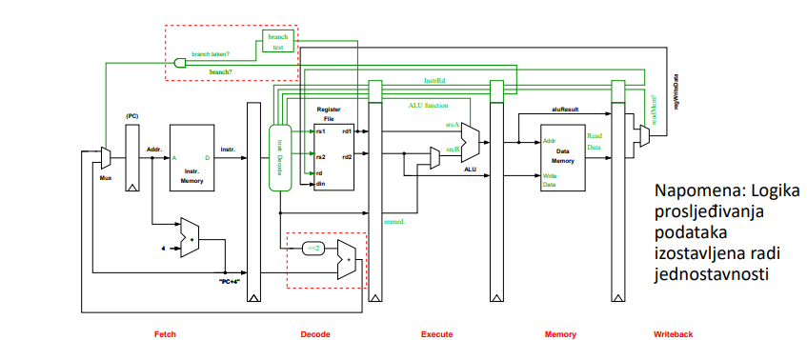
Izračunamo grananje što je ranije moguće
• Premjestite test grananja i izračun ciljne adrese grananja u fazu dekodiranja.
• Time bi se kazna grananja smanjila na jedan ciklus u slučaju izvršenog grananja.
  • i.e., U slučaju izvršenog grananja moramo odbaciti iduću instrukciju u pipeline
Da bi ova tehnika djelovala:
  Stanje grananja mora biti jednostavno procijeniti.
    • Test za nulu je jednostavan .
    • Testovi koji zahtijevaju ALU operaciju vjerojatno su previše složeni.
    • Ne želimo da test grananja produži vrijeme ciklusa.
  • Moramo se pobrinuti za potencijalne podatkovne rizike.
    • Ako neposredno prije grananja piše u registar koji se koristi za testiranje uvjeta grananja, moramo odugovlačiti jedan ciklus (tj. dok ova instrukcija ne generira svoj rezultat).
    • Trebat će nam i putevi prosljeđivanja od faza EXE i MEM do faze dekodiranja.

Slide 46
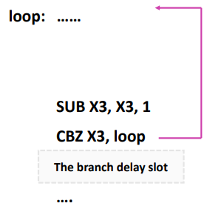
• Pričekamo na grananje
• Mogli bismo odlučiti uvijek izvršiti instrukcije nakon grananja, bez obzira na to je li grananje izvršeno
• Ova instrukcija iza grananja se sad zove “branch delay slot.”
• Kompajler obično može popuniti branch delay slot 60-70% ukupnog vremena izvršavanja.
• Ako imamo više faza u pipelineu možemo kreirati dodatne delay slotove no time ih ima previše pa ih je teško popuniti
• Pitanje: gdje možemo pronaći instrukciju kojom možemo popuniti delay slot?
• Ako je instrukciju nemoguće pronaći onda na njezino mjesto ide NOP instrukcija.

Slide 47
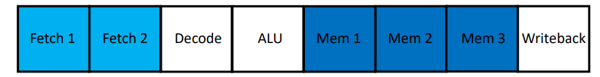
Primjer
Ovaj pipeline ima 8 faza
• Osnovno kašnjenje zbog grananja je 3 ciklusa.
• Uvjet grananja i odredišna adresa se računaju u fazi ALU.
• Sva grananja smatramo kao da neće biti izvršena.
• Kako to utječe na CPI:
  • Napravimo neke razumne pretpostavke:
    • 15% instrukcija su bezuvjetne ili izvršena grananja; posljedica im je kašnjenje 3 ciklusa.
    • 5% instrukcija su neizvršena grananja Kako pretpostavljamo da je to svaki put slučaj ovo ne stvara kašnjenje
    • Ukupni utjecaj na CPI zbog kašnjenja = 0.15 * 3 + 0.05 * 0 = 0.45

Slide 48
Predviđanje grananja
• Za procesore visokih performansi, s dubokim pipeline strukturama, do sada opisane tehnike nisu dovoljne.
• Primjerice Arm Cortex-A15
  • 15 stupnjeva pipelinea
  • Grananja se računaju u kasnijim fazama izvršavanja.
  • Svaka greška u procjeni grananja je ~14 ciklusa kašnjenja
  • Procesor dohvaća do 4 instrukcije po ciklusu i dekodira po 3 istovremeno
  • Rezultat svega ovoga je da krivo procijenjeno grananje može značiti ponovno izvršavanje više od 40 instrukcija

Slide 49
Statičko predviđanje grananja
• Metode statičkog predviđanja iskorištavaju opažanje da će određeno grananje vjerojatno biti vrlo pristrano u jednom smjeru.
• Sheme se često temelje na tome grana li se grana naprijed ili natrag u kodu ili alternativno ovise o op-kodu instrukcija u grananju.
• Predviđanje temeljeno na pomaku
  • Možemo iskoristiti jednostavno opažanje da su grane koje se granaju unazad (prema nižoj adresi) obično grane petlje i da će vjerojatno biti aktivirane .
  • Ako ciljna adresa grananja < PC, predviđamo da će grananje biti izvršeno.
  • Točnost ove vrste sheme je oko 65% (ili 80-95% uz pomoć profiliranja).

Slide 50
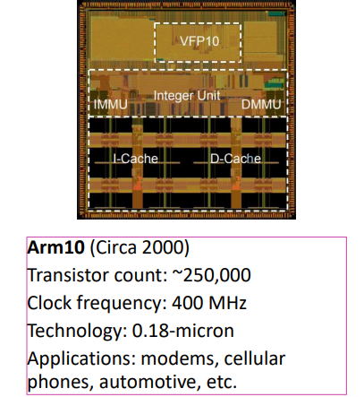
Primjer: Procesor Arm10
• Cijeli pipeline imao je 6 faza.
• Arm10 je koristio shemu predviđanja grana temeljenu na statičkom predviđanju.
• Dio za predviđanje grananja u Arm10 također je radio prije faze dohvaćanja (upute za prefetching) kako bi se smanjili troškovi grananja.

Slide 51
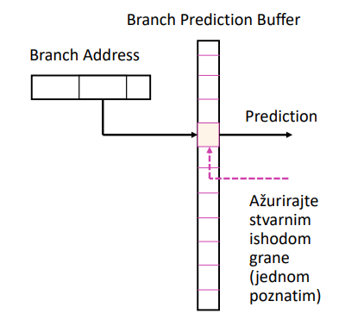
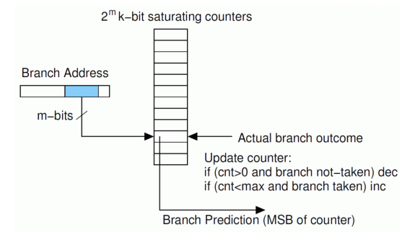
Jednostavan dinamički prediktor grananja na jednoj razini
Jednostavan algoritam za predviđanje dinamičkog grananja će predvidjeti granu kao izvršenu samo ako je to bilo tako posljednji put kad smo je izvršili. Možemo koristiti jednostavnu tablicu jednobitnih unosa za pohranu naših predviđanja.
Nedostatak ovih jednobitnih unosa u tablici je u tome što jedan događaj može preokrenuti predviđanje. Vjerojatno želimo neku histerezu, npr. u slučaju petlji kako bismo izbjegli dva pogrešna predviđanja po petlji (pri ulasku i izlasku).
One-level Branch Predictors

Slide 52
Korelirajući prediktori
• Kako možemo poboljšati jednostavne bimodalne prediktore?
• Možemo iskoristiti činjenicu da je ishod mnogih grana povezan ili s prošlim ishodima iste grane (lokalna povijest) ili s drugim novijim granama (globalna povijest).
• Sada umjesto jednostavnog mijenjanja PC baziranog na hashingu kako bismo odabrali brojač, možemo uključiti lokalnu ili globalnu povijest podružnica kako bismo poboljšali naše predviđanje.

Slide 53
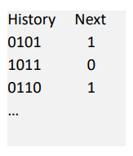
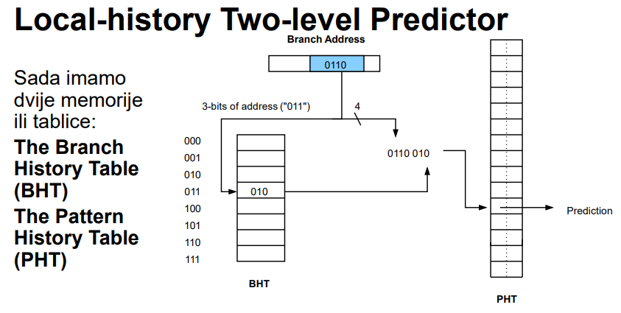
Korelirajući prediktori (lokalna povijest)
Ako ishod određene grane ima ponavljajući obrazac, njezina lokalna povijest može se koristiti za poboljšanje točnosti predviđanja.
E.g., određena instrukcija može biti predvidljiva ako pogledamo njezinu lokalnu povijest:
  … 010110101101011010110101101011

Slide 54
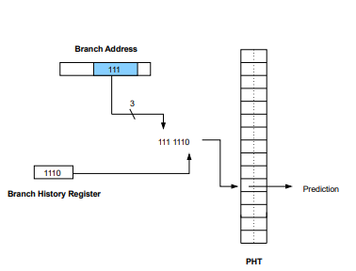
Iskorištavanje povijesti globalnih grana
• Osim iskorištavanja lokalne povijesti određene grane, također možemo primijetiti da je ponašanje grane često povezano s ponašanjem drugih novijih grana (globalna povijest):
  • If (cond1) { .... }
  • If (cond2) { .... }
  • If (cond1 && cond2) { .... } / dependent on outcome of / previous branches
Global History Two-level Predictor

Slide 55
Optimizacije
Tournament Prediktori
  Naprednije sheme koriste lokalne i globalne prediktore povijesti
  Ti takozvani "prediktori turnira" također koriste treći prediktor (još jednu tablicu dvobitnih brojača) kako bi odabrali koji će izlaz prediktora (lokalno ili globalno) koristiti.
Problemi s pseudonimom
  Performanse mogu biti ograničene negativnim smetnjama, odnosno kada se dvije grane mapiraju na isti unos u PHT, ali su pristrane u suprotnim smjerovima. Brojne sheme pokušavaju se nositi s tim, npr. korištenjem više PHT-ova ili korištenjem male označene "predmemorije" za držanje grana koje doživljavaju smetnje.

Slide 56
Ograničenja dinamičkog predviđanja grane
• Neke grane su nepredvidive (ovise o ulaznim podacima).
• Trebate "trenirati" prediktor za neko razdoblje prije nego što predviđanja budu točna
• Točnost prediktora bit će ograničena područjem (trošak), vremenom ciklusa ili snagom hardvera.
• Pseudonim i smetnje

Slide 57
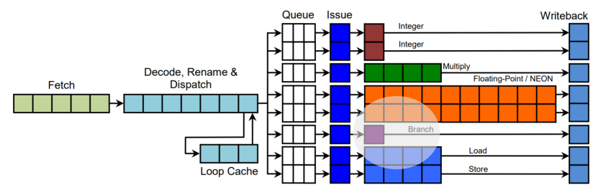
Primjer: Arm Cortex-A15
Cortex A-15 koristi prediktor "dvosmjernog načina rada", produžetak globalnog prediktora na dvije razine povijesti kako bi se smanjila ograničenja zbog destruktivnog pseudonima.
Sada postoje dva PHT-a, svaki s 8192 unosa i dodatnim "izbornim" prediktorom za odabir između dva PHT-a.
Sveukupno, prediktor grane je relativno velik i troši ~15% snage jezgre.

Slide 58
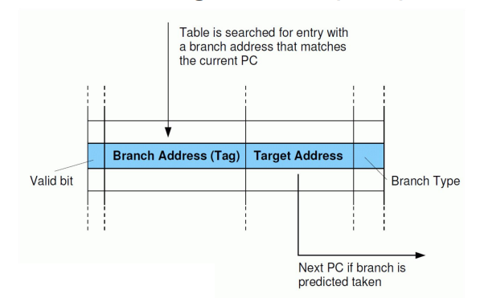
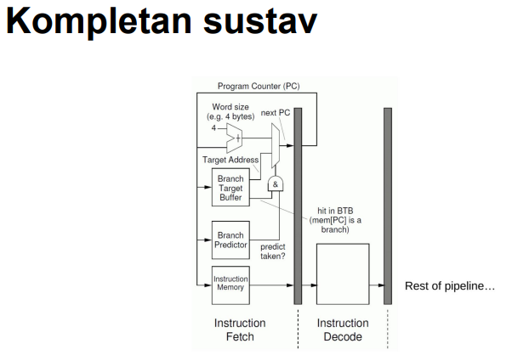
Grananje bez zastoja
Što trebamo znati kako bismo u potpunosti izbjegli usporavanja u grananju?
  Trebate znati koja instrukcija koje "trenutno" donosimo je grananje (zapamtite, još se nije vratila iz memorije, pa kako možemo znati?)
  1. Moramo predvidjeti hoće li se grananje dogoditi ili ne
  2. Ako se grananje događa moramo odrediti odredišnu adresu
Da bismo pružili informacije za rješavanje problema 1 i 3, nedavna grananja pohranjujemo zajedno s njihovim ciljnim adresama u Bransch target bufferu (BTB).

Slide 59
Ostali BTB trikovi: Preklapanje grane
• Osim pohrane ciljne adrese, ciljne instrukcije mogli bismo pohraniti u BTB.
• Nema potrebe za dohvaćanjem sljedećih uputa; CPI za grananje je sada zapravo nula.
• Također bi mogli omogućiti da odvojimo više vremena za pristup (većem) BTB
• Grananje je sada uklonjeno iz slijeda instrukcija koji je predstavljen pipelineu za izvršenje - umjesto toga, grana se zamjenjuje ciljnom instrukcijom grane
• Također možemo stvoriti zasebnu strukturu za predmemoriranje instrukcija za cilj grananja (i.e. the Branch Target Instruction Cache or BTIC)

Slide 60
Prediktori povratnih adresa
Funkcije se mogu pozvati s više mjesta u programu
Točnost cilja grane (povratne adrese) pohranjene u BTB-u može biti vrlo niska.
Rješenje: za pohranu tih adresa koristite mali hardverski stog (stog povratne adrese).
Što ako se ovaj stog prelijeva?

Slide 61
Iznimke
• U nekim situacijama moramo prekinuti izvršenje programa i poduzeti neke radnje. Ti se uvjeti ili događaji sustava nazivaju iznimkama. Potrebne radnje poduzima povlašteni softver, takozvani exception handler ili softver za obradu iznimaka.
• Iznimke se mogu pojaviti iz više različitih razloga,
  • page fault, breakpoint, I/O device request, floating-point errors, memory protection violation
Vrste iznimaka (za Arm):
  • Interrupts
  • Aborts
  • Reset
  • Exception generating instructions

Slide 62
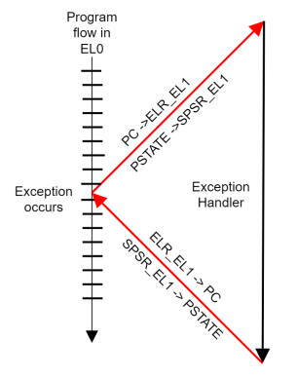
Iznimke
Iznimka će uzrokovati da procesor izvrši sljedeće:
Spremite stanje procesora (PSTATE), npr. zastavice procesora, bitove maske prekida, razinu iznimke itd.
Spremanje povratne adrese (trenutni PC).
  1. Skok na dio za rukovanje iznimkom definiran vektorom u memoriji
  2. Spremite registre, izvršite kod rukovatelja iznimke, vratite registre.
  3. Povratak iz iznimke (instrukcija ERET).

Slide 63
Iznimke
Namjera je privremeno prekinuti izvršavanje programa, riješiti iznimku, a zatim nastaviti izvršavanje.
Dobar način da osiguramo da možemo lako nastaviti je osigurati da stanje procesora bude u skladu sa sekvencijalnim modelom izvođenja programa prije nego što se izvrši iznimka, odnosno:
  Sve instrukcije prije E trebale su ispuniti i ažurirati svoje odredišne registre. Trebalo je postupati sa svim iznimkama uzrokovanim ovim instrukcijama.
  Sve instrukcije nakon E u programskom redoslijedu ne bi trebale biti dovršene i nisu trebale mijenjati nijedno stanje procesora.
  Hoće li se E dovršiti ili ne, ovisit će o iznimki.
  To se naziva "preciznim iznimkama".

Slide 64
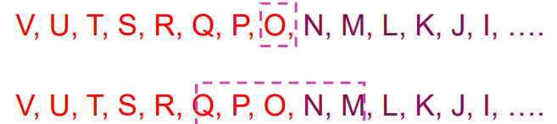
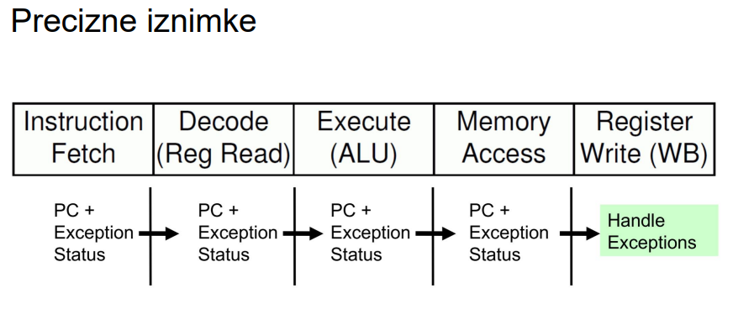
Precizne iznimke i pipelining
Zahtjevi na prethodnom slajdu su trivijalni u slučaju nepipeliranog procesora, ali složeniji za procesor sa pipelineom.

Slide 65
Ograničenja pipelininga
• Kao što smo vidjeli u posljednjem modulu, dublji pipeline ne mora nužno dovesti do boljih performansi.
• Moramo naporno raditi kako bismo puniti pipeline i podacima i instrukcijama kako bi minimizirali zastoje
• Ako unutar pipelinea imamo i našu fazu izvršenja, također ćemo morati pronaći uzastopne neovisne instrukcije kako ne bi imali puno čekanja
Pipelining je u konačnici ograničen i poteškoćama na nižoj razini:
  Registarski i troškovi izvršenja ciklusa nisu nula. Ako imamo vrlo malo logike po fazi pipelinea, to može predstavljati značajan dio našeg puta kritičnog kašnjenja.
  Trebate uravnotežiti logiku između faza. Vremensko razdoblje ciklusa određeno je kašnjenjem u najgorem slučaju.
  Ograničenja broja registara u pipeline
• U konačnici, nećemo moći povećati performanse procesora koji pokušava izdati samo jednu uputu po ciklusu.
• Čak i prije nego što se dostigne ova točka, poželjno je koristiti druge tehnike: obavljati više posla u svakoj fazi, dohvatiti i izvršiti više instrukcija po ciklusu.

Slide 66
Paralelizam - single i multi-core procesori
PREDAVANJE 12-I

Slide 67
Tipovi paralelizma
• Paralelizam u hardveru
  • single-core - pipelining, superscalar, VLIW
  • SIMD instructions, Vector processors, GPU (primjer: MMX, SSE)
  • multi-core - SMP, distributed-memory MP
  • multicomputer(klasteri)
• Paralelizam u softveru
  • Instruction-level parallelism
  • Task-level parallelism
  • Data parallelism
  • Transaction level parallelism

Slide 68
Instruction-level parallelism
• Više instrukcija iz istog toka instrukcija se izvršavaju u isto vrijeme
• Generiran i upravljan od strane hardvera (superskalarni procesori) ili kompajlera (VLIW)
• Pristup koji je u praksi limitiran podatkovnim i kontrolnim međuovisnostima

Slide 69
Thread-level ili task-level paralelizam
• Više threadova ili sekvenci instrukcija iz iste aplikacije izvršavaju se konkurentno
• Generiran od strane kompajlera (korisnika), upravljan od strane kompajlera i hardvera
• U praksi, limitiran zbog overheada u komunikaciji i sinkronizaciji, kao i karakteristika različitih algoritama

Slide 70
Data-level paralelizam
• Instrukcije iz jednog toka operiraju konkurentno na više podataka
• U praksi, limitiran od strane nepravilnih uzoraka manipulacije podataka i bandwidth-a memorije

Slide 71
Transaction-level paralelizam
• Više threadova/procesa iz različitih transakcija se izvršavaju konkurentno
• U praksi limitiran zbog overheada konkurentnosti

Slide 72
Osnovni pojmovi - ponavljanje
Procesori koriste slijedeće tehnologije za poboljšanje performansi:
  • pipelining (razbijanje instrukcija u manje dijelove);
  • superskalarnost (neovisno izvršavanje instrukcija u različitim dijelovima procesora);
  • out-of-order izvršavanje (redoslijed izvršavanja je drugačiji od programskog koda)
  • problem: svaka od ovih metoda znači dodatnu kompleksnost hardvera

Slide 73
Superpipelined i Superscalar procesori
U praksi, pokazalo se da je bolje producirati superskalarne procesore, često sa vrlo dubokim pipelineom, što je puno bolje od superpipelined procesora:
  • problemi sa povećanim frekvencijama rada procesora
  • neke operacije ili moduli se teško razbijaju na pipeline operacije
  • potreba za balansiranjem logike u različitim fazama pipelinea
Ali:
  • Scheduling instrukcija je vrlo kompleksan
  • Postoje i druge metode - unutrašnji paralelizam u instrukcijskom toku, kompleksnost, grananje kroz VLIW (Very Long Instruction Word)

Slide 74
VLIW
VLIW mogućnosti
• instruction-level paralelizam - programi kontroliraju paralelno izvršavanje instrukcija
• koristi kompajler za razrješavanje svih problema
• potprogrami odlučuju paralelni tijek instrukcija i rješavaju konflikte
• povećava se kompleksnost kompajlera, ali u isto vrijeme se smanjuje kompleksnost hardvera
• procesori imaju više funkcionalnih jedinica, dohvaćaju potrebne instrukcije iz instrukcijske cache memorije koja ima VLIW organizaciju
• Više neovisnih operacija se grupira zajedno u jednu VLIW instrukciju, koja se inicijalizira u istom ciklusu
• Svaka operacija dobiva svoju neovisnu funkcionalnu jedinicu
• Sve funkcionalne jedinice imaju zajedničke registre
• Instrukcijske riječi su tipično dugačke 64-1024 bitova, ovisno o broju izvršnih jedinica i duljine koda koji je potreban za kontrolu svake funkcionalne jedinice
• scheduling instrukcija i paralelno slanje riječi se radi statički (kompajler)
• kompajler provjerava međuovisnosti prije schedulinga paralelnih instrukcija

Slide 75
VLIW prednosti
VLIW problemi
• Smanjenje kompleksnosti hardvera
• Smanjenje potrošnje energije (zbog manje kompleksnosti hardvera)
• Pošto se međuovisnost provjerava u fazi kompajliranja, dekodiranje, problematike instrukcija i dekodiranje se značajno pojednostavljuju
• Potencijalni porast frekvencije
• Funkcionalne jedinice su pozicionirane u skladu sa potrebama kompajlera
• Kompleksni kompajleri koje je teško dizajnirati
• Povećana veličina programa
• Potreban je veći memorijski bandwidth, kao i bandwidth registara
• neočekivani događaji (npr.cache miss) mogu dovesti do zastoja u pipelineu
• ako VLIW instrukcije imaju praznina, trošimo memorijski prostor i bandwidth instrukcija za ništa

Slide 76
SIMD (Single-Instruction, MultipleData)
• višeprocesorska mašina sposobna izvršavati istu instrukciju na procesoru, ali raditi na različitim podacima
• ovaj se pristup tipično koristi u znanstvenim izračunima pošto takva vrsta računarstva obično ima puno vektorskih i matričnih operacija
• Informacije se mogu slati na sve elemente procesiranja, organizirani podatkovni elementi vektora mogu biti razdijeljeni u više setova (N setova za N elemenata procesiranja), pa svaki element procesiranja može procesirati jedan set podataka

Slide 77
ARM SIMD instrukcije (NEON)
Intel SIMD instrukcije (Instruction Set Extensions)
"Arm Neon technology is an advanced Single Instruction Multiple Data (SIMD) architecture extension for the A-profile and R-profile processors. Neon technology is a packed SIMD architecture. Neon registers are considered as vectors of elements of the same data type, with Neon instructions operating on multiple elements simultaneously. Multiple data types are supported by the technology, including floating-point and integer operations. Neon technology is intended to improve the multimedia user experience by accelerating audio and video encoding and decoding, user interface, 2D and 3D graphics, and gaming. Neon can also accelerate signal processing algorithms and functions to speed up applications such as audio and video processing, voice and facial recognition, computer vision, and deep learning."
Source: ARM Developer website, https://developer.arm.com/Architectures/Neon
• MultiMedia eXtension (1996) - MMX (Pentium MMX, Pentium II)
• Streaming SIMD Extensions - SSE (Pentium III), SSE2 (Pentium 4), SSE3 (Pentium 4 with HT), SSE4 (Intel Silvermont, 2013)
• Advanced Vector eXtensions - AVX (2008.), AVX2 (2013), AVX512 (2013)

Slide 78
Vektorski procesori
"Although what constitutes a vector processor has changed over the years, their key characteristic is that they can operate on arrays or vectors of data, while conventional CPUs operate on individual data elements or scalars."
• Peter S. Pacheco, Matthew Malensek: An Introduction to Parallel Programming (Second Edition), 2022.

Slide 79
Tipični dijelovi vektorskih procesora
• VEKTORSKI REGISTRI - sposobni pohraniti vektor operanda i izvršavati operacije nad njima. Duljina je fiksirana na razini sustava, obično je između 4 i 128 64-bitna elementa
• VEKTORIZIRANE I PIPELINE JEDINICE - izvršavaju istu operaciju na svaki vektorski element, ili, u slučaju operacija tipa zbrajanje, ista operacija se izvršava nad parom susjednih elemenata dva vektora. Dakle, radi se o SIMD operacijama
• INTERLEAVED MEMORIJA - ima više banki memorije, kojima se može pristupati manje ili više neovisno. Nakon pristupa jednoj banci, postoji kašnjenje nakon kojeg se može ponoviti pristup, ali različitoj banci se može pristupiti puno ranije. Dakle, ako su elementi vektora distribuirani kroz više banki, kašnjenje kod load-store operacija će biti blizu 0.
• PRISTUP MEMORIJI "U KORACIMA", hardverski mehanizam za sakupljanje i komadanje - program pristupa elementima vektora koji su locirani na fiksnim intervalima u memoriji. Npr. prvi, peti, deveti itd (stride = 4). Sakupljanje/komadanje je zapisivanje (sakupljanje) ili čitanje (komadanje) elemenata vektora koji su locirani na varijabilnim intervalima - npr. prvi, drugi, četvrti, osmi, i slično. Tipični vektorski sustavi imaju poseban hardver za akceleraciju ovih operacija.

Slide 80
Prednosti vektorskih procesora
Nedostatci vektorskih procesora
• brzina, jednostavno korištenje za dosta aplikacija
• kompajleri su jako dobri u smislu detektiranja koda koji se može vektorizirati, petlje koje se ne mogu vektorizirati, informacije zašto i slično - olakšava odluke o redizajnu aplikacije ako je potreban
• velika brzina memorije, svaki podatak koji se i koristi, što je u suprotnosti sa spekulativnim izvršavanjem, cache memorijom i sličnim tehnologijama koje ne koriste svaki podatak
• ne vole neuredne podatke
• imaju jako tanku liniju skalabilnosti, tj. sposobnost da odrade veće zadaće
• što su vektori veći, to je teže dizajnirati sustav koji ih može korstiti
• skalabilnost se postiže većim brojem vektorskih procesora, ne duljinom vektora
• trenutni sustavi imaju ograničenu podršku za operacije na vrlo kratkim vektorima, dok su procesori koji rade sa dugačkim vektorima rijetki i proizvedeni po narudžbi, i stoga vrlo skupi

Slide 81
Grafičke kartice
• koriste točke, linije i trokute za predstavljanje površine fizičkog objekta
• koriste pipeline grafičkog procesora za pretvaranje interne reprezentacije u niz piksela koji se mogu prikazivati na ekranu
• više faza pipelinea == programibilne faze
• ponašanje programibilnih dijelova pipelinea speficira se korištenjem funkcija koje se zovu shader funkcije
• shader funkcije su obično jako kratke, često samo par linija C koda
• shader funkcije su implicitno paralelne, pošto se mogu primjeniti na više elemenata (npr. na vertice, točke gdje se spajaju dva ili više segmenta linija) u nizu grafike

Slide 82
Grafičko procesiranje
• SIMD procesiranje je osnova grafičkog procesiranja pošto se primjena shader funkcije na elemente grafike odvija u više faza
• ovakvo procesiranje postiže se kroz primjenu velikih količina ALU-a na svakoj jezgri GPU procesora
• Procesiranje jedne slike traži ogromne količine podataka - često i stotine megabajta
• GPU-ovi zbog toga moraju održavati veliku brzinu i efikasnost premještanja podataka, a u svrhu izbjegavanja zastoja koriste hardverski multithreading - neki GPUovi su sposobni spremiti stanje više od 100 pauziranih threadova za svaki pokrenuti thread
• Broj threadova ovisi o količini resursa (npr. registara) koje trebaju shader funkcije
• Negativna strana - potrebna je velika količina threadova koja procesira podatke da bi ALU bio efikasno iskorišten, pa GPU-ovi imaju relativno loše performanse na malim problemima

Slide 83
Dodatne karakteristike GPU-ova
• GPU-ovi nisu striktno SIMD sustavi
• Iako ALUovi koriste SIMD paralelizam, GPU-ovi mogu imati veliku količinu jezgri koje mogu izvršavati neovisne instrukcije
• vrlo popularni za generalno računarstvo visokih performansi
• razvijeno nekoliko programskih jezika koje koristimo za iskorištavanje njihovih mogućnosti - za kombinaciju CPU+GPU postoji OpenCL, a za iskorištavanje GPU-a samog CUDA

Slide 84
Ubrzanje, skalabilnost
• Skalabilnost - dodavanje X puta više resursa da bismo dobili blizu X puta bolje performanse
• Resursi su obično procesori, ali može biti memorija, ili bandwidth
• Obično znači da ako dodamo X puta više procesora želimo dobiti cca X puta veće performanse
• Postoji nekoliko modela skalabilnosti
  • Ograničeni problemom
  • Ograničeni vremenom
• Adekvatni model ovisi o potrebama korisnika

Slide 85

Skaliranje ograničeno problemom
• Veličina problema je fiksna, cilj je smanjiti vrijeme izvršavanja
• Povećavamo broj procesora i količinu memorije
• Primjer: simulacija vremenske prognoze koja se ne završi u razumnom vremenu
• “Ubrzanje” se definira kao

Slide 86
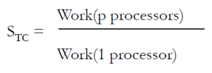
Skaliranje ograničeno vremenom
• Zadana je maksimalna količina vremena za izvršavanje, fiksno
• Cilj je smanjiti veličinu problema
• Broj procesora i količina vremena se povećava
• Primjer: simulacija vremenske prognoze sa poboljšanim, finijim rasterom
• “Ubrzanje” se definira kao

Slide 87
Motivacija za razvoj višejezgrenih/ višeprocesorskih sustava
• Moore-ov zakon
  • Obično temeljni zakon za ubrzanje single-core procesora
  • Obično kroz bolje spekulativno izvršavanje, koje na žalost ne daje linearno poboljšanje performansi
• Ovakva shema nije više moguća pošto Dennardovo skaliranje više ne vrijedi
  • Kakav je smisao razviti procesor koji koristi veću količinu energije bez većeg poboljšanja performansi?
• Višejezgrene arhitekture su efikasniji način korištenja tranzistora
  • Napredak u performansama dolazi kroz paralelizam, thread ili process-level paralelizam
  • Multi-core procesori su postojali i prije, ali su ih ovi problemi pogurnuli u mainstream
• Koji su izazovi kod komunikacije između više jezgri? Kako komuniciraju?

Slide 88
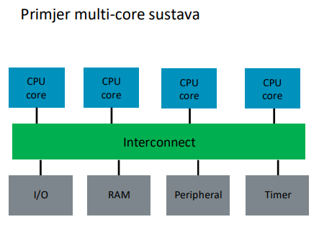
Multi-core arhitekture
• Više jezgri na jednom čipu
• Jezgre su spojene kroz nekakav oblik sabirnice
• Jezgre dijele neke komponente - npr. memorijsko sučelje ili neku razinu cache memorije

Slide 89
Multi-core
• Jezgre povezane i mogu surađivati
• Puno izazova:
  • Kako jezgre međusobno komuniciraju?
  • Kako se sinkroniziraju podaci?
  • Kako osiguravamo da jezgre ne dobe zastarjele podatke koje su modificirale druge jezgre?
  • Kako jezgre vide redoslijed događaja koji dolaze iz drugih jezgri?
• Obično ove koncepte razmatramo kroz razmatranje:
  • zajedničke memorije i prenošenja poruka
  • cache koherencije
  • konzistentnosti memorije

Slide 90
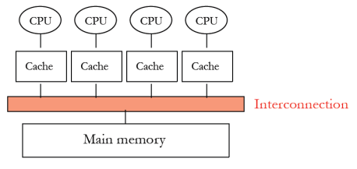
UMA/SMP
• Model zasnovan na slijedećoj fizičkoj organizaciji procesora i memorije:
  • fizički centralizirana memorija, uniformni pristup
  • sva memorija je na jednakoj "udaljenosti" od svih procesora - zbog toga se često zove i simetrično multiprocesiranje (SMP)
  • brzina rada memorije je fiksna i mora zadovoljiti potrebe svih procesora - problem skaliranja na veći broj procesora
  • Koristi se danas - npr.u sustavima sa jednim fizičkim podnožjem za procesore

Slide 91
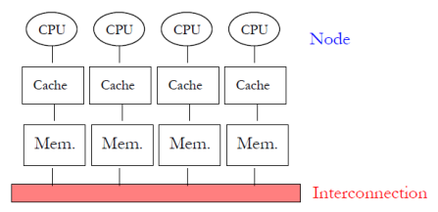
NUMA
• Model zasnovan na slijedećoj fizičkoj organizaciji procesora i memorije:
  • fizički distribuirana memorija, nije uniformna
  • dio memorije je alociran za svaki procesor
  • pokušava se napraviti sustav kod kojeg je većina zahtjeva prema memoriji lokalnog tipa
  • pristup lokalnoj memoriji je brži od pristupa remote memoriji
  • zajedno, to znači da ako imamo većinom lokalne pristupe memoriji, brzina rada memorije se povećava linearno sa brojem procesora
  • koristi se kod multi-socket sustava (serverski sustavi)

Slide 92
Paralelizam II - Paralelizam i heterogenost (asimetričnost)
PREDAVANJE 12 – II

Slide 93
Heterogenost (Asimetričnost) → Specijalizacija
• Pojmovi heterogenosti i asimetričnosti - isto značenje
• Heterogenost je generalni koncept dizajna sustava (i drugih stvari u životu)
• Ideja: umjesto više instanci istog resursa (homogeni, simetrični sustav), dizajnirajmo neke instance da budu drugačije (heterogene, asimetrične)
• Različite instance mogu biti optimizirane za veću efikasnost kod izvršavanja različitih tipova zadataka i/ili za zadovoljavanje drugačijih dizajn kriterija
  • to zapravo omogućuje specijalizaciju i prilagodbu

Slide 94
Zašto asimetričnost
• Različiti workload-i se drugačije ponašaju
  • različite aplikacije - različito ponašanje
  • različite faze izvršavanja aplikacije - različito ponašanje
  • ista aplikacija koja se izvršava u različito vrijeme može se drugačije ponašati (zbog promjena na ulazu, dinamičkih uvjeta okoline)
  • Npr. lokalnost, bolja predvidivost grananja, paralelizma na razini instrukcija, međuovisnosti podataka, ...
• Sustavi su dizajnirani za različite metrike u isto vrijeme
  • Gotovo nikad nemamo samo jedan cilj u dizajnu
  • Npr. performanse, energetska efikasnost, pravednost, predvidivost, pouzdanost, dostupnost, trošak, kapacitet memorije, latencija, ...
• Problem: Simetrični dizajn je one-size-fits-all
    • Pokušava jedan dizajn prilagoditi svim metrikama i aplikacijama
• Vrlo je teško napraviti takav dizajn
  • koji zadovoljava sve aplikacije čak i za samo jednu metriku
  • koji zadovoljava sve dizajn metrike za sve aplikacije u isto vrijeme
• Ovo vrijedi i za komponente i resurse
  • cache memorija, jezgre, memorijski kontroleri, sabirnice, diskovi, serveri, ...
  • algoritmi, politike, ...

Slide 95
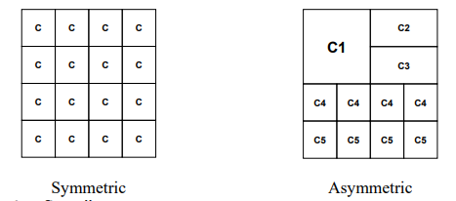
Asimetričnost omogućava prilagodbu
• Simetrično: One size fits all
  • Potrošnja energije i performanse nisu optimalni za različite aplikacije
• Asimetrično: Prilagodba
  • Potreba za procesiranjem varira s obzirom na aplikaciju
  • Pokretanje koda na resursu koji je najbolji fit

Slide 96
Primjeri, prije spomenuti
• CRAY-1 design: scalar + vector pipelines
• Modern processors: scalar instructions + SIMD extensions
• Decoupled Access Execute: access + execute processors
• Thread Cluster Memory Scheduling: different memory scheduling policies for different thread clusters
• RAIDR: Heterogeneous refresh rates in DRAM
• Heterogeneous-Latency DRAM (Tiered Latency DRAM)
• Hybrid memory systems
  • DRAM + Phase Change Memory
  • Fast, Costly DRAM + Slow, Cheap DRAM
  • Reliable, Costly DRAM + Unreliable, Cheap DRAM
• Heterogeneous cache replacement policies

Slide 97
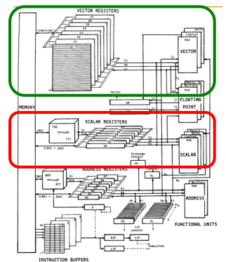
Primjer asimetričnog dizajna: CRAY-1
• CRAY-1
• Russell, “The CRAY-1 computer system, ” CACM 1978.
• skalarni i vektorski način rada
• 8 64-element vector registara
• 64 bits po elementu
• 16 memory banks
• 8 64-bit skalarnih registara
• 8 24-bitnih adresnih registara

Slide 98
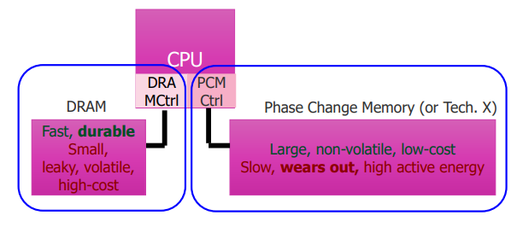
Prisjetimo se: hibridni memorijski sustavi
Hardware/software upravljaju alokacijom memorije kako bi se postiglo najbolje od više tehnologija odjednom

Slide 99
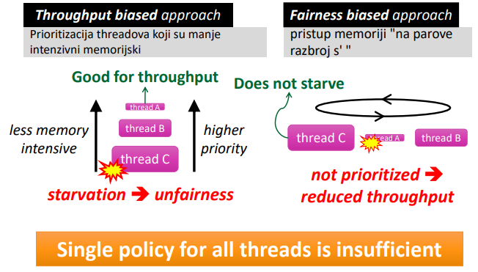
Propusnost vs. Pravednost

Slide 100

Podsjetimo se: Najbolje od oba svijeta

Slide 101

Scheduling threadova na razini memorije klastera

Slide 102


Heterogeno povezivanje (Tilera)
• 2D Mesh
• Pet mreža
• Prospajanje na razini četiri paketa
  • Dimension order routing, wormhole flow control
  • TDN: Cache request packets
  • MDN: Response packets
  • IDN: I/O packets
  • UDN: Core to core messaging
• Prospajanje na razini jednog sklopa
  • STN: Low-latency, high-bandwidth static network
  • Streaming data

Slide 103

General-Purpose vs. Special-Purpose
• Ideja asimetričnosti je - omogućiti specijalizaciju
• Da možemo premostiti jaz između čiste GP i SP arhitekture
  • čista GP: jedan dizajn za sve
  • čista SP: jedan dizajn po aplikaciji ili metrici
  • asimetrično: više pod-dizajna koji su optimizirani za neki set aplikacija i grupirani zajedno
• Cilj dobrog asimetričnog dizajna je da dobijemo najbolje od GP i SP svjetova

Slide 104
Asimetričnost - prednosti i mane
• Prednosti
  + omogućava optimizaciju za više metrika
  + može omogućiti bolju prilagodbu aplikaciji
  + daje SP benefite sa GP fleksibilnošću
• Mane
  - veći overhead i kompleksnost dizajna i verifikacije
  - veći overhead u upravljanju (scheduling)
  - overhead u prebacivanju između više komponenti može dovesti do degradacije performansi

Slide 105
Tri ključna problema budućih sustava
• Memorijski sustav
  • Aplikacije su sve više intenzivne s obzirom na podatke
  • Seljenje podataka limitira performanse i efikasnost
• Efikasnost (performanse i energija) → skalabilnost
  • Omogućava razvoj skalabilnijih sustava - nove aplikacije
  • Omogućava bolje korisničko iskustvo - novi usage modeli
• Predvidljivost i robusnost
  • Dijeljenje resursa i nepouzdanog hardvera = QoS problem
  • Predvidljivost performansi i QoS su primarna ograničenja

Slide 106
Komercijalni primjeri asimetričnog dizajna
• Integrirani CPU+GPU procesori (npr. Intel procesori sa GPUom)
• CPU+bilo koji hardverski akcelerator (npr. mobilni telefon)
  • Heterogeni multi-core sustavi
  • ARM big.LITTLE
  • IBM Cell
• CPU + FPGA sustavi (velika količina primjera)

Slide 107

Povećanje heterogenosti u modernim sustavima
• Heterogeni agenti: Veliki i mali procesori, GPU, akceleratori
• Heterogene memorije: Brzi i spori DRAM, NVMe
• Heterogene sabirnice : podaci, kontrola, sinhronizacija

Slide 108



Trenutne heterogene SoC arhitekture

Slide 109


Dizajn multi-core sustava: heterogeni princip
"Puno" jezgri na čipu (manycore)
• Jednostavniji dizajn, troši manje struje nego jedna velika jezgra
• Široki paralelizam na čipu

Slide 110

Problematika paralelizma
• Amdah-lov zakon
  • f: dio programa koji se može paralelizirati
  • N: broj procesora
• Amdahl, “Validity of the single processor approach to achieving large scale computing capabilities,” AFIPS 1967.
• Maksimalno ubrzanje limitirano je serijskim dijelom aplikacije - serijskim uskim grlom
• Paralelni dio aplikacije nikad nije savršeno paralelan
  • Overhead sinkronizacije (npr. mijenjanje djieljenih podataka)
  • Overhead neujednačenog opterećenja (nesavršenost u paralelizaciji)
  • Overhead dijeljenja resursa (natjecanje za resurse, za N procesora)

Slide 111

Problem: Serijski dio koda
• Ne može se sve paralelizirati
• Razlozi:
  • sekvencijalni dijelovi koda (Amdah-lov serijski dio koda)
  • kritične sekcije
  • prepreke
  • limitirana mogućnost pipelininga
• Serijski dijelovi koda:
  • smanjuju performanse
  • smanjuju skalabilnost
  • troše energiju

Slide 112
Zahtjevi različitih dijelova koda
• Što želimo:
  • U serijskom dijelu koda - jednu veliku, brzu jezgru
  • U paralelnom dijelu koda - veću količinu malih jezgri
• Ove dvije želje su u direktnom konfliktu
  • ako imamo jednu veliku, brzu jezgru, ne možemo imati puno jezgri
  • mala jezgra je puno više energetski i prostorno efikasna od velike jezgre

Slide 113

“Velike” vs. “Male” jezgre
Velike jezgre nisu efikasne: npr. 2x više performansi za 4x veću površinu

Slide 114


Velika jezgra: IBM POWER4
• Simetrični multi-core chip…
• Dvije velike jezgre
• 2 jezgre, out-of-order execution
• 100-entry instruction window u svakoj jezgri
• 8-wide instruction fetch, issue, execute
• veliki, lokalni i globalni hybrid branch predictor
• 1.5MB, 8-way L2 cache
• Aggressive stream based prefetching

Slide 115


Niagara Core
• četverojezgreni, 6-stage, in-order procesor
• round robin odabir threadova (osim kada se dogodi cache miss)
• dijeljeni FP unit

Slide 116
Performance vs. Parallelism
• Pretpostavke:
  1. Manja jezgra ima budžet za površinu = 1 i performanse 1
  2. Veća jezgra ima budžet za površinu = 4 i performanse 2

Slide 117


Pristup sa velikim jezgrama
Pristup sa malim jezgrama
• pločica sa više velikih jezgri
• IBM Power 5, AMD Barcelona, Intel Core2Quad, Intel Nehalem
+ visoke single-thread performanse, tj.serijske performanse
- loše performanse u paralelnom procesiranju
• na pločici je skupina malih jezgri
• Sun Niagara, Intel Larrabee, Tilera TILE (tile ultra-small)
+ velika brzina izvršavanja paralelnog dijela koda
- loše performanse serijskog dijela koda

Slide 118
Da li možemo dobiti oboje?
• velike jezgre
  + visoke single-thread performanse, tj.serijske performanse
  - loše performanse u paralelnom procesiranju
• male jezgre
  + velika brzina izvršavanja paralelnog dijela koda
  - loše performanse serijskog dijela koda
• Ideja: Obje vrste jezgri na jednom čipu - asimetrične performanse

Slide 119

Asymmetric Chip Multiprocessor (ACMP)
• Jedna velika i niz malih jezgri
+ Ubrzavanje serijskog dijela kroz velike jezgre
+ Ubrzavanje paralelnog dijela kroz male jezgre i korištenje velike jezgre za veliku propusnost

Slide 120

Accelerating Serial Bottlenecks

Slide 121
Accelerating Parallel Bottlenecks
• Serializirano ili nebalansirano izvođenje u paralenom dijelu koda može imati benefita od velike jezgre
• Primjer:
  • Kritične sekcije u kojem postoji natjecanje za resurse
  • Paralelne sekcije kojima treba dulje da se završe
• Ideja: dinamički identificirati te dijelove koda I pokrenuti ih na velikoj jezgri

Slide 122

ACMP performanse vs. paralelizam

Slide 123

Modifikacija Amdahl-ovog zakona
• Pojednostavljeni Amdahl-ov zakon za asimetrični multiprocessor
• Pretpostavke:
  • Serijski kod ide na veliku jezgru
  • Paralelni kod ide na male I velike jezgre
  • f: dio koda koji se da paralelizirati
  • L: broj velikih jezgri
  • S: broj malih jezgri
  • X: ubrzanje velike jezgre u odnosu na malu

Slide 124
Asimetričnost za energetsku efikasnost
• Kumar et al., “Single-ISA Heterogeneous Multi-Core Architectures: The Potential for Processor Power Reduction, ” MICRO 2003.
• Ideja:
  • Implementirati više tipova jezgri na procesoru
  • Nadgledati karakteristike threada koji je pokrenut (npr. periodički uzorkovati potrošnju energije I performansi svake jezgre)
  • Dinamički odabrati jezgru koja daje najbolji odnos energija/performanse za određenu fazu
    • Najbolja jezgra – ovisi o metrici koju koristimo za optimizaciju

Slide 125


Korištenje asimetrije za energetsku efikasnost
• Prednosti
  + Fleksibilnost
  + Možemo izvršavati operacije na jezgri koja je najbolja za te operacije (u smislu energetske potrošnje)
•Mane/problemi
    - Ako napravimo krivo predviđanje – izvršavanje na krivoj jezgri – lose performanse, pretjerana potrošnja energije ili oboje
    - Overhead zbog prebacivanja između jezgri
    - Trebamo napredno nadgledanje faze izvršavanja
      - Koje karakteristike nadgledati?
      - Kako odabrati jezgru?

Slide 126
Kako postići asimetriju?
• Statički
  • Tip I snaga jezgri fiksirani u fazi dizajna
  • Dva pristupa za dizajn “bržih” jezgri:
    • Viša frekvencija
    • Kompleksnija, robustnija jezgra sa drugačijom mikroarhitekturom
  • Da li je statička asimetrija prirodna? (varijacije u fekvenciji čipa postoje ovako I onako)
• Dinamički
  • Tip I snaga jezgri se dinamički mijenja
  • Dva pristupa za dizajn “bržih” jezgri:
    • Dinamički podići frekvenciju (unutar zadane potrošnje snage)
    • Kombinirati manje jezgre kako bismo dobili kompleksniju, jaču jezgru
    • Možda postoje I drugi pristup

Slide 127
Asimetričnost kroz podizanje frekvencije
• Statička
  • Varijacije u proizvodnom procesu znače da jezgre same po sebi mogu imati različitu frekvenciju
  • Namjerno dizajnirati jezgre tako da imaju različite frekvencije
• Dinamička
  • Annavaram et al., “Mitigating Amdahl’s Law Through EPI Throttling, ” ISCA 2005.
  • Dinamičko skaliranje korištenjem napona I frekvencije

Slide 128
EPI Throttling
• Cilj: Minimizacija vremena izvršavanja paralelnih programa kroz zadanu energetsku potrošnju
• Za najbolje performanse skalarne obrade I propusnosti, variramo količinu potrošene energije po instrukciji (EPI) bazirano na dostupnom paralelizmu
  • P = EPI •IPS
  • P = fixed power budget
  • EPI = energy per instruction
  • IPS = aggregate instructions retired per second
• Ideja: Za fiksirani budžet energije
  • Pokretati sekvencijalne zadatke na high-EPI procesoru
  • Pokretati paralelne zadatke na više low-EPI procesora

Slide 129

EPI Throttling kroz dinamičko skaliranje frekvencije naponom
• DVFS: Dynamic voltage frequency scaling
• U fazama koje imaju nisku razinu paralelizma
  • Pokrenuti izvršavanje na malo jezgri sa visokom frekvencijom I potrošnjom
• U fazama koje imaju visoku razinu paralelizma
  • Pokrenuti izvršavanje na velikom broju jezgri sa niskom frekvencijom I potrošnjom

Slide 130
Podizanje frekvencije male vs velike jezgre
• Podizanje frekvencije imaju svi Intelovi procesori od Nehalem jezgre na dalje, I npr. IBM POWER7
• Prednosti
  + jednostavna implementacija, ne trebamo redizajnirati ništa
  + paralelna propusnost ne pada kada je razina thread-level paralelizma visoka
  + čuva lokalnost threada koji radi na jezgri podignute frekvencije
• Mane
  - Ako je thread ograničen memorijom, nema ubrzanja
  - Ne smanjuje količinu ciklusa po instrukciji (CPI)
  - Mijenjanje frekvencije/napona može trajati dulje nego prebacivanje na veću jezgru

Slide 131
Puno pitanja za buduća istraživanja
• Kako dizajnirati asimetrične komponente?
• Fiksno, raspodijeljeno, sa mogućnošću rekonfiguraciju?
• Kakvi tipovi asimetričnosti? Koje tehnologije?
• Kakav nadzor provoditi u hardveru I softveru?
• Za otkrivanje faze I potreba trenutnog izvršavanja
• Kako dizajnirati feedback/kontrolnu petlju između komponenti I sistemskog softvera?
• Kako dizajnirati softver da automatski upravlja resursima?
• Praćenje ponašanja threadova, odabir best-fit komponenti za workload

Slide 132


Specifični use-case: HPC

Slide 133
Heterogeni pristupi podržani hardverom
• "There are multiple different technologies that are prominent - on desktop, server and HPC markets. Some common examples include:
  • GPGPU (General-Purpose Graphics Processing Unit) technologies like CUDA (Compute Unified Device Architecture) and OpenCL (Open Computing Language) on various hardware platforms like NVIDIA/AMD GPUs paired with x86 processors.
  • Intel Xeon Phi and similar accelerators, that can take advantage of concepts like OpenCL, OpenMP, C/C++, Fortran etc.
  • Xilinx and similar FPGA/ASICs, that can also take advantage of various concepts like OpenCL, HLS etc.”
• “All these solutions can be mixed and matched and used side-by-side with other solutions, like Open MPI (Open Message Passing Interface), Intel MPI, MPICH (MessagePassing Interface Chameleon) for distributed parallel computing, which fits well with the concept of HPC. Idea behind these technologies is quite straightforward – to run code on multiple processors and use one of these solutions via library calls."

Slide 134
Zašto je ovo zanimljivo?
• “x86-based ecosystem has been well-developed over the past 40+ years, which means that a lot of workloads can be handled by it.”
• “ARM-based ecosystem has been focused more on non HPC markets in the past However, the newly developed 64-bit architecture along with their respective SoCs will have a large impact on the CPU performance and memory bandwidth of these ARM processors in HPC domain.”
• “RISC-V based ecosystem has been focused on open-sourcing CPU technology via open instruction set and could be the “Linux of CPU design” if everything goes well.”
• “GPUs are very fast for specific types of workloads.”
• “ASICs are even faster for specific types of workloads.”

Slide 135


Zašto?

Slide 136

Zaključak
• Budućnost je heterogena
• Budućnost je hibridna
• Budućnost je (vrlo vjerojatno) manycore
• Budućnost je u “vrlo bliskoj integraciji”
• Budućnost je cross-design.

Slide 137
Memorijska hijerarhija
PREDAVANJE 13
OTVORITI PREZENTACIJU POSEBNO
jer ima 109 slajdova :’)

Slide 138
ARM assembly
VJEZBE 08
https://cpulator.01xz.net/?sys=arm-de1soc

Slide 139
Demo examples:
.global _start
_start:
mov r2, #13
mov r3, #14
add r0, r2, r3
mov r7,#1
mov r10,#3
svc 0
.global _start
_start:
main:
mov r0, #0
loop:
cmp r0, #512
beq end
add r0, r0, #1
b loop /* repeating the loop */ _stop:
b _stop
Create a loop that will count from 0 to 1024 in register R10
.global _start
_start:
main:
mov r10, #0
loop:
cmp r10, #1024
beq end
add r10, r10, #1
b loop /* repeating the loop */
_stop:
b _stop
.global _start
_start:
mov r2, #13
mov r3, #14
add r0, r2, r3
_stop:
b _stop

Slide 140
ARM assembly
VJEŽBE 09

Slide 141
Demo examples – blinking led:
.global _start
_start:
ldr r0,=LED
MOV r2,#0b00000001
_write:
str r2,[r0]
mov r5,#0
_delay:
add r5,r5,#1
cmp r5,#102400
bne _delay
str r3,[r0]
mov r5,#0
_delay2:
add r5,r5,#1
cmp r5,#102400
bne _delay2
str r2,[r0]
b _write
.data
.equ LED, 0xFF200000
Demo examples – counter
.global _start
_start:
ldr r0,=LED
MOV r2,#0b0000001
_write:
str r2,[r0]
mov r5,#0
_delay:
add r5,r5,#1
cmp r5,#102400
bne _delay
mov r5,#0
_delay2:
add r5,r5,#1
cmp r5,#102400
bne _delay2
str r3,[r0]
add r2,r2,#1
str r2,[r0]
b _write
.data
.equ LED, 0xFF200000
Demo examples – rolling led
.global _start
_start:
ldr r0,=LED
MOV r2,#0b0000001
_write:
str r2,[r0]
mov r5,#0
_delay:
add r5,r5,#1
cmp r5,#102400
bne _delay
mov r5,#0
_delay2:
add r5,r5,#1
cmp r5,#102400
bne _delay2
str r3,[r0]
ROR r2,#1
str r2,[r0]
b _write
.data
.equ LED, 0xFF200000

Slide 142
Demo examples – control:
global _start
_start:
ldr r0,=LED
MOV r2,#0b00000001
ldr r1,=switch
mov r3,#0
_write:
str r2,[r0]
mov r5,#0
_delay:
add r5,r5,#1
cmp r5,#102400
bne _delay
str r3,[r0]
str r2,[r0]
ROR r2,#1
_wait:
ldr r6,[r1]
cmp r6,#1
beq _wait
b _write
.data
.equ LED, 0xFF200000
.equ switch, 0xff200040
Demo examples UART:
.global _start
_start:
ldr r0,=UART
ldr r1,=TEXT_
_write:
ldrb r2,[r1]
cmp r2,#0
beq _stop
str r2,[r0]
add r1,r1,#1
b _write
_stop:
b _stop
.data
.equ UART, 0xFF201000
TEXT_: .asciz "Hello world from ARM!" .end
Output numbers 1,2,3,4,5,6 to seven segment leds (left to right)

Slide 143
Make leds move from left to right WHEN the switch is ON.
.global _start
_start: // ucitaj lokaciju switcha u r0, lokaciju led-a u r1, stavi 2 na 9 u r2, upisi r2 u led
ldr r0, =SW
ldr r1, =LED
mov r2,#0b1000000000
str r2, [r1]
_checkSwitch:
//stavi r5 u nulu, vazno za delay
mov r5,#0
//delay slicno implementiran kao u zadatku 2, ali ne kao subrutina
_delay:
add r5,r5,#1
cmp r5,#102400
bne _delay
//ucitaj vrijednost switcha u r3, ako je ta vrijednost 0 (nije ukljucen), vrati se na _checkSwitch
ldr r3,[r0]
cmp r3, #0
beq _checkSwitch
//provjeri je li vrijednost led-a 1, ako je, idi na shift desno, ako nije, idi na reset
cmp r2, #1
bne _shiftRight
b _reset
//shiftaj r2 za jedan u desno, upisi vrijednost r2 na memorijsku lokaciju r1 (led), vrati se na check switch
_shiftRight:
lsr r2, #1
str r2, [r1]
b _checkSwitch
//resetiraj r2 na 2 na 9, upisi vrijednost u memoriju na r1, vrati se na _checkSwitch
_reset:
mov r2,#0b1000000000
str r2, [r1]
b _checkSwitch
.data
.equ SW, 0xff200040
.equ LED, 0xff200000

Slide 144
ARM assembly
VJEŽBE 10

Slide 145
• Use switches to input number in binary
Show number on LED display as binary

Slide 146
Show that number as decimal on 7-segment led display
If the number changes, update the display

Slide 147
ARM assembly
VJEŽBE 11

Slide 148
.global _start
_start:
ldr r5,=UART
ldr r6,=STRING
loop:
ldrb r0,[r6]
cmp r0, #0
beq end
cmp r0,#0x60
blt writeout
bl convert
writeout:
bl write
add r6,r6,#1
b loop
write: str r0,[r5]
bx lr
convert:
sub r0,r0,#0x20
bx lr
.data
.equ UART, 0xff201000
STRING:
.asciz "Riba ribi grize rep"
Create a routine for subtracting two numbers
Create a routine for adding two numbers
.global _start
_start:
mov r1, #5
mov r2, #3
main:
bl addnum
bl subnum
addnum:
add r0, r1, r2
bx lr
subnum:
sub r0, r1, r2
bx lr

Slide 149
ARM assembly – Amdahl Law
VJEŽBE 12

Slide 150
Tasks :
.global _start
_start:
mov r0,#0
mov r5,#0
loop1:
add r0,r0,#1
add r5,r5,#1
cmp r0,#1024
blt loop1
mov r0,#0
loop2:
add r0,r0,#1
add r5,r5,#1
cmp r0,#2024
blt loop2
mov r0,#0
loop3:
add r0,r0,#1
add r5,r5,#1
cmp r0,#4024
blt loop3
mov r0,#0
loop4:
add r0,r0,#1
add r5,r5,#1
cmp r0,#1024
blt loop4
mov r0,#0

Slide 151

Amdahl Law
Smax is the maximum possible improvement of the overall system. It is expressed as a decimal greater than 1. If the operation is improved to be done in half the time, Smax = 2. Higher means a greater improvement.
p is the part of the system to be improved, expressed as a number between 0-1. If the part is 45% of the system, p = 0.45.
s is the improvement factor of p, expressed by how many times faster p can be done. If it can be done in 1/3rd the time, then s = 3.
Essentially, the equation subtracts out the part to be improved, then puts it back in after it has been improved.

Slide 152
Dodatno – sedam segmentni displej

Slide 153
1. Na displayu ispistati brojanje od 0 do 9
.global _start
_start:
ldr r0, =DISP
mov r1, #0 // Counter
ldr r2, =nums
_loop:
ldrb r3, [r2, r1]
str r3,[r0]
add r1, r1, #1
// Check if the counter is 10
cmp r1, #11
beq _counter_reset
_delay:
add r5,r5,#1
cmp r5,#204800
bne _delay
mov r5,#0
b _loop
_counter_reset:
mov r1, #0
b _loop
data
.equ DISP, 0xff200020
// To get these numbers, search online for 7 segment display codes
nums:
.byte 0x3f // 0
.byte 0x06 // 1
.byte 0x5b // 2
.byte 0x4f // 3
.byte 0x66 // 4
.byte 0x6d // 5
.byte 0x7d // 6
.byte 0x07 // 7
.byte 0x7f // 8
.byte 0x6f // 9

Slide 154
2. Brojanje u nazad (od 9 do 0)
.global _start
_start:
ldr r0, =DISP
mov r1, #9 // Counter
ldr r2, =nums
_loop:
ldrb r3, [r2, r1]
str r3, [r0]
// Check if the counter is negative
cmp r1, #-1
beq _counter_reset
sub r1, r1, #1
_delay:
add r5, r5, #1
cmp r5, #204800
bne _delay
mov r5, #0
b _loop
_counter_reset:
mov r1, #9
b _loop
.data
.equ DISP, 0xff200020
// To get these numbers, search online for
7 segment display codes
nums:
.byte 0x3f // 0
.byte 0x06 // 1
.byte 0x5b // 2
.byte 0x4f // 3
.byte 0x66 // 4
.byte 0x6d // 5
.byte 0x7d // 6
.byte 0x07 // 7
.byte 0x7f // 8
.byte 0x6f // 9

Slide 155
3. Brojanje svakog drugog u bilo kojem rasponu
.global _start
_start:
ldr r0, =DISP
mov r1, #0 // Counter
ldr r2, =nums
_loop:
ldrb r3, [r2, r1]
str r3,[r0]
// Check if the counter is 11
cmp r1, #11
// Branch Greater Than number
bgt _counter_reset
add r1, r1, #2
_delay:
add r5,r5,#1
cmp r5,#204800
bne _delay
mov r5,#0
b _loop
_counter_reset:
mov r1, #0
b _loop
.data
.equ DISP, 0xff200020
// To get these numbers, search online
for 7 segment display codes
nums:
.byte 0x3f // 0
.byte 0x06 // 1
.byte 0x5b // 2
.byte 0x4f // 3
.byte 0x66 // 4
.byte 0x6d // 5
.byte 0x7d // 6
.byte 0x07 // 7
.byte 0x7f // 8
.byte 0x6f // 9

Slide 156
4. Brojanje parnih u bilo kojem rasponu
Isto kao i rjesenje treceg zadatka
5. Brojanje neparnih u bilo kojem rasponu
Isto kao i treci/cetvrti, samo sto treba promjeniti da se u r1 registar pri resetiranju brojaca i na pocetku programa stavi vrijednost #1

Slide 157
6. Brojanje na nekoj od mogućih pozicija, npr. brojanje na 3. displayu
.global _start
_start:
ldr r0, =DISP
mov r1, #0 // Counter
ldr r2, =nums
mov r7, #16 // Display position (N/8)
// 0 is pos 0, 8 is pos 1, 16 is pos 2
// and if we want to access 4/5/6/7, we
// have to store it in the second byte of
// The display
mov r5, #0 // Delay counter
_counter_reset:
mov r1, #0
b _loop
.data
.equ DISP, 0xff200020
// To get these numbers, search online
for 7 segment display codes
nums:
.byte 0x3f // 0
.byte 0x06 // 1
.byte 0x5b // 2
.byte 0x4f // 3
.byte 0x66 // 4
.byte 0x6d // 5
.byte 0x7d // 6
.byte 0x07 // 7
.byte 0x7f // 8
.byte 0x6f // 9
_loop:
ldrb r3, [r2, r1]
mov r6, r3
mov r6, r6, lsl r7
str r6, [r0]
// str r3, [r0]
add r1, r1, #1
// Check if the counter is 10
cmp r1, #11
beq _counter_reset
_delay:
add r5, r5, #1
cmp r5, #204800
bne _delay
mov r5, #0
b _loop

Slide 158
ispisi brojeve od 1-8
.global _start
_start:
ldr r0, =DISP
ldr r1, =BROJKE_1
str r1, [r0, #0x10]
ldr r2, =BROJKE_2
str r2, [r0]
.data
.equ DISP, 0xff200020
.equ BROJKE_1, 0x065b4f66
.equ BROJKE_2, 0x6d7d077f
ispisi u obrnutom rasporedu brojeve od 8-1
.global _start
_start:
ldr r0, =DISP
ldr r1, =BROJKE_1
str r1, [r0, #0x10]
ldr r2, =BROJKE_2
str r2, [r0]
.data
.equ DISP, 0xff200020
.equ BROJKE_1, 0x7f077d6d
.equ BROJKE_2, 0x664f5b06

