Slide 1
Grupni zadatak
Madlen Majetić, Marija Meštrović, Karla Đerek

Slide 2
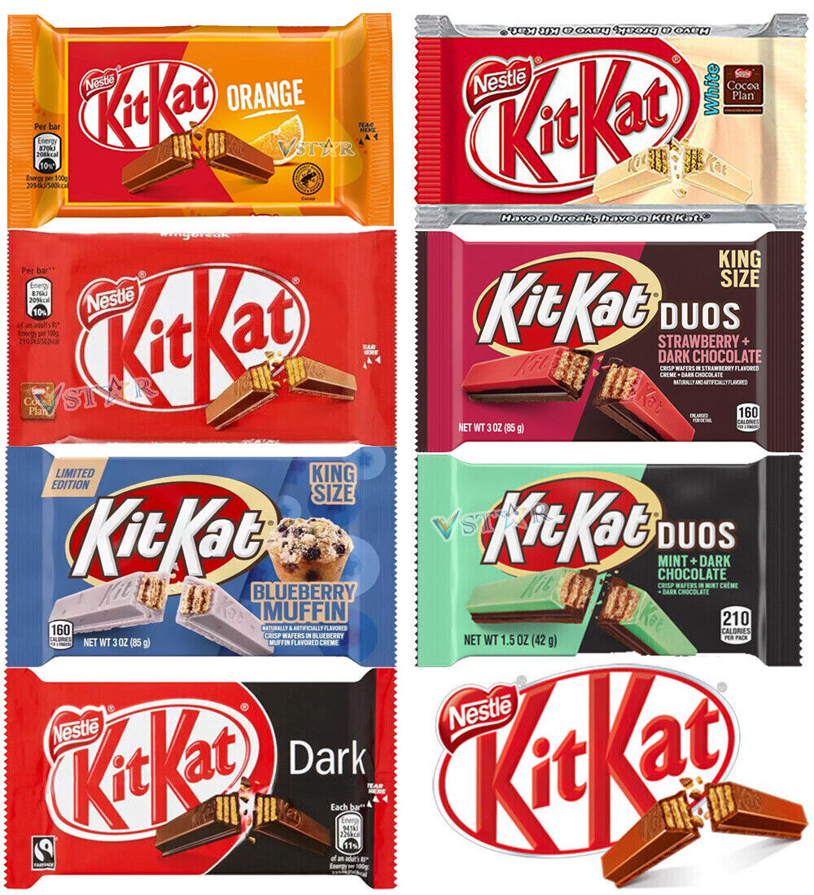
Line extension

Slide 3
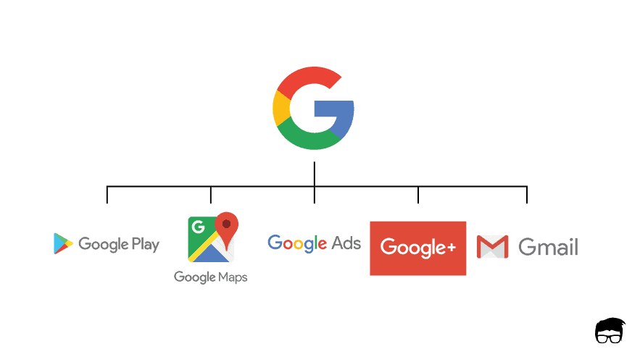
Brand extension

Slide 4

Multi-brands

Slide 5
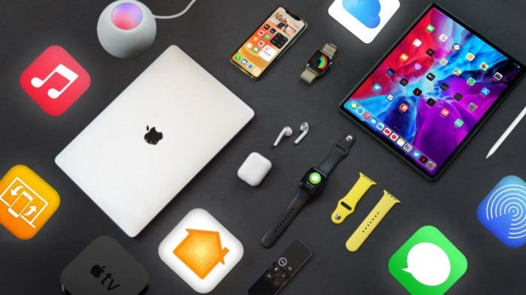
Corporate branding

Slide 6
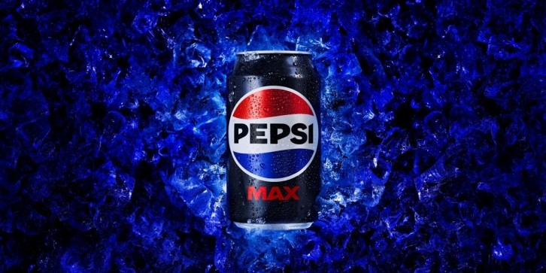
Global brand

Slide 7
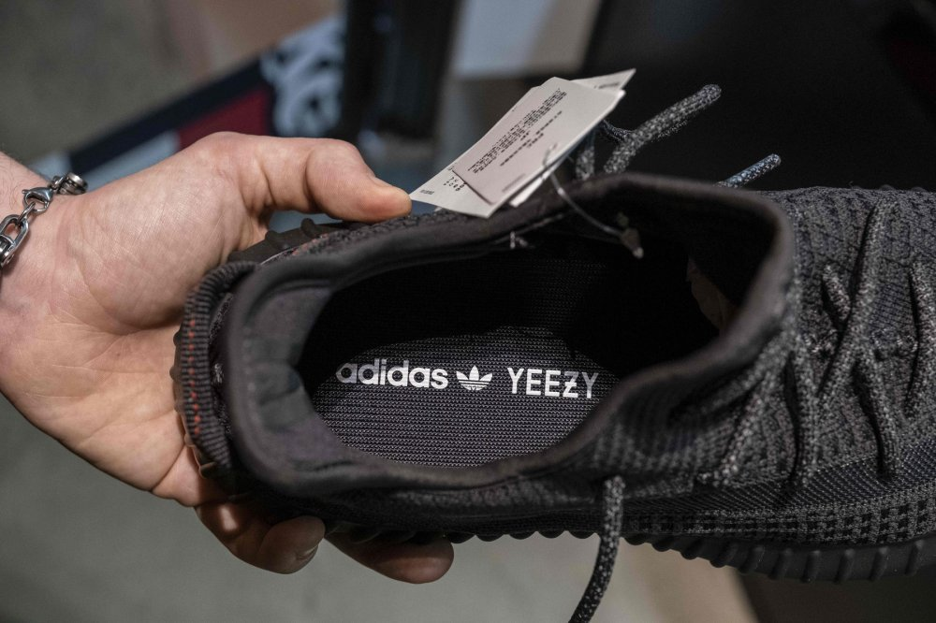
Co-branding

Slide 8
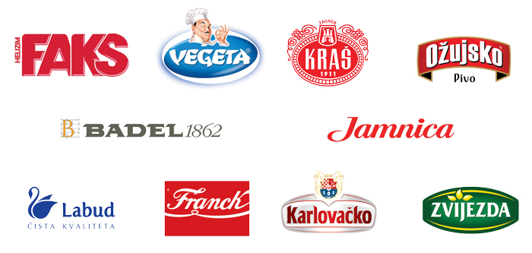
Local brand

Slide 9
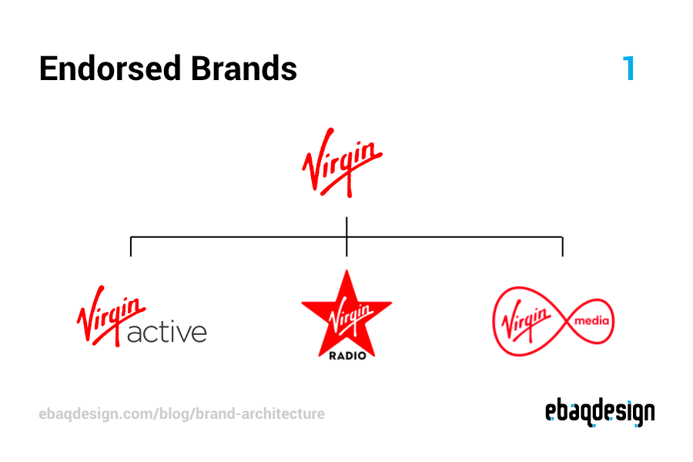
Endorsement

Slide 10

Ingrediant branding

