Slide 1
The Conditionals

Slide 2
What are they?
A conditional sentence comprises two clauses:
the IF clause, + the main clause
(the condition) (the result)
We use conditional sentences to talk about the relationship between events and their consequences.

Slide 3
THE ZERO CONDITIONAL
(aka The Present Conditional, The Universal Condition)
IF + PRESENT TENSE, PRESENT TENSE
If you heat ice, it melts.
We don’t process orders the same day if we receive them after 3 pm.
*We can also use an imperative or a modal for the result:
Don’t get into an unlicensed taxi if you’re traveling alone.
What should I do if my computer crashes?
The condition always has THE SAME RESULT!

Slide 4
THE FIRST CONDITIONAL
IF + PRESENT TENSE, WILL + infinitive
(real possibility in the present!)
If you study, you will pass the exam.
If you order it now, we could get it to you by tomorrow.
(modal verb)
If they arrive early, take them to the canteen. (imperative)
We use it to talk about actions that WILL or are likely to happen in the future, depending on another action happening.

Slide 5
Alternatives to IF
We can use these alternatives to IF with conditionals to talk about real present and future:
• as long as/ providing/provided (that) / on condition that / so long as= if only
( conditionals I & II)
A sports centre is a low financial risk as long as/providing/ provided that
you sell memberships.
unless = except if (conditional I)
People won’t fill in marketing questionnaires unless you offer them a prize.
in case / in the case of / in the event that / in the event of = to avoid a possible
problem later (conditional I)
I’ll keep my mobile with me in case you need to contact me.

Slide 6
THE SECOND CONDITIONAL
IF + PAST TENSE, WOULD + infinitive
(unreal possibility in the present)
If I won the lottery, I would quit my job.
If we had a good database, we wouldn’t waste so much time.
If we didn’t have such poor customer service, we’d be much more successful.
We use it to talk about things in the future that are probably not going to be true (hypothetical present = when we are thinking about the present situation and imagining how it could be different)

Slide 7
THE THIRD CONDITIONAL
IF + PAST PERFECT, WOULD + HAVE + PAST PARTICIPLE
(unreal possibility in the past!)
If she had studied, she would have passed the exam.
If you hadn’t been late, we wouldn’t have missed the bus.
It wouldn’t have taken so much time if they’d known who to contact.
We use it to describe a situation that didn't happen, and to imagine the result of this situation (hypothetical past)

Slide 8
MIXED CONDITIONALS
1. [If + type II conditional, type III conditional]: a hypothetical present situation that is the result of a past action that did not actually happen.
II + III
If I were you, I would have called.
If I were more outgoing, I would have asked her out.
If I were on a better salary, I would have bought that car.
If I weren’t going to that wedding, I would have gone out last night.

Slide 9
MIXED CONDITIONALS cont.
2. [If + type III conditional, type II conditional]: a hypothetical present or future result that is the consequence of a past action that did not actually happen.
III + II
If I hadn’t told you the results, you would be in a better mood now.
If I had finished high school, I would be a college student now.
If I had bought it, then it would be worth $1.5 million today.
If I had gone to the party last night, I would be exhausted now.

Slide 10
INVERTED CONSTRUCTIONS
CONDITIONAL I - inverted construction with SHOULD
Should the business fail, they will be able to recover their loan.
CONDITIONAL II - inverted construction with the subjunctive
WERE …TO
Were the business to fail, they would be able to recover their loan.
CONDITIONAL III - inverted construction with the past perfect
Had the deal gone ahead, around 75% of the market for textiles would have ended up in the hands of two firms.

Slide 11
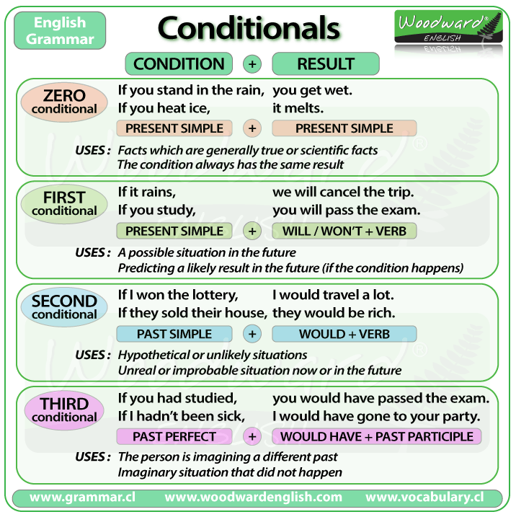
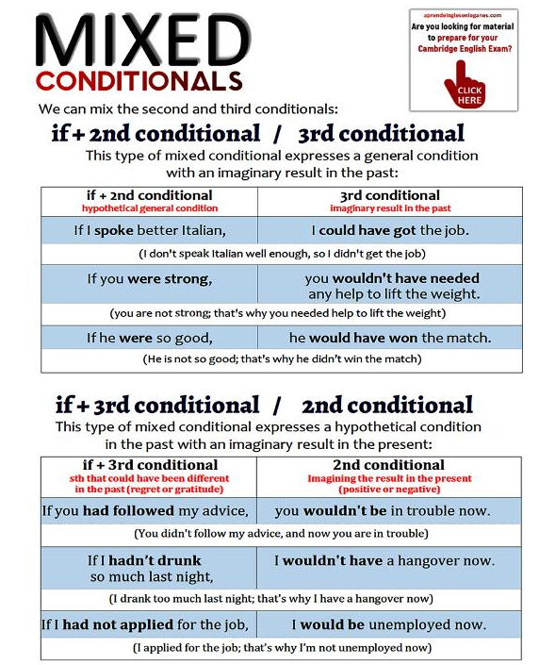
Summary chart

Slide 12
Let’s revise!
https://www.ego4u.com/en/cram-up/tests/conditional-sentences-3
https://test-english.com/grammar-points/b1/first-and-second-conditionals/
https://www.perfect-english-grammar.com/conditional-exercises.html
https://test-english.com/grammar-points/b2/mixed-conditionals/

Slide 13
#neverstoplearning

