Slide 1
MODAL VERBS

Slide 2
TYPES OF VERBS
There are 4 types of verbs:
Main verbs – A “main” verb expresses an action, event, or state (e.g. play, run, learn, swim, go, be, have, do).
Linking verbs (copular verbs) – A type of verb that describes the subject of a sentence (e.g. seem, be, become, appear, taste)
Auxiliary verbs – Also known as “helper verbs,” these work alongside a main verb to express different tenses and grammatical moods. Only three: be, have & do.
Modal verbs – These help us express possibility, intent, ability, or necessity.

Slide 3

MODAL VERBS
Modal verbs are a type of auxiliary verbs which are verbs that cannot be used on their own. They need to be accompanied by another (main) verb. Sometimes modal verbs are called modal auxiliaries.

Slide 4
NECESSITY
MUST – when the speaker feels the necessity
I must go on a diet. I’m getting overweight.
HAVE (GOT) TO – when the necessity is outside the speaker
I have to go on a diet. The doctor has told me to.
NEEDN’T – lack of necessity is felt by the speaker
You needn’t take me to the station. I can walk.
• DON’T HAVE TO – it results from the situation
You don’t have to take me to the station. Mary is giving me a lift.
• MUSTN’T – we use it to tell someone NOT TO DO something
Student’s must not use dictionaries in the examination.

Slide 5
OBLIGATION AND ADVICE
SHOULD & OUGHT TO – to say what is the right thing or the
best thing to do
They should/ought to build more hospitals.
• HAD BETTER – to say what is the best thing to do in a
particular situation (stronger than should!)
You’re ill. You had better see a doctor.
• BE SUPPOSED TO – what people expect to happen because it
is the normal way of doing things
This jacket is supposed to have been cleaned, but it looks dirty.

Slide 6
PERMISSION
GIVING PERMISSION = CAN or MAY
Any person over 18 years may/can apply to join the club.
REFUSING PERMISSION = CANNOT/ CAN’T or MAY NOT
Customers cannot/may not bring their own food into this café.
ASKING PERMISSION = CAN, COULD or MAY
Can/Could/May I take your umbrella?
THE PERMISSION DOES NOT DEPEND ON THE SPEAKER = BE ALLOWED TO
Are we allowed to leave early?

Slide 7
CERTAINTY
• WILL – expresses a prediction
There’s someone at the door. – It’ll be the postman.
MUST – speaker sees something as logically true
CAN’T – speaker sees something as logically impossible
The bill can’t be so much. There must be some mistake.

Slide 8
PROBABILITY
SHOULD & OUGHT TO
We should know / ought to know the result soon.
They should have / ought to have our letter by now.

Slide 9
POSSIBILITY
MAY & MIGHT
This old picture may / might be valuable.
That may not / might not be a bad idea.
• CAN & COULD
We can / could have a party.
If we’re short of money, I can / could sell my jewellery.

Slide 10
ABILITY
CAN (present)
Can you play the piano?
• COULD (past)
Nicola could play chess when he was six.
• BE ABLE TO (future)
Great news! I will be able to come to your party after all!

Slide 11
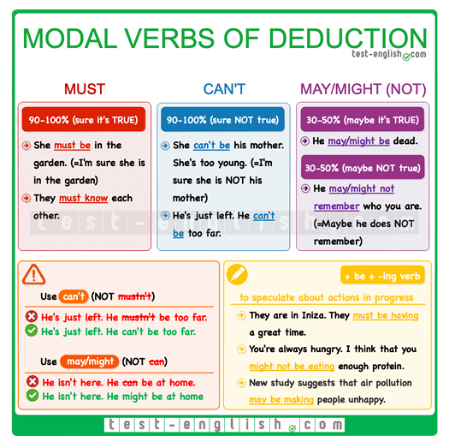
Summary chart

Slide 12
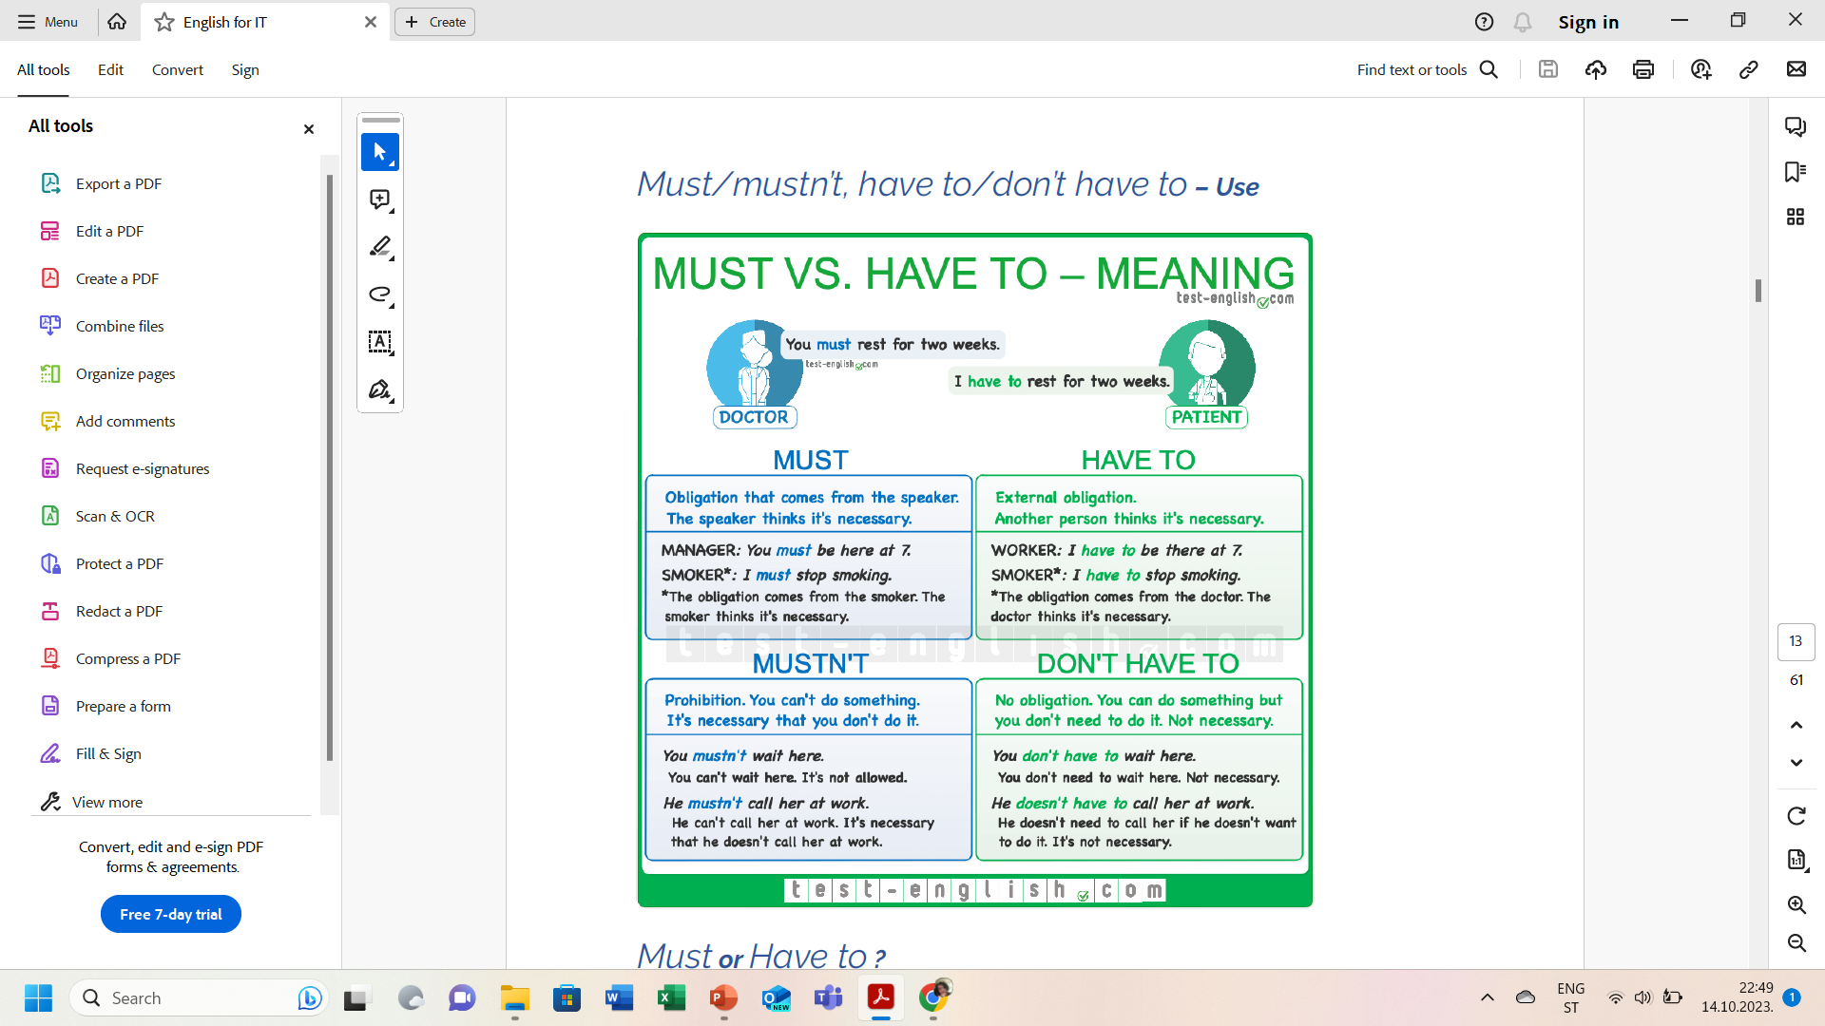
Summary chart

Slide 13
Summary chart

Slide 14
Let’s practice!
https://www.callanschool.info/images/noticias_pdf/primary-auxiliaries.pdf
https://test-english.com/grammar-points/b1/modal-verbs-of-deduction/
https://test-english.com/grammar-points/b1/have-to-must-should/
https://www.english-grammar.at/online_exercises/modal-verbs/m016.htm

Slide 15
#neverstoplearning

