Slide 1
Sigurnost informacijskih sustava
mr.sc. Dražen Pranić

Slide 2
Uvod
Osnovni pojmovi
Identifikacija
Autentifikacija
Autentifikacijske metode

Slide 3
Aaron Barr slučaj (početak 2011)
CEO sigurnosnih tvrtki HBGary and HBGary federal
Clients from financial industry, US government
https://www.itworld.com/article/2747872/who-is-anonymous--commander-x--not-this-guy.html
In interview with Financial Times → planned to reveal the names of some “leaders” of the hacker group Anonymous
Anonymous responded by hacking HBGary Federal’s site, stealing 71,000 emails from the company and its sister firm HBGary, and defacing Barr’s Twitter account.
Anonymous posted in public 71.000 HBGary’s business emails → confidential information with their partners were exposed
Aaron Barr has been re-using a one password across multiple systems → company gmail

Slide 4
Microsoft incident
Beginning in late November 2023, the threat actor used a password spray attack to compromise a legacy non-production test tenant account and gain a foothold, and then used the account’s permissions to access a very small percentage of Microsoft corporate email accounts, including members of our senior leadership team and employees in our cybersecurity, legal, and other functions, and exfiltrated some emails and attached documents.
The investigation indicates they were initially targeting email accounts for information related to Midnight Blizzard itself. We are in the process of notifying employees whose email was accessed.

Slide 5
Microsoft incident
Microsoft originally disclosed the breach in late January and attributed it to a group it calls Midnight Blizzard, which has been linked to Russia's SVR by the US and UK governments.
It is apparent that Midnight Blizzard is attempting to use secrets of different types it has found. Some of these secrets were shared between customers and Microsoft in email, and as we discover them in our exfiltrated email, we have been and are reaching out to these customers to assist them in taking mitigating measures. Midnight Blizzard has increased the volume of some aspects of the attack, such as password sprays, by as much as 10-fold in February, compared to the already large volume we saw in January 2024.
The 'secrets' Microsoft refers to could include API keys, access tokens or passwords.

Slide 6
Microsoft report
https://www.cisa.gov/sites/default/files/2024-04/CSRB_Review_of_the_Summer_2023_MEO_Intrusion_Final_508c.pdf?is=f0dfcb67a8bf905fdbe4f8e079980e46b13165ce0f6d5a4345bcb6fc93cd8c3f
In May and June 2023, a threat actor compromised the Microsoft Exchange Online mailboxes of 22 organizations and over 500 individuals around the world. The actor—known as Storm-0558 and assessed to be affiliated with the People’s Republic of China in pursuit of espionage objectives—accessed the accounts using authentication tokens that were signed by a key Microsoft had created in 2016.
This intrusion compromised senior United States government representatives working on national security matters, including the email accounts of Commerce Secretary Gina Raimondo, United States Ambassador to the People’s Republic of China R. Nicholas Burns, and Congressman Don Bacon.

Slide 7
Microsoft report
The Board finds that this intrusion was preventable and should never have occurred.
The Board also concludes that Microsoft’s security culture was inadequate and requires an overhaul, particularly in light of the company’s centrality in the technology ecosystem and the level of trust customers place in the company to protect their data and operations.

Slide 8
Microsoft report
the cascade of Microsoft’s avoidable errors that allowed this intrusion to succeed;
Microsoft’s failure to detect the compromise of its cryptographic crown jewels on its own, relying instead on a customer to reach out to identify anomalies the customer had observed;
the Board’s assessment of security practices at other cloud service providers, which maintained security controls that Microsoft did not;
Microsoft’s failure to detect a compromise of an employee's laptop from a recently acquired company prior to allowing it to connect to Microsoft’s corporate network in 2021;
Microsoft’s decision not to correct, in a timely manner, its inaccurate public statements about this incident, including a corporate statement that Microsoft believed it had determined the likely root cause of the intrusion when in fact, it still has not; even though Microsoft acknowledged to the Board in November 2023 that its September 6, 2023 blog post about the root cause was inaccurate, it did not update that post until March 12, 2024, as the Board was concluding its review and only after the Board’s repeated questioning about Microsoft’s plans to issue a correction

Slide 9
Microsoft report
the Board's observation of a separate incident, disclosed by Microsoft in January 2024, the investigation of which was not in the purview of the Board’s review, which revealed a compromise that allowed a different nation-state actor to access highly-sensitive Microsoft corporate email accounts, source code repositories, and internal systems;
how Microsoft’s ubiquitous and critical products, which underpin essential services that support national security, the foundations of our economy, and public health and safety, require the company to demonstrate the highest standards of security, accountability, and transparency.

Slide 10
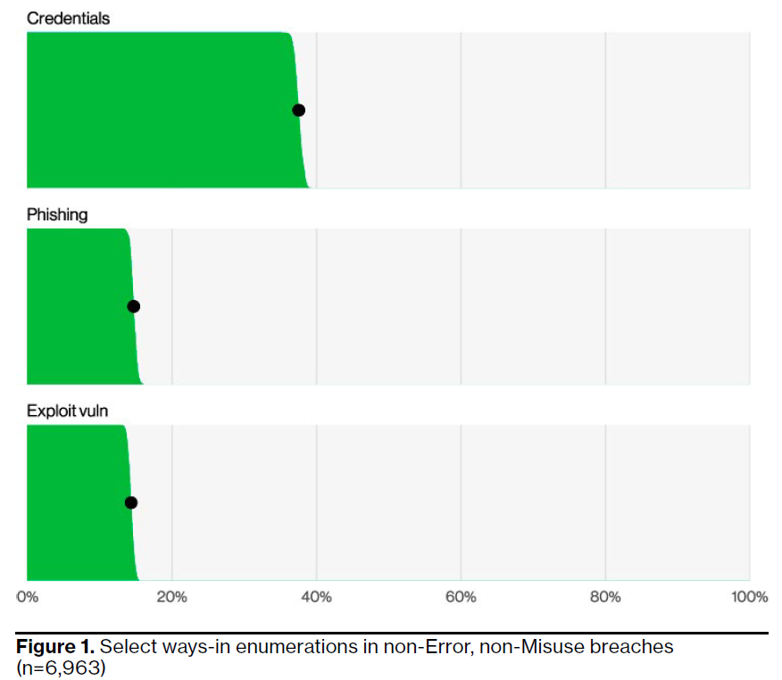
Verizon Data Breach Izvještaj 2024

Slide 11
Identifikacija
Identifikacija – proces kojim korisnik predočava informacijskom sustavu zahtijevani identitet
Najčešće se provodi pomoću jedinstvene korisničko-identifikacijske oznake (engl. User ID)
Identifikacija korisnika mora biti jedinstvena
Osigurati primjereno upravljanje jedinstvenim korisničko-identifikacijskim oznakama

Slide 12
Autentifikacija
Proces kojim se potvrđuje korisnički identitet koji zahtijeva pristup informacijskom sustavu
Tri načina utvrđivanja korisničkog identiteta
  Nešto što samo korisnik zna
  Nešto što samo korisnik posjeduje
  Nešto što korisnik jest (različite biometrijske metode)
Mogu se primjenjivati samostalno ili u kombinaciji

Slide 13
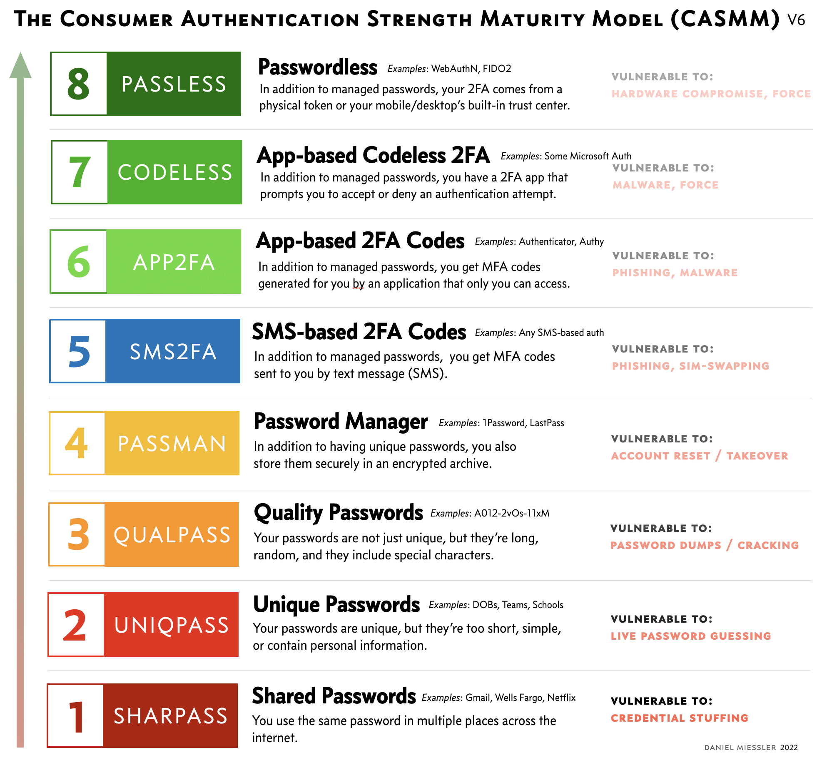

Slide 14
Nešto što samo korisnik zna
PIN
Lozinka
  Upravljanje lozinkama
  Protokoli za slanje lozinka preko mreže
Lozinkama je potrebno upravljati!
  imaju životni ciklus, i pravila za postavljanje

Slide 15
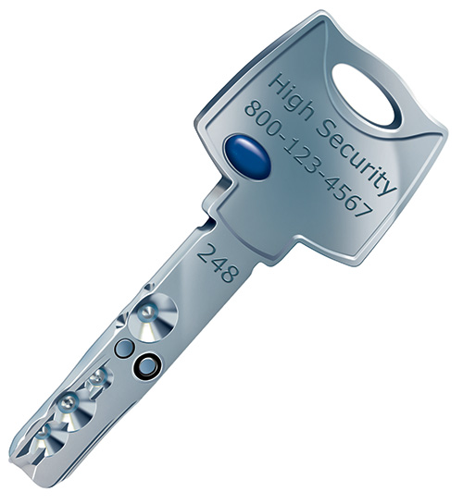
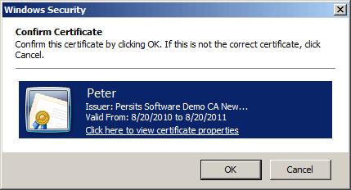
Nešto što samo korisnik posjeduje
Ključ
Certifikat
Pametna kartica

Slide 16
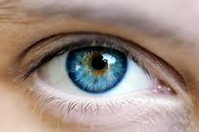
Nešto što korisnik jest
Koncept „nešto što jesam” temelji se na biometriji.
  Najjednostavniji primjer - otisak prsta
  Najskuplji – skeniranje šarenice oka
Biometrija
  Cijena
  Opravdanost
Tehnologija jako napreduje

Slide 17
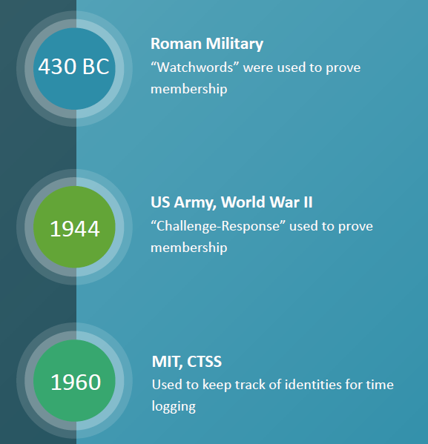
Lozinke (nešto što korisnik zna)
https://www.welivesecurity.com/2017/05/04/short-history-computer-password

Slide 18
Još malo o zaporkama
https://blog.dashlane.com/virginia-tech-passwords-study/
…access to the anonymized version of the 61.5 million passwords from the project so they could conduct further research into password trends…
Virginia Tech researchers led by Dr. Wang have collected a number of publicly available password datasets from the Internet in January 2017. The datasets were obtained from various online forums and data archives. The resulting 107 datasets (61.5 million passwords) allow the researchers to analyze how users reuse and modify their passwords across different online services.
52% of the users studied have the same passwords (or very similar and easily hackable ones) for different services.

Slide 19
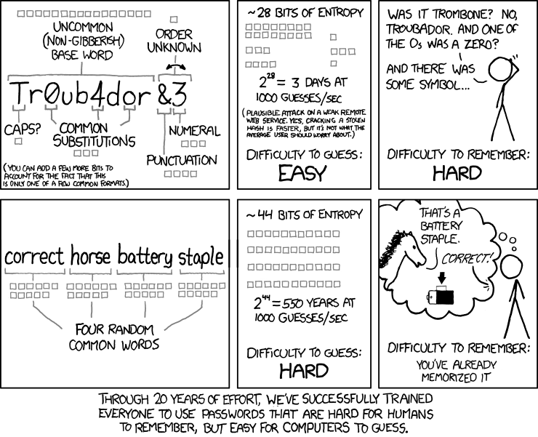

Slide 20
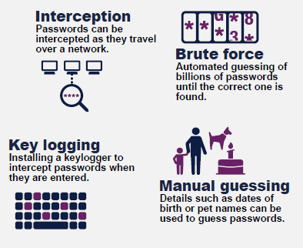
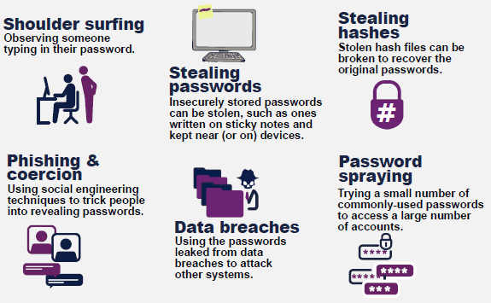
Kako se zaporke otkrivaju?

Slide 21
NIST guideline
while primarily targeted at federal agencies, these standards have become the de facto benchmark for password security thanks to their comprehensive research, rigorous review process, and universal applicability.
https://www.theverge.com/2017/8/7/16107966/password-tips-bill-burr-regrets-advice-nits-cybersecurity

Slide 22
NIST do advices
Special Publication 800-63-3: Digital Authentication Guidelines
https://nvlpubs.nist.gov/nistpubs/SpecialPublications/NIST.SP.800-63B-4.2pd.pdf
Password Length: A password should be at least 8 characters long and preferably 15 characters. This is because passwords can be cracked, and the longer the password, the longer it takes to crack the code.
Allow Flexibility in Length: You can go up to 64 characters for passwords thus providing users with the opportunity to create a more complex password.
Character Options: More password entropy, meaning the passwords should also be able to accept space and all printable ASCII characters.
Unicode Support: Passwords should also allow Unicode characters, which helps users include characters from different languages. Each Unicode character counts as one towards the total password length.

Slide 23
NIST don’t do advices
Arbitrary Complexity Requirements: Eliminate unproductive, rigid guidelines that currently include having to type both lower and upper case, numbers, and symbols. Most of the time they don’t offer protection and are incredibly annoying to the users.
Periodic Password Resets: Don’t force users to change passwords at regular intervals unless there is evidence of a security breach. Requiring constant resets can lead to weaker passwords over time.
Password Hints: Stop allowing users to store password hints that could potentially be exposed to unauthorized users.
Security Questions: Stop relying on outdated security questions like “What was the name of your first pet?” These are easy for attackers to guess or find out through social engineering.

Slide 24
Zašto je loša redovita promjena zaporki?
https://www.sans.org/security-awareness-training/blog/time-password-expiration-die
OUTDATED THREAT MODEL
  the greatest risk to your password is no longer cracking, but password harvesting.
BEHAVIORAL COST
  lost employee time and help desk tickets …the cost to corporate security culture.
INCREASING RISK
  the only behavior you are really promoting in your workforce is people are simply incrementing that number 1 at the end of their password to a number 2.

Slide 25
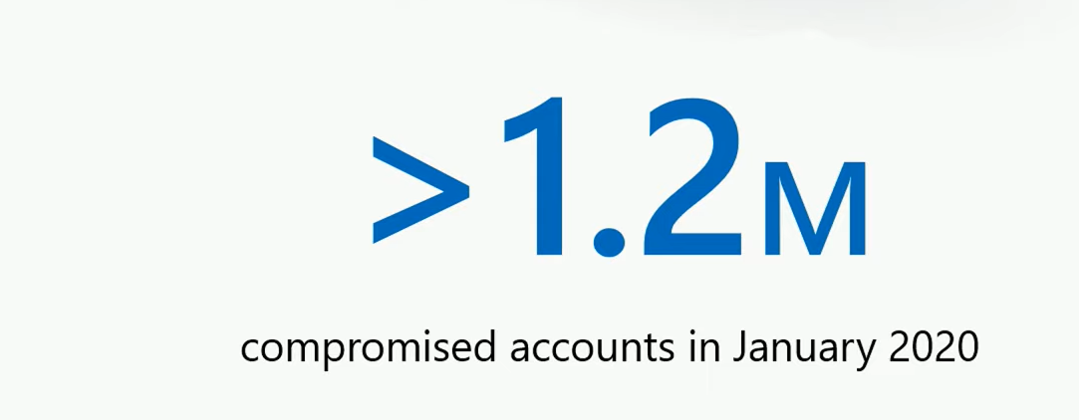
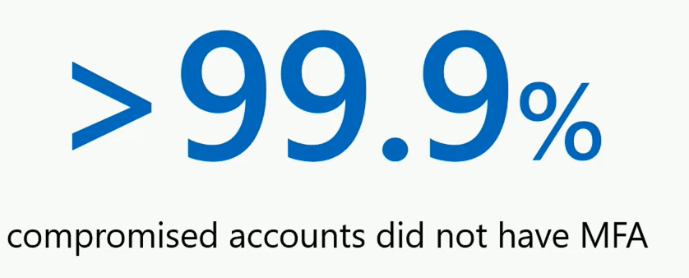
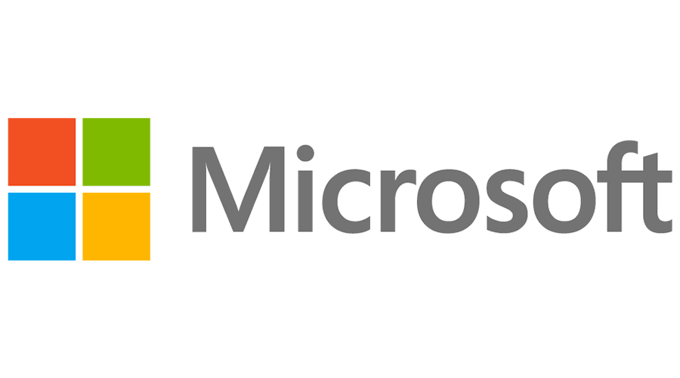
0,5 % svih enterprise računa
AG = 15 računa

Slide 26
Dvo-faktorska ili više-faktorska autentifikacija
Kombinacija dvaju načina autentifikacije (2FA) ili više faktora (MFA)
Internet bankarstvo u Hrvatskoj -„Autentifikacija osoba mora uključivati kombinaciju najmanje dvaju načina potvrđivanja korisničkog identiteta, gdje je god to moguće primijeniti” (čl 37.2 HNB Odluka o upravljanju informacijskim sustavom)

Slide 27
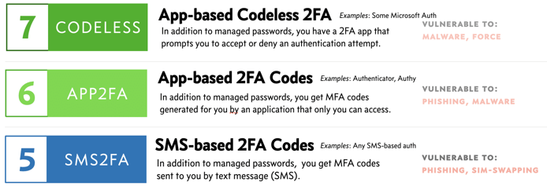
2FA/MFA metode
OTP softver – OTP (engl. one-time password) generiran od kompanije i poslan na mobilni uređaj, e-mail,…
Mobilna autentikacijska aplikacija
Hardverski – OTP generiran od sigurnosnog uređaja/tokena
Hardverski – certifikat spremljen na FIDO ključu

Slide 28
2FA korištenjem mobilnih aplikacija
Bazirano na vremenskoj sinkronizaciji
Simetrični ključ se šalje kroz QR code
Temeljem jedinstvenog ključa i vremena se kreira OTP
Vremenski interval obično traje 30 sekundi
Telefon je autonoman u kreiranju OTP-a (ne treba veza s Internetom, SIM kartica,…)

Slide 29
Mobilna autentikacijska aplikacija ili sms OTP
https://pages.nist.gov/800-63-3/sp800-63b.html
NIST smatra SMS nesigurnom OTP metodom
Zašto se onda koristi SMS?
  Lakoća implementacije
  Korištenje mobilne aplikacije ovisi o korisniku → mora podesiti aplikaciju (učitati QR code,…)

Slide 30
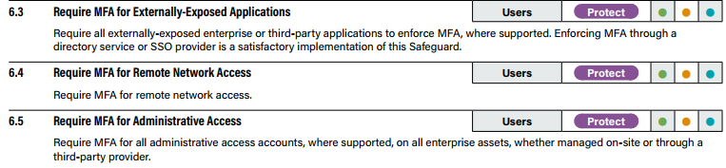
Kada obvezno tražiti MFA?

Slide 31
MFA napadi („MFA bombing”)
“Many MFA providers allow for users to accept a phone app push notification or to receive a phone call and press a key as a second factor,” Mandiant researchers wrote.
“The [Nobelium] threat actor took advantage of this and issued multiple MFA requests to the end user’s legitimate device until the user accepted the authentication, allowing the threat actor to eventually gain access to the account.”
“No limit is placed on the amount of calls that can be made,” a member of Lapsus$ wrote on the group’s official Telegram channel. “Call the employee 100 times at 1 am while he is trying to sleep, and he will more than likely accept it. Once the employee accepts the initial call, you can access the MFA enrollment portal and enroll another device.”

Slide 32
MFA napadi
Sending a bunch of MFA requests and hoping the target finally accepts one to make the noise stop.
Sending one or two prompts per day. This method often attracts less attention, but “there is still a good chance the target will accept the MFA request.”
Calling the target, pretending to be part of the company, and telling the target they need to send an MFA request as part of a company process.

Slide 33
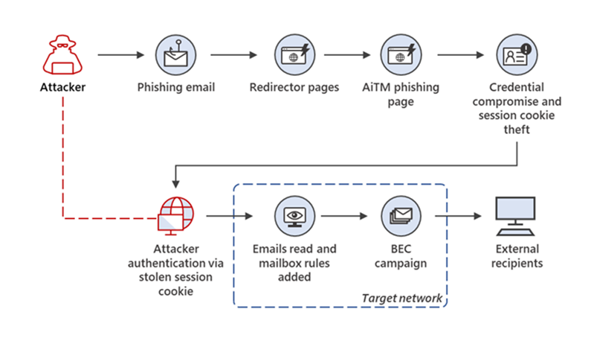
Adversary-in-the-middle (AiTM) phishing sites
In AiTM phishing, attackers deploy a proxy server between a target user and the website the user wishes to visit (that is, the site the attacker wishes to impersonate).
steal and intercept the target’s password and the session cookie that proves their ongoing and authenticated session with the website.

Slide 34
Risk based autentifikacija
Kontekstualna (Risk Based) autentifikacija postaje sve važnija
Potrebno pronaći pravi balans između jačine autentifikacije, ukupne cijene koštanja i korisničkog iskustva
Uređaj korisnika, IP adresa, vrijeme spajanja važni parametri
U pravilu navedeno omogućavaju cloud autentifikacijski servisi
Je li dobra praksa svaki put korisnika tražiti MFA?

Slide 35
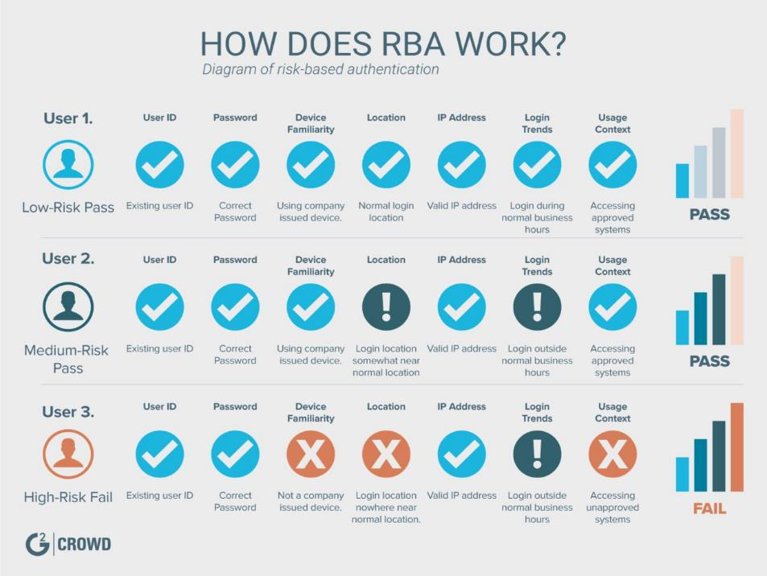

Slide 36
Autentifikacija bez lozinki (engl. paswordless authentication)
“Passwords will usually keep out the casual intruder, but not one who is determined.” - J. Martin. “Security, Accuracy, and Privacy In Computer Systems.” Prentice-Hall. 1973
https://www.cisa.gov/news-events/news/bad-practices-0
„The use of single-factor authentication for remote or administrative access is dangerous and significantly elevates risk to national security, national economic security, and national public health and safety. This dangerous practice is especially egregious in technologies accessible from the Internet.”
Passwordless Authentication is an authentication method that allows a user to gain access to an application or IT system without entering a password or answering security questions

Slide 37
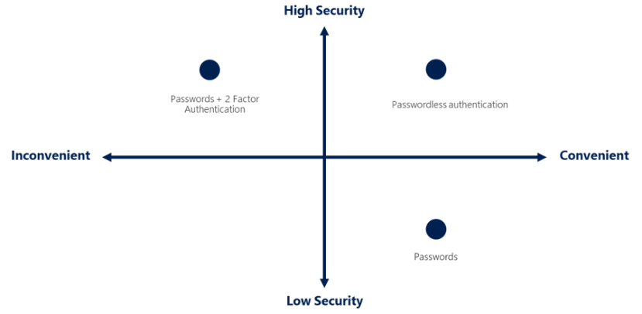
Autentifikacija bez lozinki

Slide 38
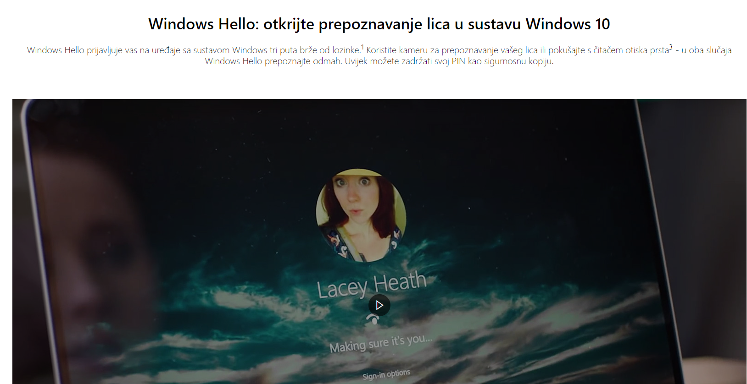

Slide 39
CISA preporuka
https://www.cisa.gov/sites/default/files/2024-12/guidance-mobile-communications-best-practices.pdf
Enable Fast Identity Online (FIDO) phishing-resistant authentication. FIDO authentication uses the strongest form of MFA and is effective against MFA bypass techniques.
Where feasible, hardware based FIDO security keys, such as Yubico or Google Titan, are the most effective; however, FIDO passkeys are an acceptable alternative.
Enroll each account in FIDO-based authentication, especially Microsoft, Apple, and Google accounts. Once enrolled in FIDO-based authentication, disable other, less secure forms of MFA.

Slide 40
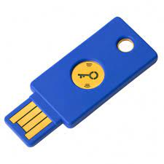
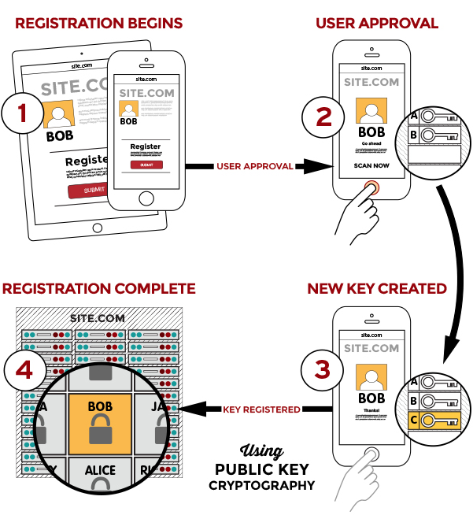
FIDO2
https://fidoalliance.org/how-fido-works/
User is prompted to choose an available FIDO authenticator that matches the online service’s acceptance policy.
User unlocks the FIDO authenticator using a fingerprint reader, a button on a second–factor device, securely–entered PIN or other method.
User’s device creates a new public/private key pair unique for the local device, online service and user’s account.
Public key is sent to the online service and associated with the user’s account. The private key and any information about the local authentication method (such as biometric measurements or templates) never leave the local device.

Slide 41
Passkey
https://fidoalliance.org/passkeys/
https://www.dashlane.com/blog/what-is-a-passkey-and-how-does-it-work
https://www.youtube.com/watch?v=2xdV-xut7EQ&ab_channel=ChromeforDevelopers
Based on FIDO standards, passkeys are a replacement for passwords that provide faster, easier, and more secure sign-ins to websites and apps across a user’s devices. Unlike passwords, passkeys are always strong and phishing-resistant.​
Passkeys simplify account registration for apps and websites, are easy to use, work across most of a user’s devices, and even work on other devices within physical proximity.​

Slide 42
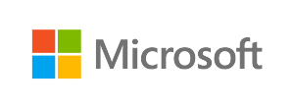
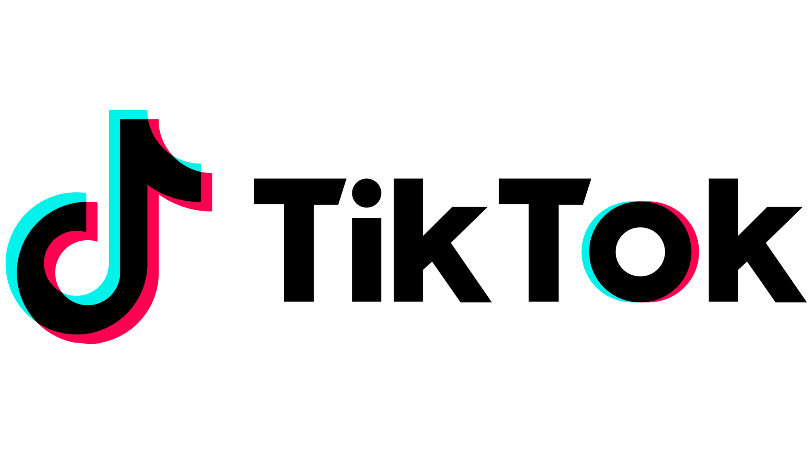

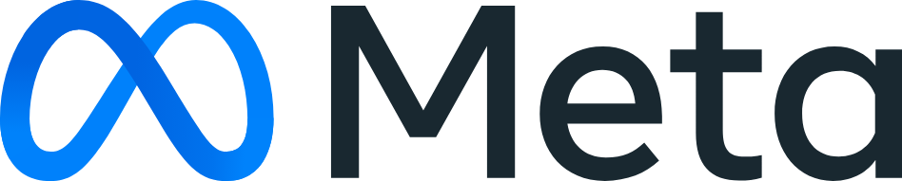
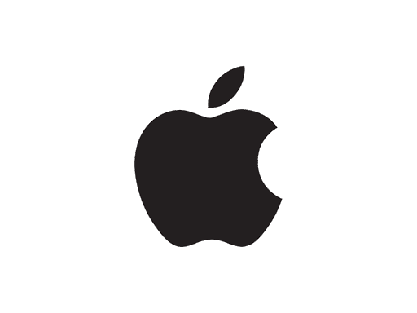
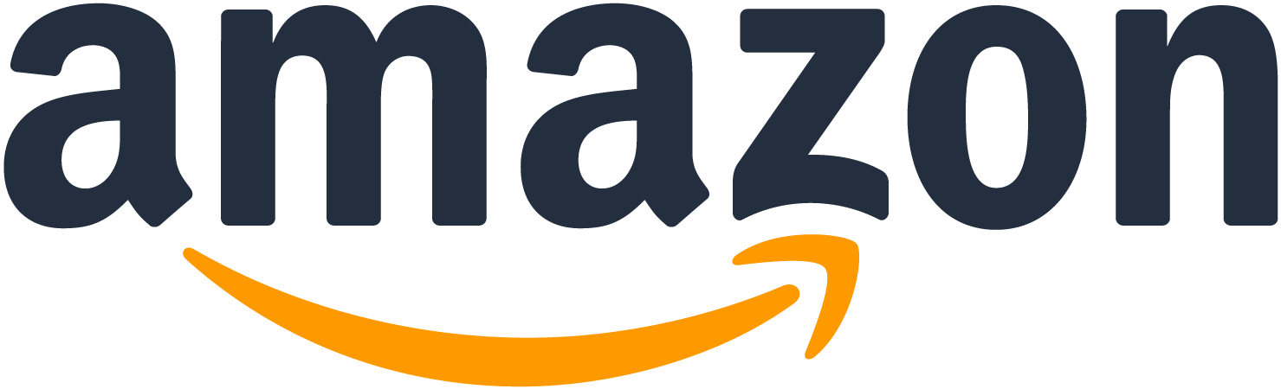
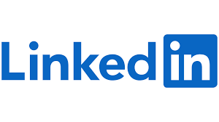
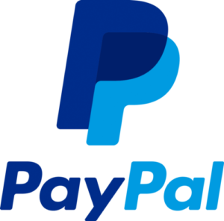

Tko podržava?
https://passkeys-directory.dashlane.com/

Slide 43
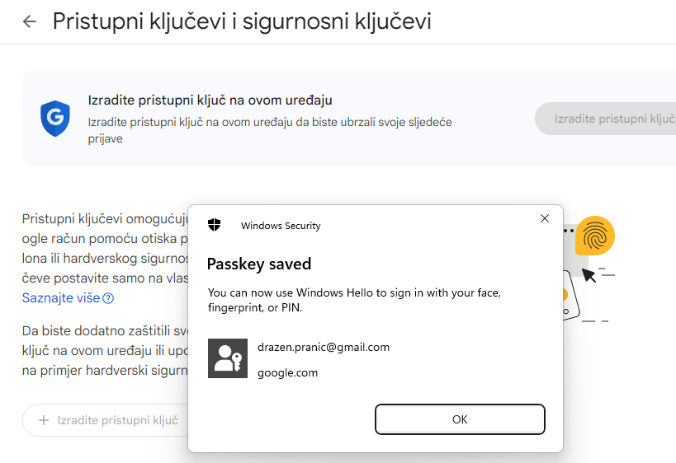
Passkey Gmail example

Slide 44
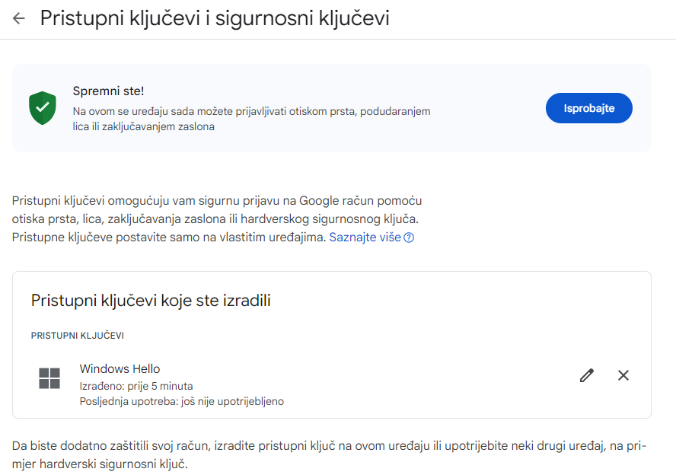
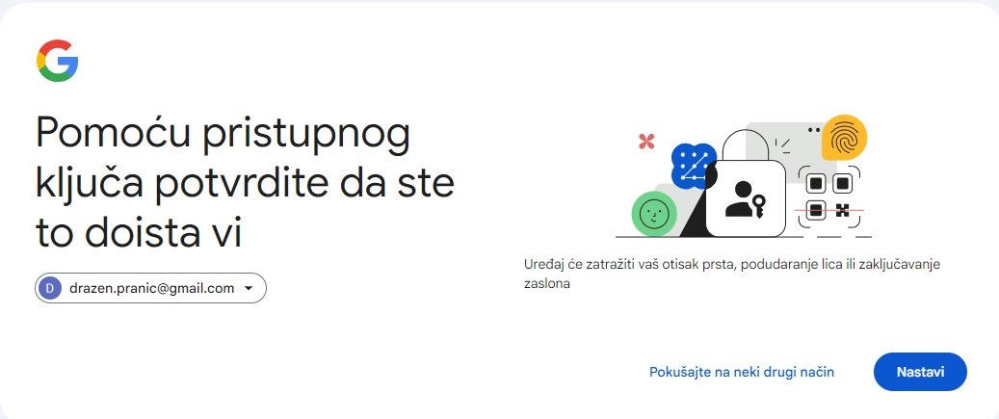
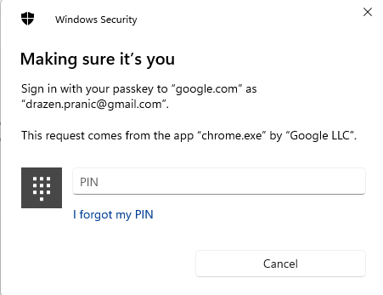
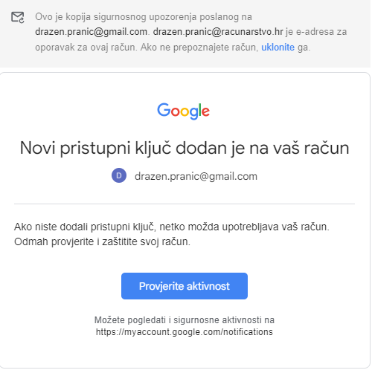
Passkey Gmail example

Slide 45
Zaključak
Pojašnjenje pojmova
Krađa identiteta uvijek izazov i velika prijetnja
Lozinke ne mogu biti jedina mjera zaštite od napada
Mijenjanje lozinki smanjuje sigurnost
RBA
Autentifikacija bez lozinki
FIDO2 i Passkey

