Slide 1
Sigurnost informacijskih sustava
mr.sc. Dražen Pranić

Slide 2
Agenda
Vrste kontrola
Kontrolni okviri
CIS Top 18
Australian four/eight
NIST kontrolni okvir
ISO 27001/27002

Slide 3
Online prijevare
https://news.risky.biz/pig-butchering-is-even-worse-than-65c0eb42a0e6da001a37dfc0/
A harrowing new UN report describes how hundreds of thousands of trafficked people are forced into working in online scam operations.
These operations cover the gamut from online fraud such as romance scams and fake cryptocurrency investment schemes to illegal gambling. They take place in online scam centres known as "boiler rooms" or "pig-butchering farms".

Slide 4
Online prijevare
at least 120,000 people across Myanmar and 100,000 in Cambodia are thought to be forced to work on online scams.
The report describes the Philippines, Thailand and Laos as transit or destination countries "where at least tens of thousands of people" have been involved. Police operations in the Philippines rescued over 1,000 people in May of this year and another 2,700 people in June from this kind of forced labour.
The workers are lured to the online scam centres by the promise of an attractive job with a high salary, regular bonuses, free accommodation and food.

Slide 5
Online prijevare
Many of the victims are well-educated, sometimes coming from professional jobs or with graduate or even post-graduate degrees, computer-literate and multilingual. Victims come from across the ASEAN region (from Indonesia, Lao PDR, Malaysia, Myanmar, Philippines, Singapore, Thailand and Vietnam), as well as mainland China, Hong Kong and Taiwan, South Asia,
Once they arrive at the country in which the online scam centre is located, these workers often have their passports taken and they are placed in gated compounds. They are forced to work by threat of force.
https://time.com/6836703/pig-butchering-scam-victim-loss-money-study-crypto/ → 75$ billion crypto scam in four years
https://www.bankinfosecurity.com/report-says-pig-butchering-crypto-scheme-took-down-us-bank-a-24351

Slide 6
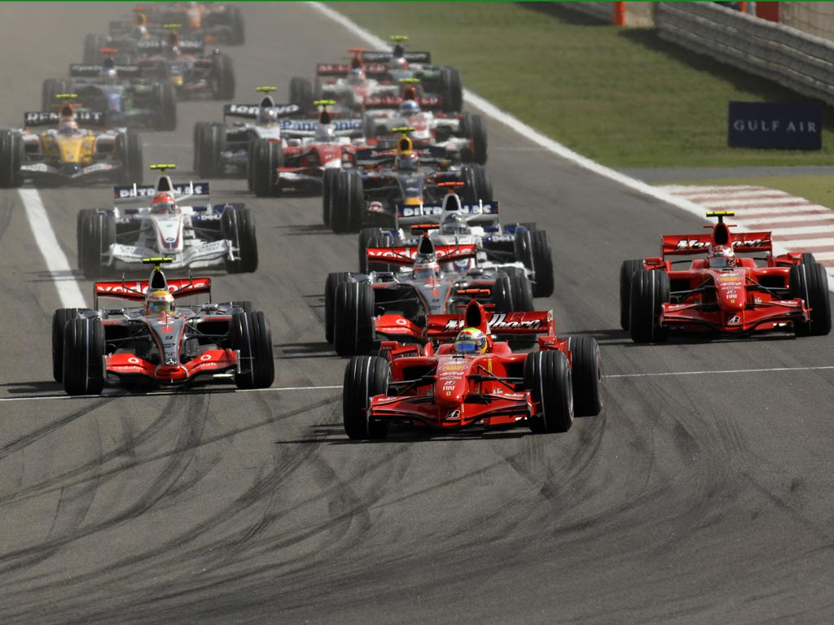

Slide 7
Definicija kontrole
Zaštita ili protumjera propisana za informacijski sustav ili organizaciju dizajnirana za zaštitu povjerljivosti, cjelovitosti i dostupnosti svojih informacija i ispunjavanje skupa definiranih sigurnosnih zahtjeva.
kontrole: procedure, prakse ili mehanizmi koji umanjuju rizik
dva načina djelovanja kontrola
  Umanjivanje vjerojatnosti da prijetnja iskoristi ranjivost
  Umanjivanje štete koja nastaje u slučaju kad prijetnja iskoristi ranjivost

Slide 8
Tipovi kontrola
Tehničke
  Kontrole koje se implementiraju za informacijske sustave
  Npr. korisnička imena i zaporke, vatrozidi, enkripcija
Organizacijske
  Različiti dokumenti koji definiraju pravila za korištenje informacijskih resursa
  Npr. pravilnik o primjerenom korištenju informacijskih sustava, pravilnik za korištenje zaporki ...
Fizičke
  Namijenjene fizičkoj zaštiti resursa
  Npr. videonadzor, alarmni sustav, fizička kontrola pristupa ...

Slide 9
Kontrole prema načinu djelovanja
Preventivne (eng. preventive controls)
  Umanjuju vjerojatnost iskorištavanja ranjivosti (Npr. kontrole pristupa, enkripcija, autentikacija, antivirus ...)
Detektivne (eng. detective controls)
  Omogućuju identifikaciju iskorištavanja ili pokušaja iskorištavanja prijetnji (Npr. log zapisi sustava, IDS sustavi ...)
Korektivne (eng. corrective controls)
  Umanjuju ranjivosti (Npr. procedure za oporavak podataka iz sigurnosnih kopija)

Slide 10
Kontrolni okviri
IT sigurnosni kontrolni okvir predstavljaju metodu/način kako organizacija usklađuje svoje politike, standarde, procedure i smjernice koje su potrebne za upravljanje IT infrastrukturom.

Slide 11
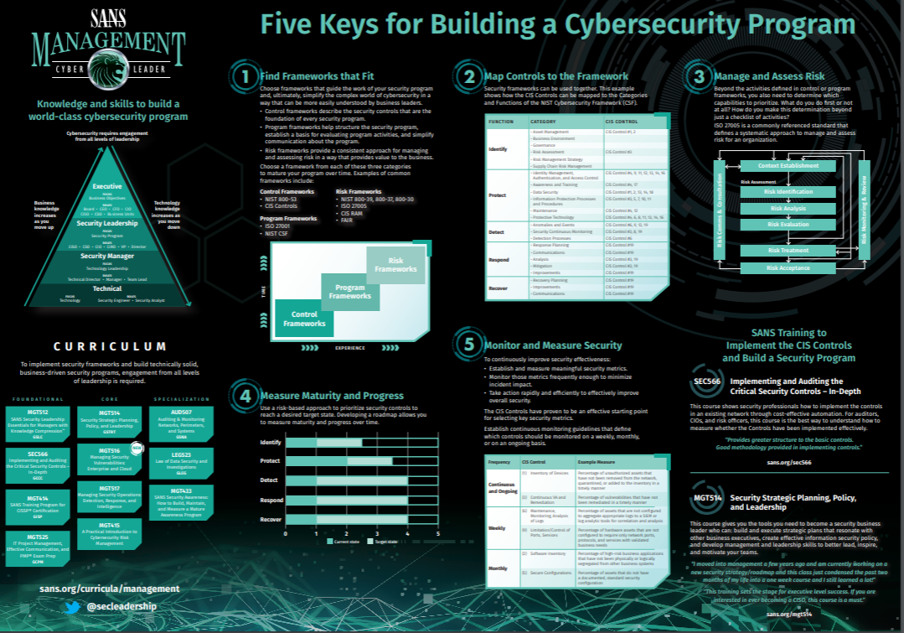

Slide 12
Koji okvir izabrati?
Je li potrebno slijediti neki sigurnosni okvir?
Ako da koji okvir?
O čemu to ovisi?
Kojim principom se voditi?

Slide 13
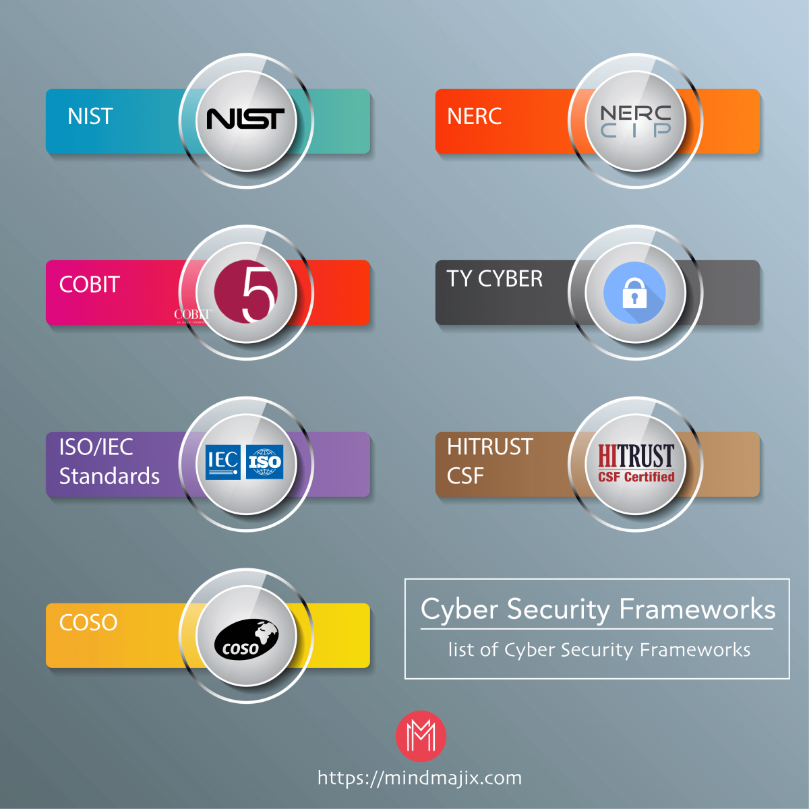
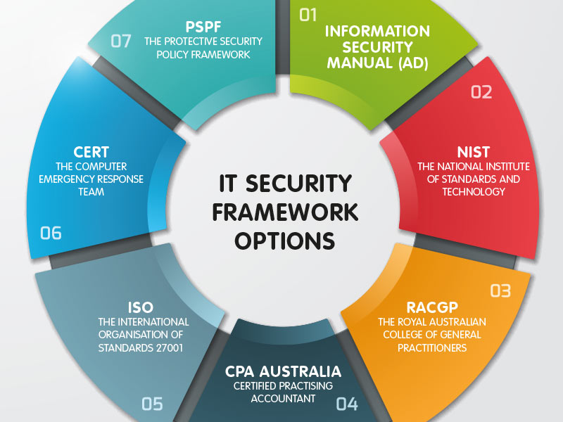
Koji okvir izabrati?

Slide 14
Popis najpoznatijih kontrolnih okvira
Australian Top Eight
CIS Top 18
NIST Security Framework
PCI DSS
COBIT
ISO 27002
…

Slide 15
Paretovo načelo
Talijanski inženjer, sociolog, ekonomist, filozof
Pronašao da 85% bogatstva u Milanu je u vlasništvu 15% građana
Pronašao da 80% zemlje u Italiji je u vlasništvu 20% ljudi
Načelo 80/20

Slide 16
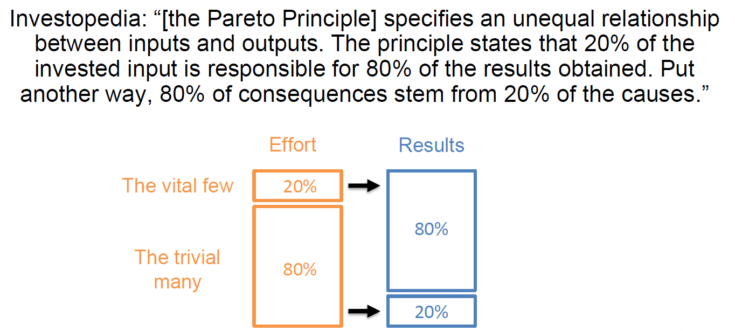
Paretovo načelo (pravilo 80/20)

Slide 17
Paretovo pravilo i sigurnost
Može li se Paretovo pravilo primijeniti na cyber sigurnost?
Jesu li sve kontrole jednako važne i jednako učinkovite?
Vrijedi li se fokusirati na one koje donose najveću korist?
Ako da, koje su to kontrole?
https://www.csoonline.com/article/3502798/high-praise-for-oz-dsd-s-catch-patch-match.html

Slide 18
Negativni Pareto
https://www.cisa.gov/BadPractices
Use of unsupported (or end-of-life) software … This dangerous practice is especially egregious in technologies accessible from the Internet.
Use of known/fixed/default passwords and credentials … This dangerous practice is especially egregious in technologies accessible from the Internet.
The use of single-factor authentication for remote or administrative access to systems … This dangerous practice is especially egregious in technologies accessible from the Internet.

Slide 19
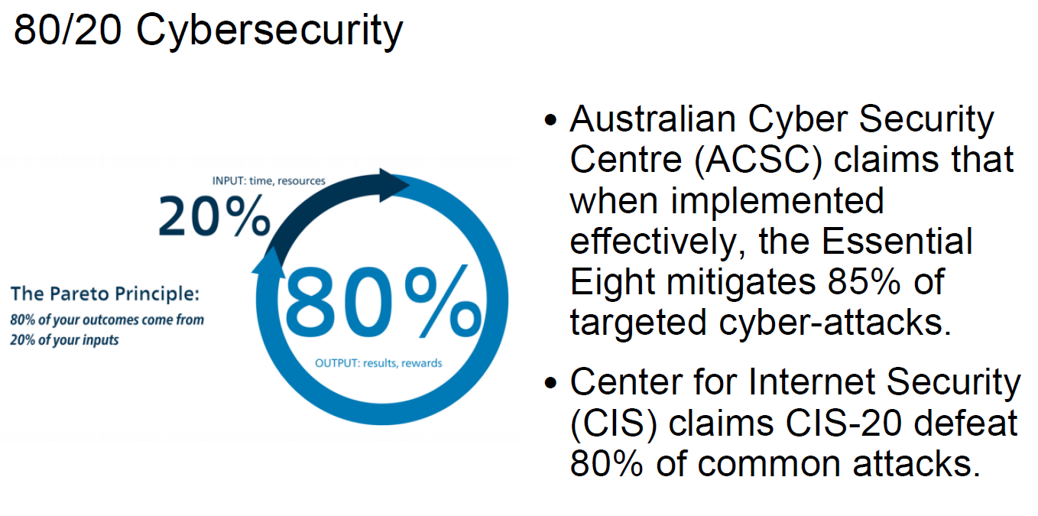

Slide 20
Australian Essential Eight
Australian Top Four → Essential Eight
  Application Whitelisting,
  Patch Applications,
  Patch Operating System,
  Minimise Administrative Privileges,
  Configure Microsoft Office macro settings,
  User application hardening,
  Multi-factor authentication,
  Regular backups.
https://www.cyber.gov.au/acsc/view-all-content/publications/essential-eight-maturity-model

Slide 21
Application whitelisting of approved/trusted programs to prevent execution of unapproved/malicious programs including .exe, DLL, scripts (e.g. Windows Script Host, PowerShell and HTA) and installers. Why: All non-approved applications (including malicious code) are prevented from executing | Patch applications e.g. Flash, web browsers, Microsoft Office, Java and PDF viewers. Patch/mitigate computers with ‘extreme risk’ vulnerabilities within 48 hours. Use the latest version of applications. Why: Security vulnerabilities in applications can be used to execute malicious code on systems.
Configure Microsoft Office macro settings to block macros from the Internet, and only allow vetted macros either in ‘trusted locations’ with limited write access or digitally signed with a trusted certificate. Why: Microsoft Office macros can be used to deliver and execute malicious code on systems. | User application hardening. Configure web browsers to block Flash (ideally uninstall it), ads and Java on the Internet. Disable unneeded features in Microsoft Office (e.g. OLE), web browsers and PDF viewers. Why: Flash, ads and Java are popular ways to deliver and execute malicious code on systems

Slide 22
Restrict administrative privileges to operating systems and applications based on user duties. Regularly revalidate the need for privileges. Don't use privileged accounts for reading email and web browsing. Why: Admin accounts are the ‘keys to the kingdom’. Adversaries use these accounts to gain full access to information and systems. | Patch operating systems. Patch/mitigate computers (including network devices) with ‘extreme risk’ vulnerabilities within 48 hours. Use the latest operating system version. Don't use unsupported versions. Why: Security vulnerabilities in operating systems can be used to further the compromise of systems.
Multi-factor authentication including for VPNs, RDP, SSH and other remote access, and for all users when they perform a privileged action or access an important (sensitive/high-availability) data repository. Why: Stronger user authentication makes it harder for adversaries to access sensitive information and systems. | Daily backups of important new/changed data, software and configuration settings, stored disconnected, retained for at least three months. Test restoration initially, annually and when IT infrastructure changes. Why: To ensure information can be accessed following a cyber security incident (e.g. a ransomware incident).

Slide 23
Australian Essential Eight
Four maturity levels have been defined (Maturity Level Zero through to Maturity Level Three
Requirements for each maturity level are detailly defined
MFA Level One | MFA Level Three (includes L1 requirements)
Multi-factor authentication is used by an organisation's users if they authenticate to their organisation’s internet-facing services. Multi-factor authentication is used by an organisation’s users if they authenticate to third party internet-facing services that process, store or communicate their organisation’s sensitive data. Multi-factor authentication (where available) is used by an organisation’s users if they authenticate to third-party internet-facing services that process, store or communicate their organisation's non-sensitive data. Multi-factor authentication is enabled by default for non-organisational users (but users can choose to opt out) if they authenticate to an organisation’s internet-facing services. | Multi-factor authentication is used to authenticate privileged users of systems. Multi-factor authentication is used to authenticate users accessing important data repositories. Multi-factor authentication is verifier impersonation resistant and uses either: something users have and something users know, or something users have that is unlocked by something users know or are. Successful and unsuccessful multi-factor authentication events are centrally logged. Event logs are protected from unauthorised modification and deletion. Event logs are monitored for signs of compromise and actioned when any signs of compromise are detected.

Slide 24
CIS Top 18
SANS - System Administration, Networking, and Security Institute → edukacija
CIS – Center for Internet Security → najbolja praksa

Slide 25
CIS Top 18
Jedan od najrespektabilnijih/najraširenijih kontrolnih okvira
Konkretan / tehnički jasan
Daje odgovor na pitanje što trebam raditi prvo?
Javno dostupan
https://www.cisecurity.org/controls/
Obuhvaća najvažnija područja iz kibernetičke sigurnosti

Slide 26
CIS Top 18
Inicijalno razvijan od strane SANS instituta a od 2015 odgovoran CIS
Velik broj uključenih → kontinuirano se razvija
The US State Department, under CISO John Streufert, has already demonstrated more than 94% reduction in "measured" security risk through the rigorous automation and measurement of the Top 20 Controls.

Slide 27
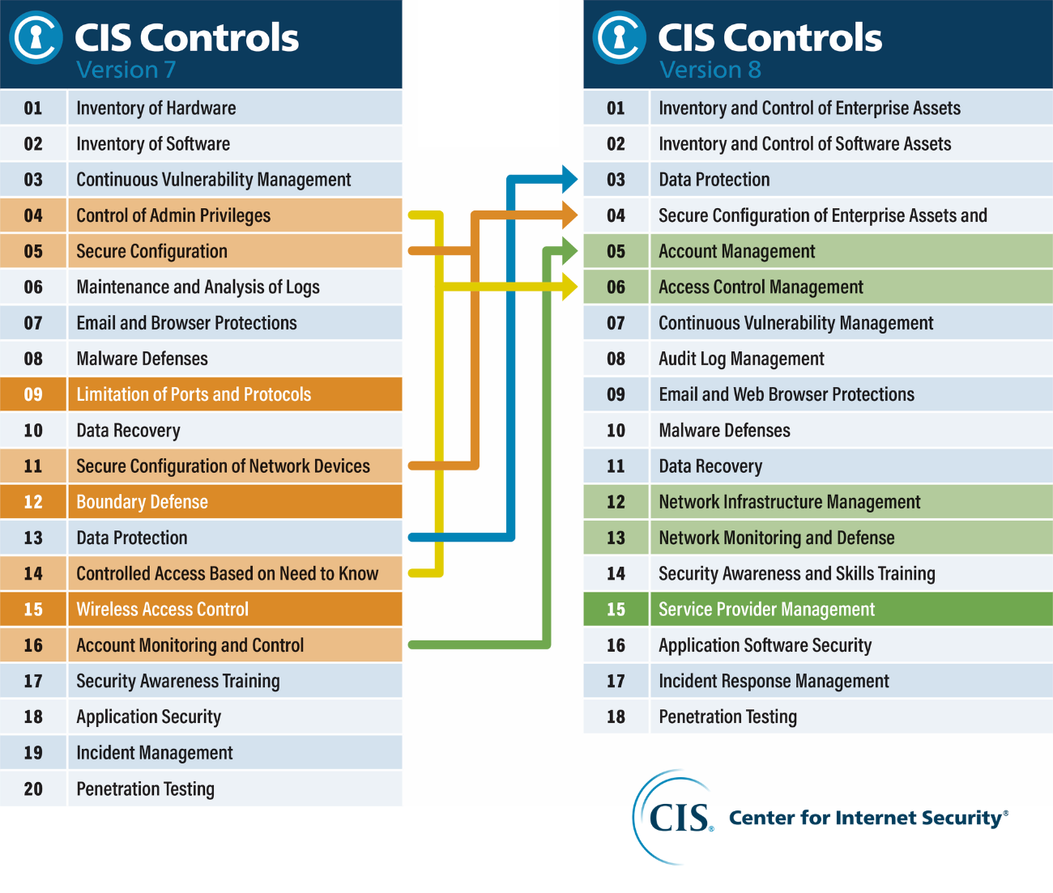

Slide 28
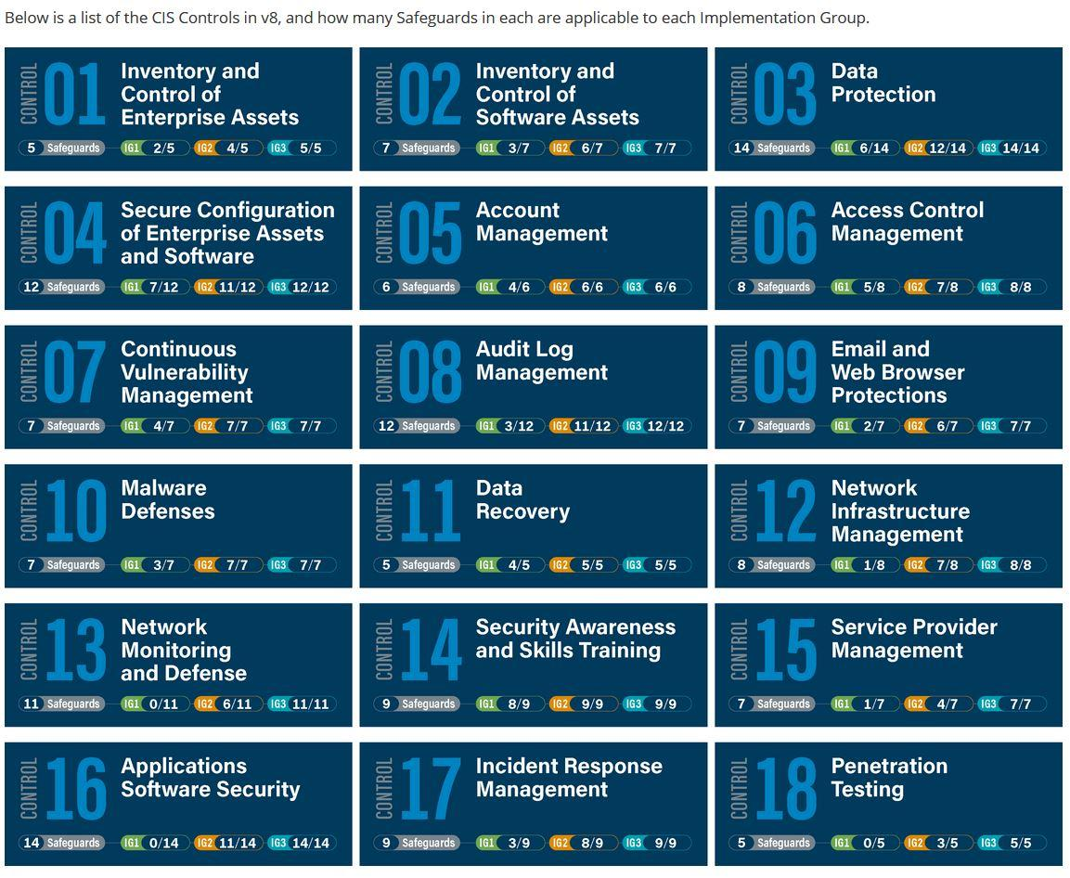

Slide 29
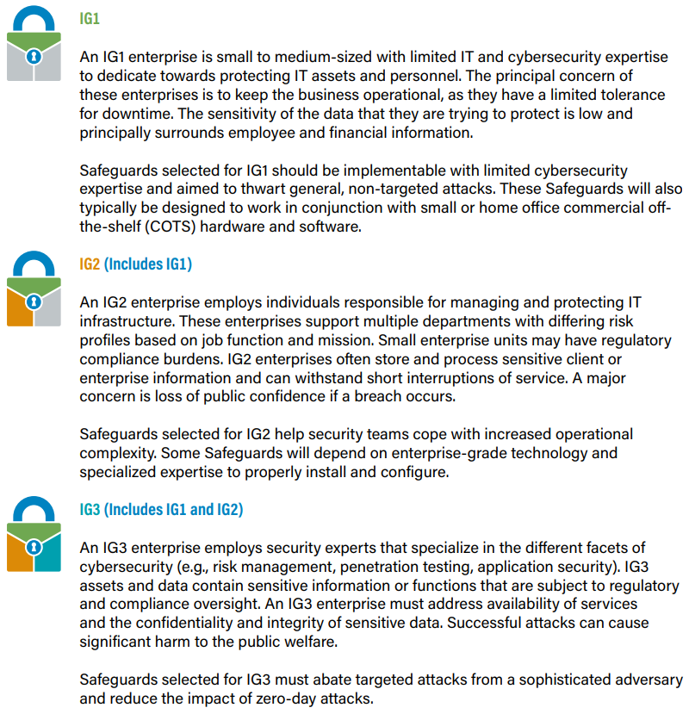

Slide 30
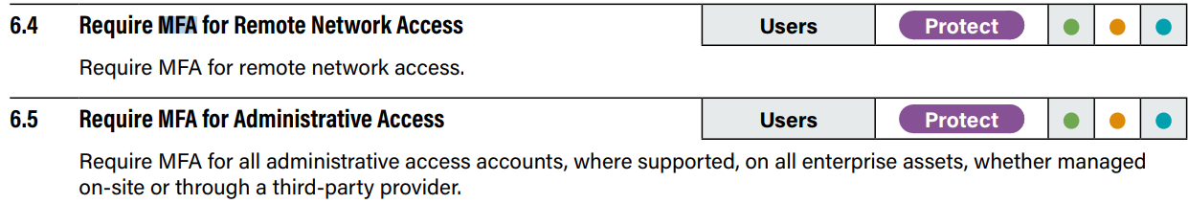
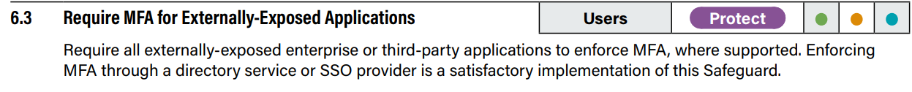
CIS Top 18 – MFA primjer

Slide 31
NIST Cybersecurity framework
The NIST Cybersecurity Framework (NIST CSF) provides a policy framework of computer security guidance for how private sector organizations in the United States can assess and improve their ability to prevent, detect, and respond to cyber attacks
NIST CSF compliance is mandatory for federal agencies and their contractors
https://www.nist.gov/cyberframework

Slide 32
NIST CSF
 | Function
What processes and assets need protection? | Identify | Understandable by everyone Applies to any type of risk management Defines the entire breadth of cybersecurity Spans both prevention and reaction
What safeguards are available? | Protect
What techniques can identify incidents? | Detect
What techniques can contain impacts of incidents? | Respond
What techniques can restore capabilities? | Recover

Slide 33
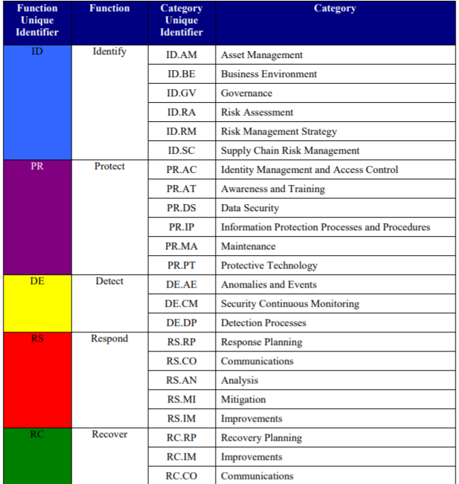

Slide 34
CIS Top 18 vs NIST CSF
At a high level, NIST CSF is risk-based guidance
CIS V8 is a more maturity-driven framework.
NIST CSF provides security objectives. Essentially, it helps your organization think about its risk and then helps point you in the right direction to better understand how to identify and respond to these risks
CIS is more explicit. It doesn’t just give you a generalized objective. It provides you with explicit control, which is worded in such a way you understand how to adopt and implement it.
Many organizations combine both standards

Slide 35
ISO/IEC 27001:2022
Niz standarda na području informacijske sigurnosti
Sustav upravljanja informacijskom sigurnošću (eng. Information Security Management System)
Generički standard
  Primjenjiv na sve organizacije → Neovisno o veličini, tipu i ostalim karakteristikama organizacije
Jedini standard po kojem se možete certificirati
Koristan za organizacije koje pružaju vanjske usluge te imaju potrebu dokazati kako upravljaju informacijskom sigurnosti

Slide 36
ISO/IEC 27001
Okvir za uspostavu, implementaciju, nadzor, reviziju, održavanje i poboljšavanje ISMS-a
  Specifikacija sustava koja omogućava certifikaciju
Dizajn i implementacija ovise o ciljevima, zahtjevima, procesima, tipu i veličini organizacije
Generički standard, neovisan o organizaciji (banka ili slastičarna)
Procesni pristup
  Identifikacija, primjena, interakcija i upravljanje procesima u organizaciji
  Omogućuje razumijevanje sigurnosnih zahtjeva

Slide 37
ISO 27001: Obveze
Jednom godišnje interna revizija
Jednom u tri godine vanjska revizija (recertfikacija)
Puno birokracije (obvezne dokumentacije):
  Procedura za upravljanje dokumentacijom
  Procedura za interni audit
  Procedura za korektivne mjere
  Procedura za preventivne mjere
  …

Slide 38
ISO/IEC 27002:2022
ISO/IEC 27002:2022 - Information security management systems – Code of practice for information security management →Annex A
Lista kontrola koje se moraju implementirati ovisno o procjeni rizika
Niz kontrolnih ciljeva i kontrola na različitim područjima informacijske sigurnosti

Slide 39
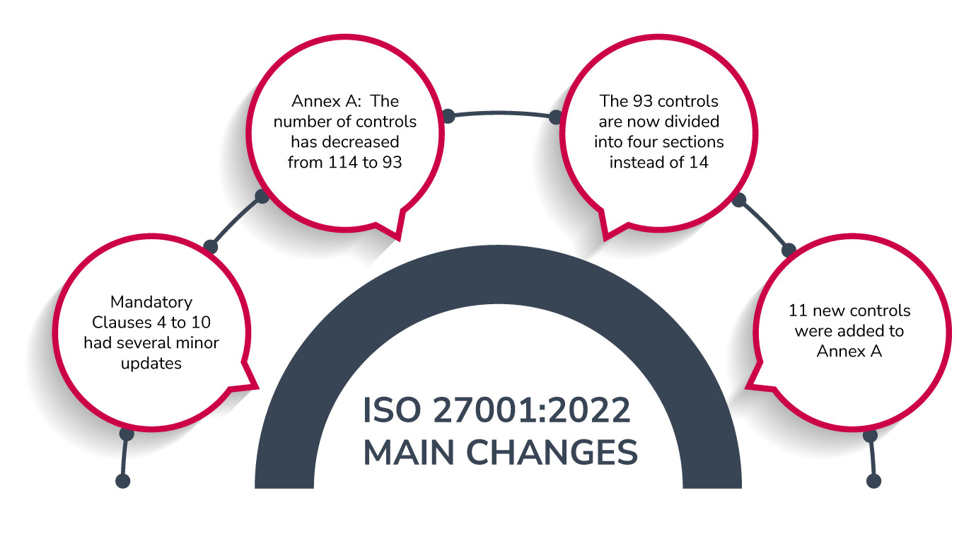

Slide 40
ISO 27022:2022
The new Sections and Controls of ISO 27002:2022 are:
Section 5: Organizational (37 controls)
Section 6: People (8 controls)
Section 7: Physical (14 controls)
Section 8: Technology (34 controls)

Slide 41
5 Organizational controls | 6 People controls | 7 Physical controls | 8 Technological controls
5.1 Policies for information security | 6.1 Screening | 7.1 Physical security perimeters | 8.1 User endpoint devices
5.2 Information security roles and responsibilities | 6.2 Terms and conditions of employment | 7.2 Physical entry | 8.2 Privileged access rights
5.3 Segregation of duties | 6.3 Information security awareness, education and training | 7.3 Securing offices, rooms and facilities | 8.3 Information access restriction
5.4 Management responsibilities | 6.4 Disciplinary process | 7.4 Physical security monitoring | 8.4 Access to source code
5.5 Contact with authorities | 6.5 Responsibilities after termination or change of employment | 7.5 Protecting against physical and environmental threats | 8.5 Secure authentication
5.6 Contact with special interest groups | 6.6 Confidentiality or non-disclosure agreements | 7.6 Working in secure areas | 8.6 Capacity management
5.7 Threat intelligence | 6.7 Remote working | 7.7 Clear desk and clear screen | 8.7 Protection against malware
5.8 Information security in project management | 6.8 Information security event reporting | 7.8 Equipment siting and protection | 8.8 Management of technical vulnerabilities
5.9 Inventory of information and other associated assets |  | 7.9 Security of assets off-premises | 8.9 Configuration management
5.10 Acceptable use of information and other associated assets |  | 7.10 Storage media | 8.10 Information deletion
5.11 Return of assets |  | 7.11 Supporting utilities | 8.11 Data masking
5.12 Classification of information |  | 7.12 Cabling security | 8.12 Data leakage prevention
5.13 Labelling of information |  | 7.13 Equipment maintenance | 8.13 Information backup
5.14 Information transfer |  | 7.14 Secure disposal or re-use of equipment | 8.14 Redundancy of information processing facilities
5.15 Access control |  |  | 8.15 Logging
5.16 Identity management |  |  | 8.16 Monitoring activities
5.17 Authentication information |  |  | 8.17 Clock synchronization
5.18 Access rights |  |  | 8.18 Use of privileged utility programs
5.19 Information security in supplier relationships |  |  | 8.19 Installation of software on operational systems

Slide 42
5 Organizational controls | 6 People controls | 7 Physical controls | 8 Technological controls
5.20 Addressing information security within supplier agreements |  |  | 8.20 Networks security
5.21 Managing information security in the ICT supply chain |  |  | 8.21 Security of network services
5.22 Monitoring, review and change management of supplier services |  |  | 8.22 Segregation of networks
5.23 Information security for use of cloud services |  |  | 8.23 Web filtering
5.24 Information security incident management planning and preparation |  |  | 8.24 Use of cryptography
5.25 Assessment and decision on information security events |  |  | 8.25 Secure development life cycle
5.26 Response to information security incidents |  |  | 8.26 Application security requirements
5.27 Learning from information security incidents |  |  | 8.27 Secure system architecture and engineering principles
5.28 Collection of evidence |  |  | 8.28 Secure coding
5.29 Information security during disruption |  |  | 8.29 Security testing in development and acceptance
5.30 ICT readiness for business continuity |  |  | 8.30 Outsourced development
5.31 Legal, statutory, regulatory and contractual requirements |  |  | 8.31 Separation of development, test and production environments
5.32 Intellectual property rights |  |  | 8.32 Change management
5.33 Protection of records |  |  | 8.33 Test information
5.34 Privacy and protection of PII |  |  | 8.34 Protection of information systems during audit testing
5.35 Independent review of information security
5.36 Compliance with policies, rules and standards for information security
5.37 Documented operating procedures

Slide 44
Zaključak
Istaknuti najvažniji kontrolni sigurnosni okviri
Implementacija nekog kontrolnog sigurnosnog okvira nužna
NIST CSF, CIS Top 18 izvrsni okviri za korporacije
Australski top 8 pomaže na koje kontrole staviti najveći fokus
ISO 27001 jedini omogućuje certifikaciju/vanjski dokaz → previše birokratski kontrolni okvir

